Slide 1
Selected Acquisition Report (SAR)
Maj Kyle Reybitz
SAF/AQXRR
as of 19 Jan 10

Slide 2
Outline
Definition and Requirements
Purpose and Uses
Content
Dec 09 SAR List
Dec 09 SAR Schedule
Process
Dec 09 Nuances
Summary

Slide 3
SAR Definition and Requirements
What is a SAR?
A standard, comprehensive summary reporting of schedule, performance, and cost information on Major Defense Acquisition Programs (MDAPs) within the Department of Defense (DoD) and to the Congress.
Statutory Requirement
Title 10, Sec. 2432
Regulatory Requirement
DoDI 5000.02
Reported “Quarterly”
Dec: Annual for all MDAPs (currently 32 AF Programs)
report submitted to Congress 60 days after PB submission
Mar, Jun and Sep: by exception/out-of-cycle
Nunn-McCurdy Unit Cost Breach
>6 month schedule delay in the Current Estimate (CE) since last SAR
Initial SAR (“quarter” following Milestone B decision)
Termination SAR (>90% expended or delivered)
Rebaselining from one Major Milestone to the next

Slide 4
SAR Purpose and Uses
Purpose
Provides status of an MDAP at a specific moment in time while documenting accomplishments, updating program information and explaining variations from previous reports
Deliverable to Congress
First source of information for staffers, committees, etc.
Publically accessible through FOIA requests
Authoritative source for MDAP information
Frequently accessed by all levels of DoD
Various elements analyzed to develop metrics and assess progress/health

Slide 5
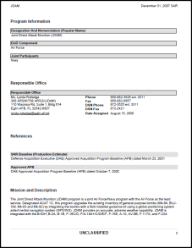
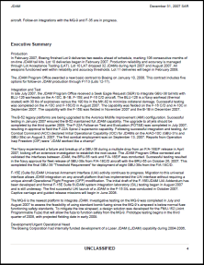
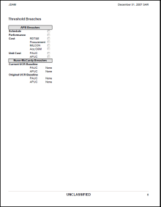
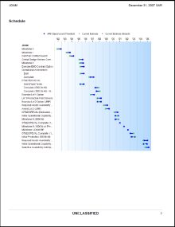
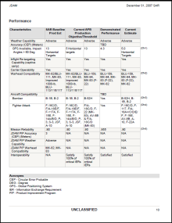
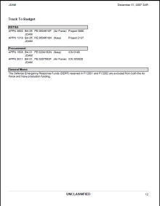
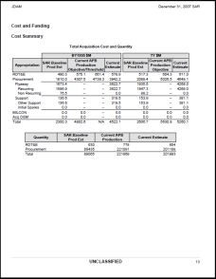
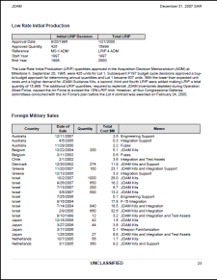
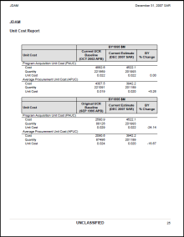
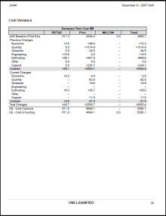
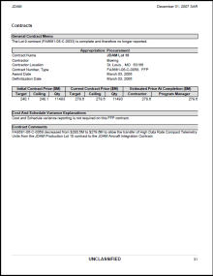
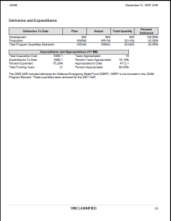
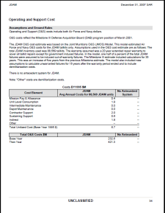
SAR Content
SECTIONS
1. Program Information
2. Responsible Office
3. References
4. Mission & Description
5. Executive Summary
6. Threshold Breaches
7. Schedule
8. Performance
9. Track to Budget
10. Cost & Funding
11. Low Rate Initial Production
12. Foreign Military Sales
13. Nuclear Costs
14. Unit Cost
15. Cost Variance*
16. Contracts
17. Deliveries & Expenditures
18. Operating & Support Costs
19. Classified Annex (if required)
1-3
COMPARED TO QUARTERLY DAES
RED – mostly overlapping data
GREEN – partially overlapping data
BLUE – mostly unique data
* Cost Variance most time consuming
4-5
6
7
8
9
10
11-13
14
15
16
17
18
(19)

Slide 6
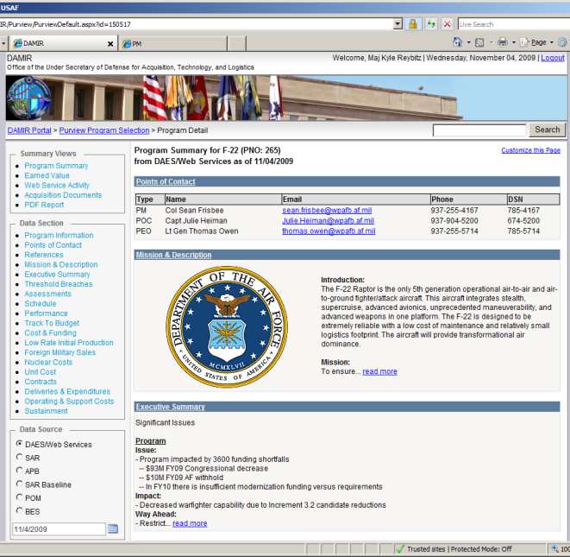
Where are SARs?
Created/stored in Defense Acquisition Management Information Retrieval (DAMIR)
OSD’s System to store/ authoritative source of:
APBs
SARs
DAESs
Other
Role based access/privileges
PMO, PEO, AQ, OSD
Basic, Review, Editor, Release
Access thru AQXRR available for the following:
Gov’t civilians
Military
Support Contractors (request must come from Civ/Mil)
http://www.acq.osd.mil/damir/

Slide 7
Dec 09 SAR Programs 31 Total
PEO/AC (11)
C-130 AMP
C-130J
C-17A
C-5 AMP
C-5 RERP
JCA
LAIRCM
B-2 EHF
B-2 RMP
F-22
JPATS
PEO/SP (8)
SBIRS-HIGH
SBSS BLK 10
AEHF
FAB-T
GBS
WGS
GPS IIIA
NAVSTAR GPS
PEO/ES (1)
NPOESS
DAO/AFNWC (1)
Minuteman III PRP**
PEO/ISR (4)
ASIP*
RQ- 4 Global Hawk
MQ-1 Predator*
MQ-9 Reaper*
PEO/JSF (1)
F-35
PEO/WP (3)
AMRAAM
JASSM
JDAM
PEO/C2&CS (2)
MP-RTIP
NAS
WI
WI
AP
WI
WI
AP
HC
WI
WI
WI
HC
DJ
MM
DJ
HC
LA
DJ
DJ
DJ
MM
MM
DJ
DJ
HC
AP
HC
MM
JW
AP
MB
SAF/AQXRR POCs
Mr. Alan Lachel, alan.lachel@pentagon.af.mil DSN 260-0374
Maj Kyle Reybitz, kyle.reybitz@pentagon.af.mill DSN 260-0375
Maj Mark Murray, mark.murray@pentagon.af.mill DSN 260-0367
Mr. Bob Loop, robert.loop@pentagon.af.mill DSN 260-0365
AP
OSD/AT&L ARA AM POCs
LA – Mr. Larry Axtell, 703-695-5167
WI – Mr. Wendel l Irby, 703-695-9692
AP – Mr. Andy Pozda, 703-571-3116
HC – Mr. Harry Chelpon, 703-614-0200
DJ – Mr. Derek Jaquish, 703-571-3118
MM – Ms. Margaret Mattei, 703-571-3117
MB – Mr. Mike Burke, 703-697-0452
JW – Mr. James Wessels, 703-697-3383
*Initial SARs
** Termination SARs

Slide 8
Dec 09 SAR Schedule
January
February
March
April
18
25
1
8
15
22
1
8
15
22
29
5
12
OSD SAR Memo (13 Jan)
FY11 Budget (1 Feb)
PMOs Enter SAR in DAMIR
PEOs release (1 Jan – 8 Feb)
Reports due to AQXR (8 Feb)
AQXR Review (9-17 Feb)
Reports due to OSD (17 Feb)
Telcons (3-10 Mar)
PMO Corrections (9-16 Mar)
OSD Final Review (11-18 Mar)
Security Review & SAR Classified
Annex copies (22-26)
OSD to Congress (2 Apr)
PMO/PEO OPR
AQXRR OPR
PMO & AQXRR OPRs
OSD OPR

Slide 9
SAR Process
AT&L Memo
Provide
PB Funding
Inflation Indices
OSD Review
OSD Review
& Submission
to Congress
OSD
Teleconference
Review
OSD
SPO
AQX
PEM
USA
Submission to OSD
Final
AQ Submission
AQ
AQX Memo
AQX Review
Security Review
PEO Instructions
PEO
PEO Inputs to AQX
Generate SAR
PMO
Incorporate
Revisions

Slide 10
SAR – AQXR Role
Coordinate with OSD, PEOs and PMOs
Support telcons with PMOs, OSD & AQX
Also PEM and PEO staffs in some cases
Package and process classified annexes
Quality check of documents
Manage back-and-forth activity between Air Force and OSD

Slide 11
Dec 09 SAR Considerations
Dec 09 SARs expected to document accomplishments and variances since Dec 07 SARs
Dec 08 “Limited” SARs are available upon request to SAF/AQXRR but are not stored in DAMIR
Weapons System Acquisition Reform Act (WSARA) 2009 Impacts TBD (expect guidance from OSD)
DTM 09-027, Section 5e. “For MDAPs, the confidence level statement shall be also included in the next selected acquisition report (SAR)…”
Confidence Level (CL) statement describes the CL used in establishing the cost estimate, the rationale for selecting the CL and if the CL is less than 80 percent, the justification for selecting the lower confidence level.
Dec 09 SARs need to be consistent with PB11 FYDP and J-Books
Numbers may not match exactly but variations need to be explained

Slide 12
SAR - Summary
SAR is a PMO deliverable/report to Congress due 60 days after release of PB (forecasted for 1 Feb 10)
SAF/AQX is the SAR Service Point of Contact; facilitator between PEO/PMO and OSD
Initial SAR submissions for all MDAPS due to SAF/AQXRR by 8 Feb 10; early start is key!
AF Inflation indices sent 12 Jan, Army/Navy indices sent 13 Jan
Official “SAR Kickoff” Memo from SAF/AQX (including OSD Memo w/Dec 09 SAR specifics) sent week of 25 Jan 10

Slide 13
BACK-UP

Slide 14
APB & Nunn-McCurdy Background
Purpose: To provide Congressional unit cost reporting for Major Defense Acquisition Programs (MDAPs) that are submitting Selected Acquisition Reports (SARs) (except MDAPs reporting RDT&E only costs prior to Milestone B)
Applicable Statute: Title 10, United States Code, Section 2433 (Unit Cost Reports) and Section 2435 (Baseline Description)
Unit Cost Measurements (in base-year dollars):
PAUC (Program Acquisition Unit Cost)
= (RDT&E $ + Procurement $ + MILCON $ + Acquisition-Related O&M $) / Total Quantity
APUC (Average Procurement Unit Cost)
= Procurement $ / Procurement Quantity
Unit Cost Tracking: Compare Current Estimate to Current Baseline Estimate and to Original Baseline Estimate
Current Estimate – Latest estimate of approved program
Current Baseline Estimate – Currently approved Acquisition Program Baseline (APB)
Original Baseline Estimate – APB approved at Milestone B (or initial MDAP APB if designation occurs after Milestone B)
Note: Original Baseline Estimate can be revised only after “Critical” Nunn-McCurdy breach.

Slide 15
APB & Nunn-McCurdy Breaches
Reporting Requirements:
Internal – Quarterly unit cost reporting required from program manager to Service Acquisition Executive via Defense Acquisition Executive Summary (DAES)/Web Services
External – Breach reporting (see below)
For “Significant” breaches, Service Secretary must notify Congress within 45 days of the report (normally PDR) upon which the determination is based and submit a SAR with the required additional unit cost breach information
For “Critical” breaches, in addition to notification and SAR, the USD(AT&L) must certify to Congress within 60 days of the SAR that:
1. The program is essential to the national security
2. There is no alternative which will provide equal or greater capability at less cost
3. The new estimates of the PAUC and APUC are reasonable
4. The management structure is adequate to control PAUC and APUC
(Note: Certification not required for terminated program)
If either SAR or certification are not submitted on time, obligational authority suspended on all major contracts
 | “Significant Breach” | “Critical Breach”
Current Baseline Estimate | +15% | +25%
Original Baseline Estimate | +30% | +50%

Slide 16
SAR - PEM Participation
Beneficial if PEMs are involved in telcons
Prep– review their SAR; ID needed changes
Attend telecon, provide inputs
Following the telcons
Process is mostly administrative
Minimal PEM involvement
If something is broken, PEM should let us know

