Slide 1
Modernization Process Model (MPM) Update
SAF/AQXP
July 2024

Slide 2
APM Rebranding
On behalf of the SAF/AQ and SQ Master Process Officer “DAF Modernization Process Model (MPM)”
The model’s maturation, reflecting a broader focus on modernization across processes
Acquisition as a key component to modernization
DAF Modernization Process Model (MPM)
Notes:
In the first quarter of FY25, the DAF Acquisition Process Model (APM) will officially rebrand as the DAF Modernization Process Model (MPM). This name change, on behalf of the SAF/AQ and SQ Master Process Officer, marks an important milestone in the model’s maturation, reflecting a broader focus on modernization across processes as we keep pace with Great Power Competition (GPC) implementation.
Discussion:
In the beginning, circa 2010, the Acquisition Process Model (APM) consisted of hand-drawn, high-level process flows on a whiteboard in the trenches of SAF/AQ’s Acquisition Chief Process Office (ACPO). As you can see from what the APM has become (www.afacpo.com), we’ve come a long way, striving to evolve to become more useful and relevant to our stakeholders, especially the functional experts in the program offices navigating and tailoring myriad acquisition processes.
To reflect the growing emphasis on Acquisition as a key component in the Department of the Air Force’s efforts to modernize to keep pace with the Global Power Competition, we are changing from the DAF APM to the DAF MPM – the Modernization Process Model! True to our history, we will continue to evolve and expand, incorporating additional policies and developing features to assist you within the constraints of our tool set.

Slide 3
Update Objectives
Versions (Release dates)
14.5 (30 Aug 24)
14.6 (30 Sept 24)
Major Updates
Research Other Transactions
AFLCMC Standard Process Packaging (PHS&T)
Landing Pages

Slide 4
Update Objectives
Minor Updates
Logistics Health Assessment
Contracts
Mange Contract Data
Independent Logistics Assessment (ILA)
Address Modular Open Systems Approach
Other Updates
Upcoming Changes
Questions and comments

Slide 5
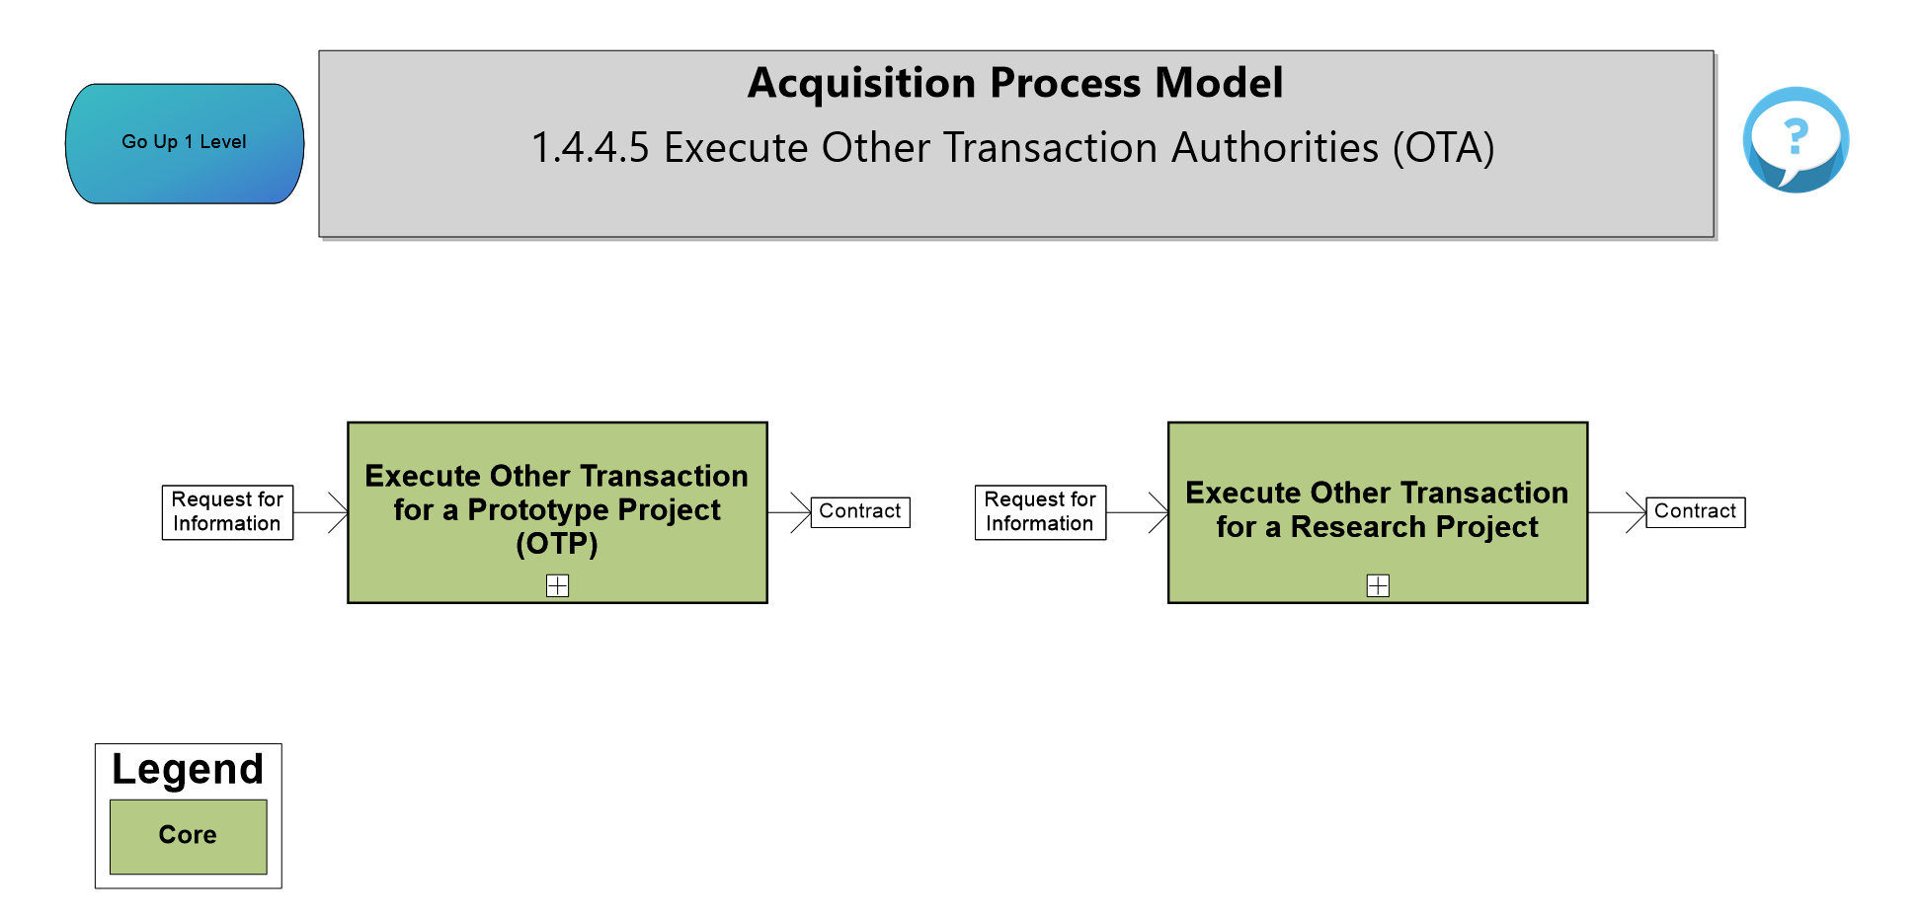
Execute Other Transaction Authorities (OTA)
Notes:
- Added new processes using the Guide to Research Other Transactions Under T10 USC 4021, 13 Sept 23
- Click on both process boxes to show the additional details under each process on 1.4.4.5.2

Slide 6
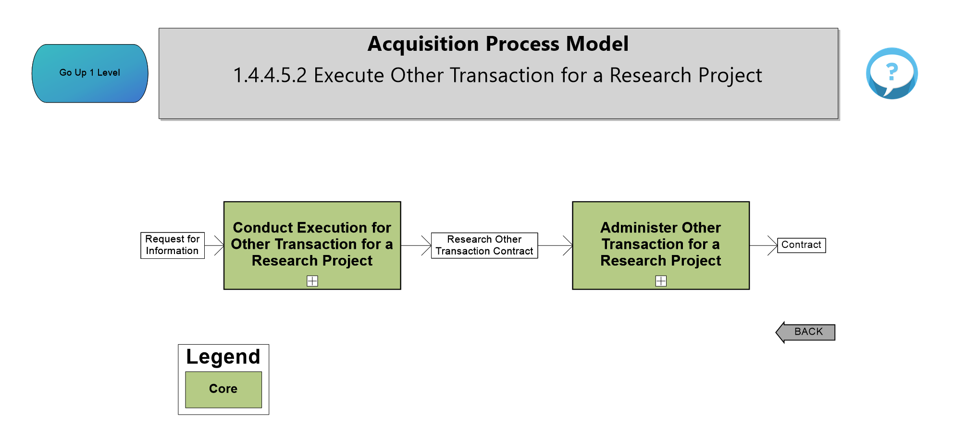
Execute Other Transaction for a Research Project
Notes:
- New processes added using the Guide to Research Other Transactions Under T10 USC 4021, 13 Sept 23
Click on both process boxes to show the additional details under each process
- Conduct Execution for Other Transaction for a Research Project, next slide
- Click on Administer Other Transaction for a Research Project to show the detail the reports required for ROT and to administer and closeout the ROT.

Slide 7
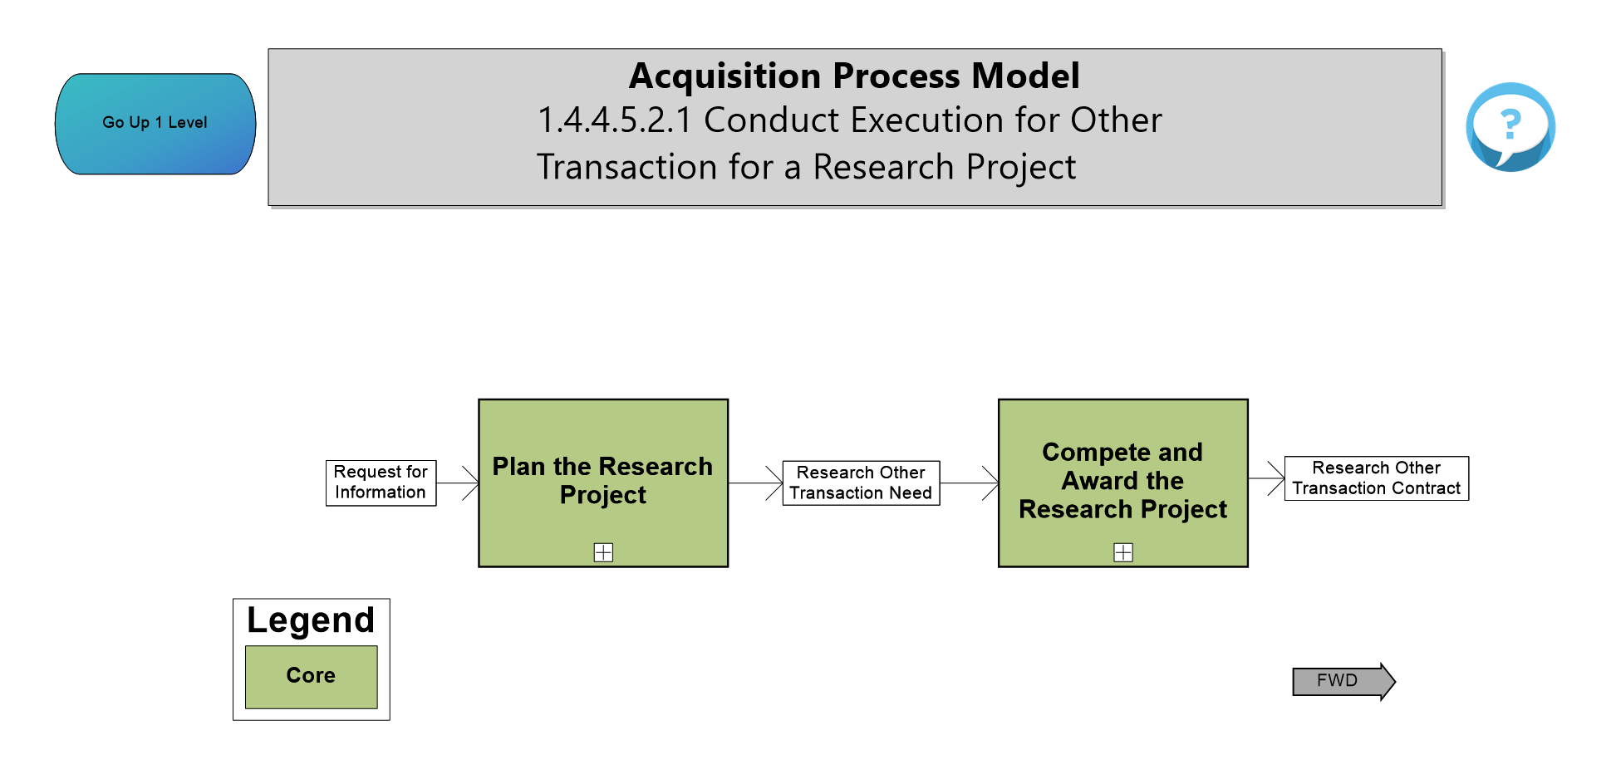
Conduct Execution for Other Transaction for a Research Project
Notes:
- New processes added using the Guide to Research Other Transactions Under T10 USC 4021, 13 Sept 23
PLAN THE RESEARCH PROJECT
Click on the process box to display the process to plan the research project
COMPLETE AND AWARD THE RESEARCH PROJECT
Click on the process box to display the process to complete and award the research project after the planning has been completed

Slide 8
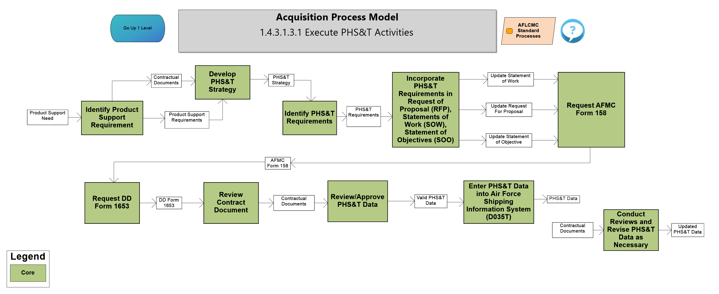
PHS&T Activities
Notes:
Updated the AFLCMC Standard Process for Packaging, Handling, Storage and Transportation, V7.0 dated 18 Jan 2024
Process Change the title from “Provide PHS&T Data and Forms” to “Identify Product Support Requirement”
Change the process titled “Submit PHS&T Data” to “Develop PHS&T Strategy”
Change the process titled “Enter PHS&T Data into Government Systems” to Enter PHS&T Data into Air Force Shipping Information System (D035T)
Remove the Process titled “Correct and Complete PHS&T”
Added the following process titles
Identify PHS&T Requirements
Incorporate PHS&T Requirements in Request of Proposal (RFP), Statements of Work (SOW), Statement of Objectives (SOO)
Request AFMC Form 158
Request DD Form 1653
Review Contract Documents
Review/Approve PHS&T Data
Conduct Reviews and Revise PHS&T Data as Necessary

Slide 9
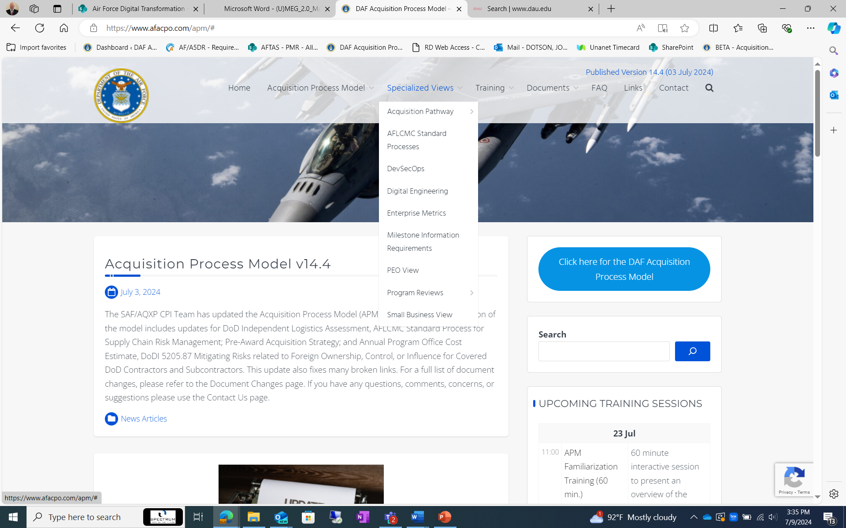
Landing Page – Specialized View
Notes:
Specialized View drop-down added to the landing page replacing the scenario drop-down; quick entry into the model based on special and functional topics

Slide 10
Landing Page – Monthly Top 10
Notes:
Added the Top 10 MPM Pages viewed; the list is updated at the end of each month and gives the user another avenue for direct entry into the MPM.

Slide 11
Logistics Health Assessment
Notes:
Release of AFLCMC Standard Process LHA 18 April 2024.
Updated process name from “Identify AML Programs to Complete LHA” to “Identify AML & WSFP in O&S Requiring LHA”
Updated description for process “Provide LHA Pre-Approval Brief”
Updated title and description for process “Approve/Waive LHA”
Updated description for process “Use LHA Data for Multiple Internal Reviews”
Updated title and description of “Present Update of LHA SPG & Metric to AFLCMC SP&P Group Biannually”

Slide 12
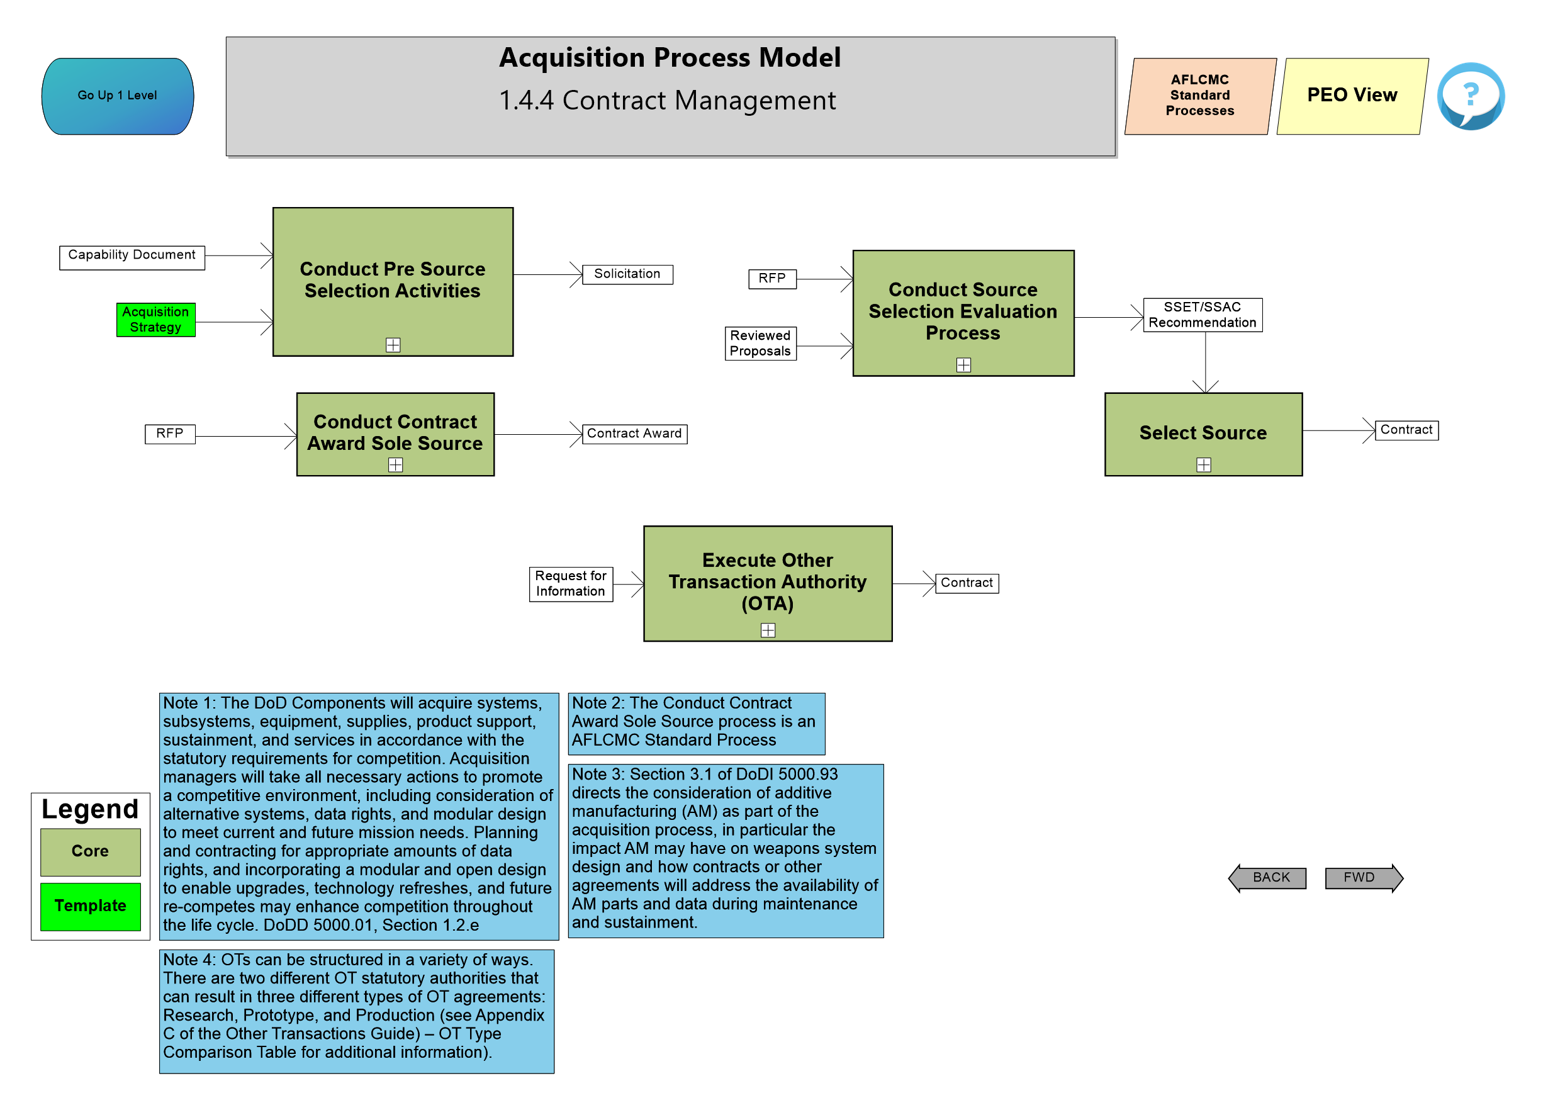
Contract Management
Notes:
- Release of AFLCMC Standard Process Contract Award (Source Selection) Competitive Acquisition Source >= $1M on 16 Nov 2023, affected the two process areas “Conduct Selection Evaluation Process” and “Select Source” under Contract Management

Slide 13
Conduct Source Selection Evaluation Process
Notes:
Updated the description of the process “Address Model Contracts”
Click on “Conduct Final Evaluation” to view diagram 1.4.4.2.6
Updated description for processes “Evaluate Final Revisions” and “Conduct Final Evaluation Briefing” and reference sections for both processes

Slide 14
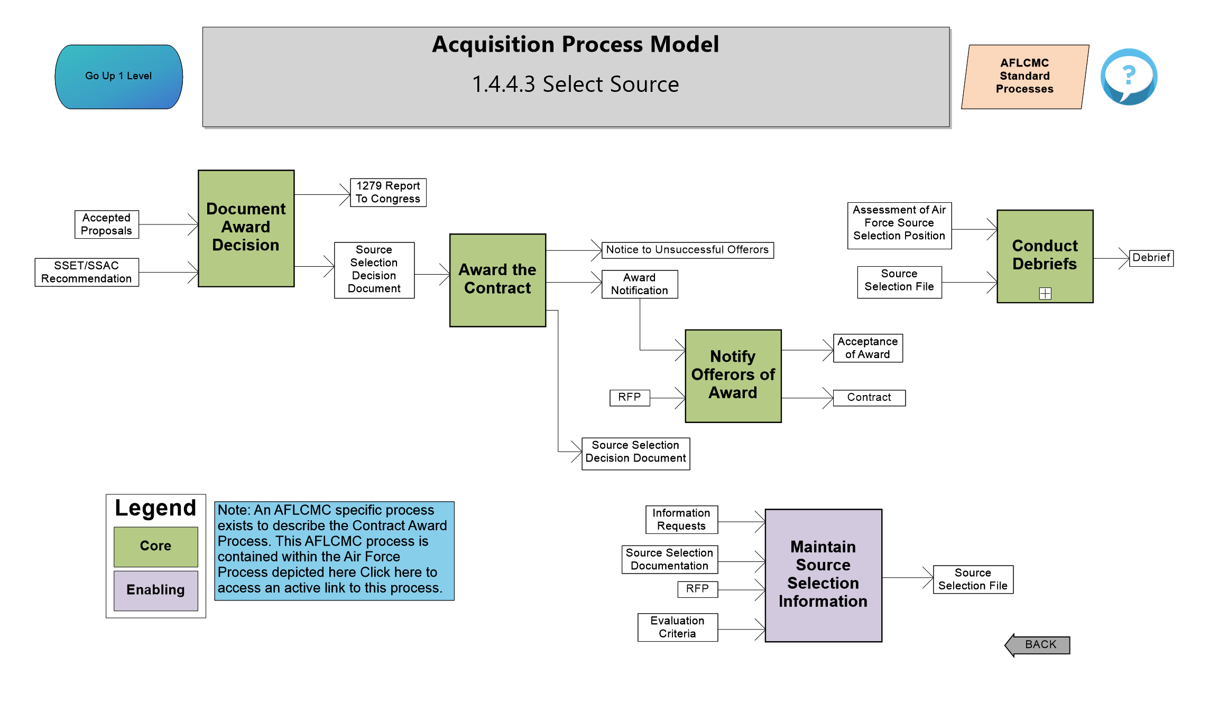
Select Source
Notes:
- Updated the description for the process “Award the Contract”

Slide 15
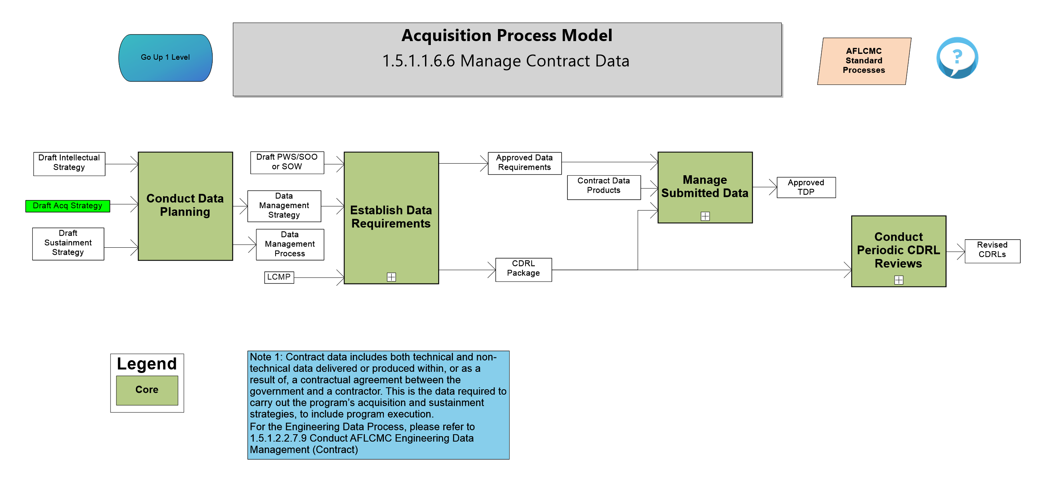
Manage Contract Data
Notes:
- Release of AFLCMC Standard Process Contract Data Management, V1.2 16 Nov 2023
- Added inputs Draft Intellectual and Sustainment Strategies into “Conduct Data Planning”

Slide 16
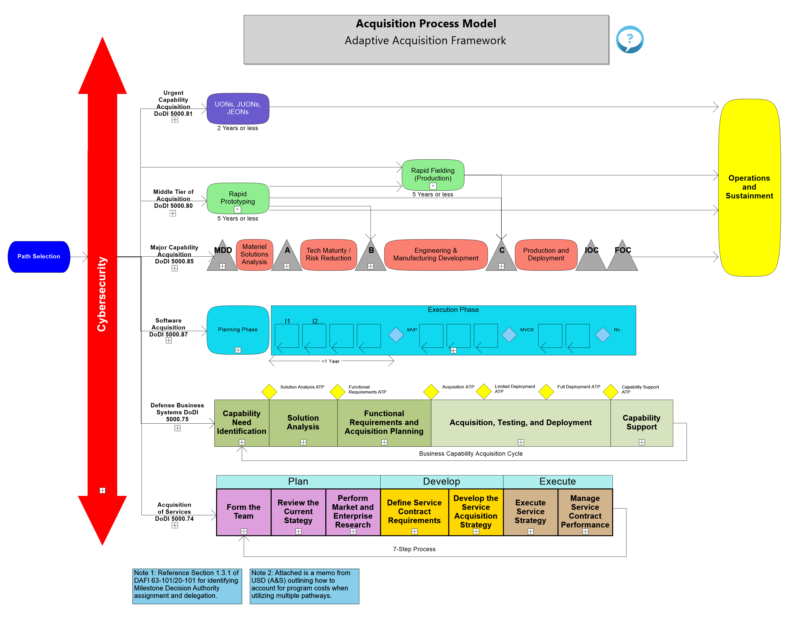
Adaptive Acquisition Framework
Notes:
- Added descriptions, referenced from the DAU Glossary, to the IOC and FOC locations

Slide 17
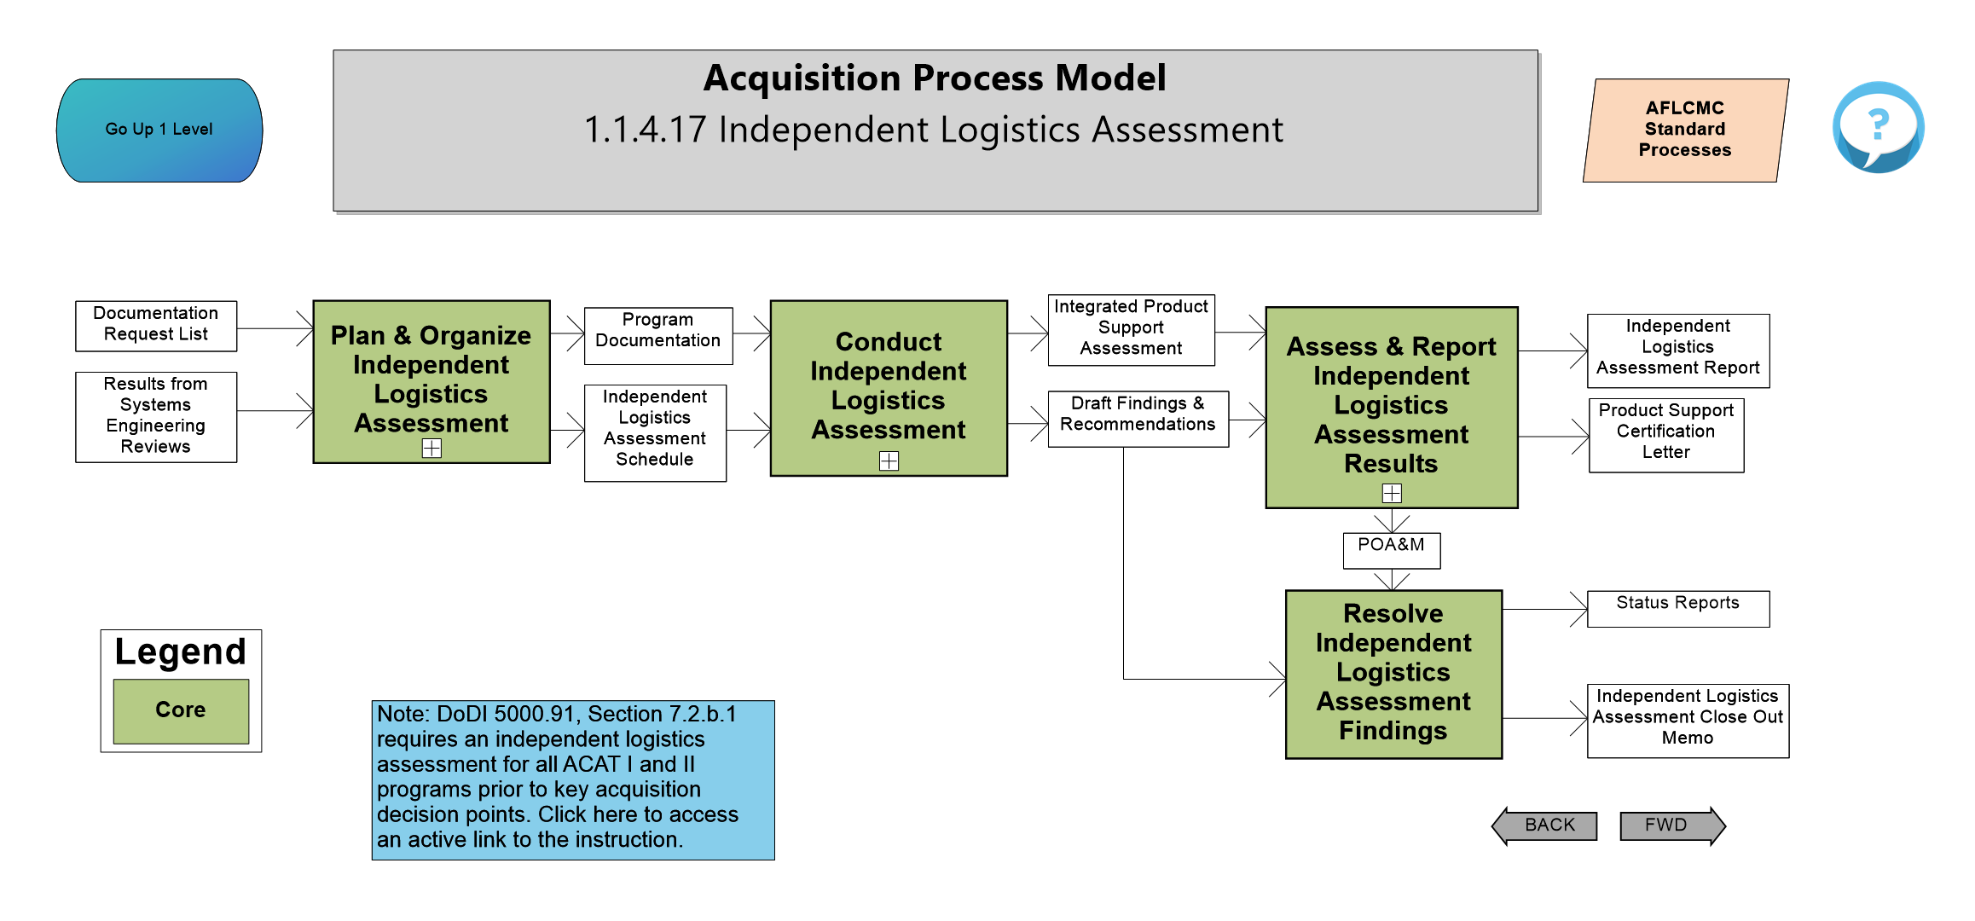
Independent Logistics Assessment
Notes:
- Updated the from the DoD Logistics Assessment Guidebook to the DoD Independent Logistics Assessment (ILA) Guidebook released 6 April 2023
Changed the owner to DASD (PM) from DASD (MR)
Updated the diagram title and all process boxes to include Independent
Updated descriptions and section numbers
Changed references from deficiencies to findings
Click on additional details below “Plan & Organize ILA”, “Conduct ILA”, and “Assess & Report ILA Results” to show changes in owner and descriptions

Slide 18
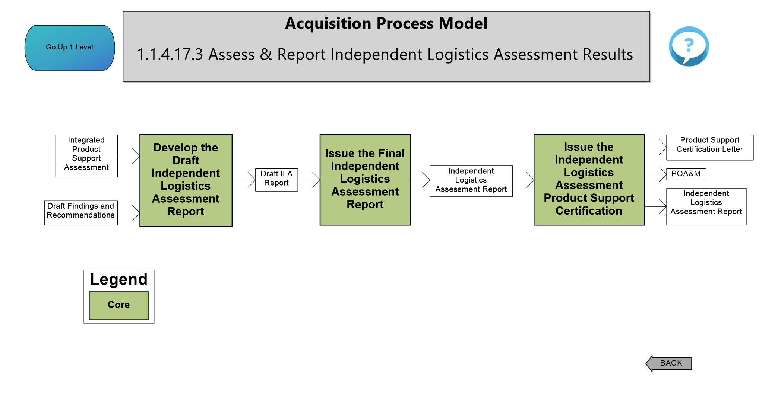
Assess & Report ILA Results
Notes:
- Added the following process steps in accordance with Section 3.3 of the newly released ILA Guidebook

Slide 19
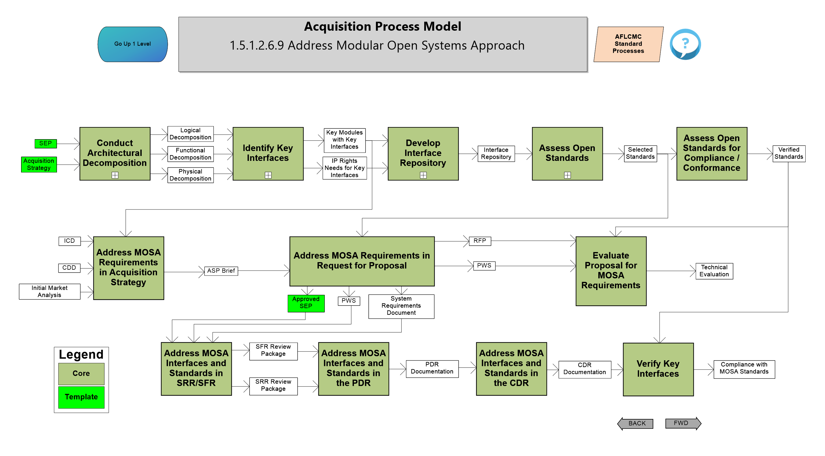
Address Modular Open Systems Approach
Notes:
Updated the from the AFMC Guidebook for Implementing Modular Open Systems Approaches in Weapon Systems, V2.0
Updated reference section for “Conduct Architectural Decomposition”, as well on 1.5.1.2.6.9.1 the reference section for “Review Existing MOSA Artifacts”
Click on “Develop Interface Repository” to display 1.5.1.2.6.9.3 updated the description for “Establish Interface Repository”
Click on “Assess Open Standards” to display 1.5.1.2.6.9.4 updated the description for “Consult SME Groups”

Slide 20
Other Updates
Air Force Life Cycle Management Center (AFLCMC) Standard Process for Supply Chain Risk Management (SCRM), Version 2.0
Air Force Life Cycle Management Center (AFLCMC) Standard Process for Pre-Award Acquisition Strategy (AS) and Request for Proposal (RFP) Development, Version 2.9
Air Force Life Cycle Management Center (AFLCMC) Standard Process for Annual Program Office Cost Estimate, Version 3.4
Air Force Technology Development and Transition Strategy Guidebook
DAU’s A Guide to Program Management Business Processes, Version 1.1
DoD Product Support Manager Website
DoD Sole Source Streamlining Toolbox
Product Support Toolkit
Requirements for the Acquisition of Digital Capabilities Guidebook
DoD Life Cycle Sustainment Plan Outline
Notes:
These documents were added as references and/or updated references with little to no change to the MPM.

Slide 21
Upcoming Changes
DAFFARS Update
FAR Part 16.505 (Addition to Services Pathway)
AMIC Processes (Acquisition Management and Integration Center)

Slide 22
Questions

Slide 23
Who Do I Talk To?
If you have questions, comments, or recommendations for improvements
Contact Mr. Brad Ferguson – (720) 333-6707 or brad.ferguson.2@us.af.mil
Contact Allen Farley – (304) 216-6308 or allen.farley@sptrm.com
Contact J.R. Dotson – (304) 641-1181 or john.dotson@sptrm.com
Contact SAF/AQXP – usaf.pentagon.saf-aq.mbx.saf-aqxp-cpi-wkflw@us.af.mil

