Slide 1
Modernization Acquisition Process Model (MPM) Familiarization
SAF/AQXP
Notes:
Revised March 2024

Slide 2
APM Rebranding
On behalf of the SAF/AQ and SQ Master Process Officer “DAF Modernization Process Model (MPM)”
The model’s maturation, reflecting a broader focus on modernization across processes
Acquisition as a key component to modernization
DAF Modernization Process Model (MPM)
Notes:
In the first quarter of FY25, the DAF Acquisition Process Model (APM) will officially rebrand as the DAF Modernization Process Model (MPM). This name change, on behalf of the SAF/AQ and SQ Master Process Officer, marks an important milestone in the model’s maturation, reflecting a broader focus on modernization across processes as we keep pace with Great Power Competition (GPC) implementation.
Discussion:
In the beginning, circa 2010, the Acquisition Process Model (APM) consisted of hand-drawn, high-level process flows on a whiteboard in the trenches of SAF/AQ’s Acquisition Chief Process Office (ACPO). As you can see from what the APM has become (www.afacpo.com), we’ve come a long way, striving to evolve to become more useful and relevant to our stakeholders, especially the functional experts in the program offices navigating and tailoring myriad acquisition processes.
To reflect the growing emphasis on Acquisition as a key component in the Department of the Air Force’s efforts to modernize to keep pace with the Global Power Competition, we are changing from the DAF APM to the DAF MPM – the Modernization Process Model! True to our history, we will continue to evolve and expand, incorporating additional policies and developing features to assist you within the constraints of our tool set.

Slide 3
Learning Objectives
Understand the purpose of the MPM
Understand the process information within the MPM
Understand the functionality of the MPM
The MPM – an integrated process perspective on the “Big A” acquisition process

Slide 4
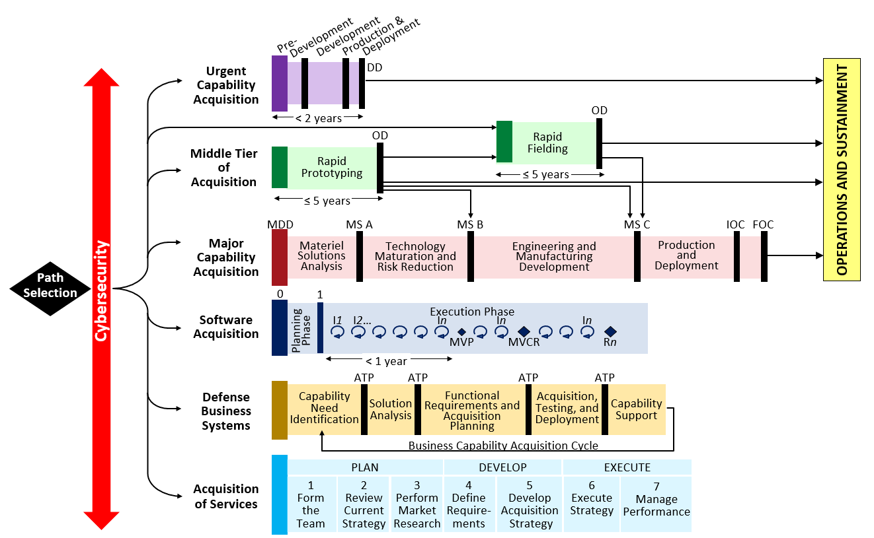
MPM Purpose
The MPM is the “as documented” process for Big A acquisition
Acquisition
Defense Acquisition System – DoDI 5000.xx, DAFI 63-101/20-101
Requirements
JCIDS Process – CJCSI 5123.01I, JCIDS Manual
Resources
PPBE Process – AFPD 90-6,
SPPBE Playbook
Notes:
. Updated on a continuous basis, the MPM provides a variety of benefits
Establish standard definition and activities associated with AF Acquisition
Provide process decomposition from DAE/SAE through PM level actions
Serve as Standard Reference Model for all stakeholders
Provide common context for process improvement initiatives
Provide integration context for other external/related process models
Serves as the process component of the Acquisition Enterprise Architecture

Slide 5
MPM Content
The MPM incorporates a variety of valuable process perspectives from over 400 sources
Laws & Regulations
Title 10
Federal Acquisition Regulations, DAFFARS, DFARS
Directives and Instructions
DoDD/I 5000.xx
DAFI 63-101/20-101
DoDI 5000.89_DAFI 99-103
Program Manager Guidance
DAFMAN/PAM 63-xxx
Series of Guidebooks
AFLCMC Standard Processes

Slide 6
MPM Citations
Institutionalized the “APM” by SAF/AQ Memorandum on 11 Sept 2016.
Valuable tool to PEOs, PMs and their staffs in obtaining up-to-date acquisition guidance
Visual representation of the processes that programs are required to complete
6

Slide 7
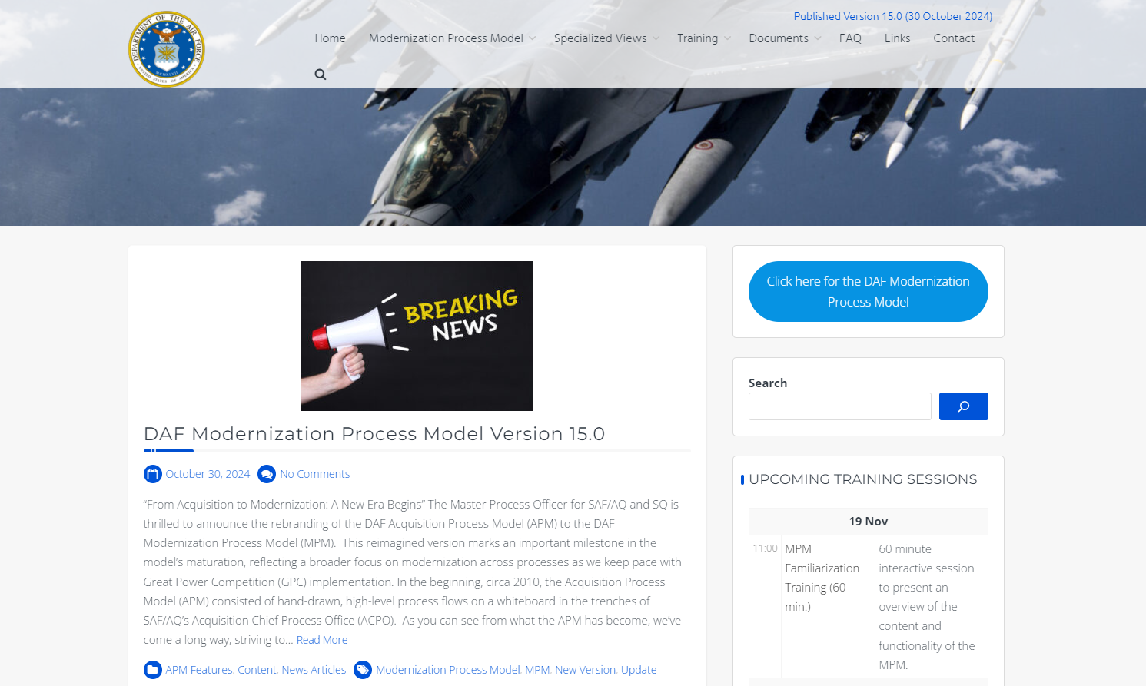
MPM Entry Screen

Slide 8
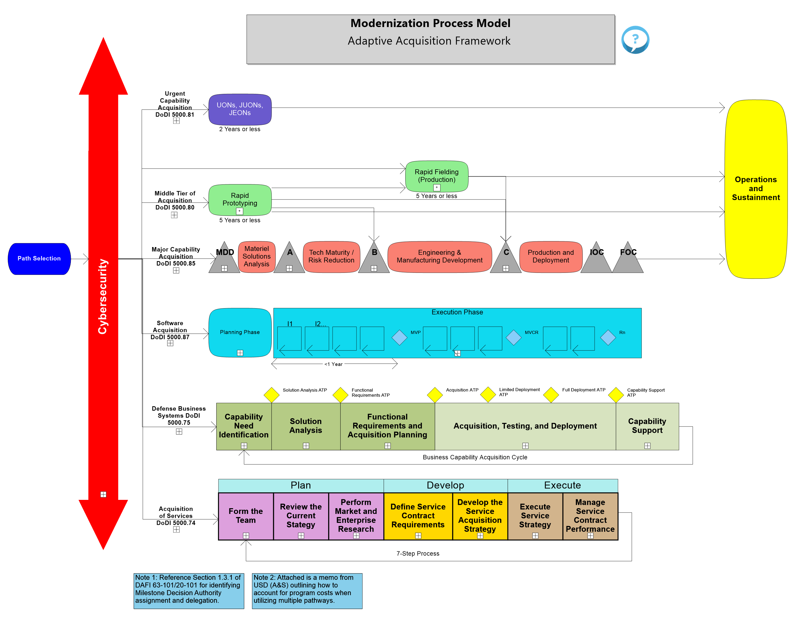
Adaptive Acquisition Framework

Slide 9
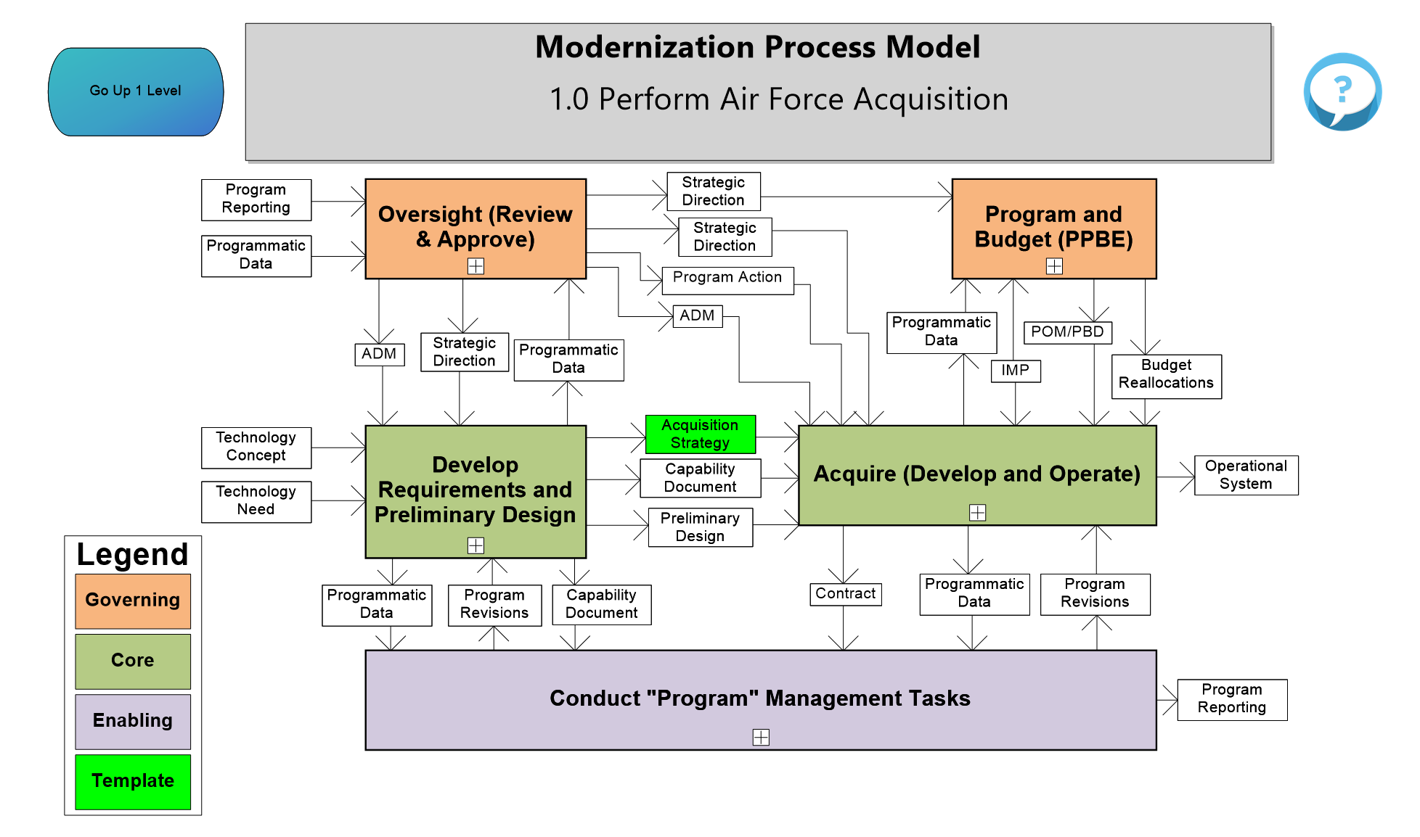
MCA Home Page
Process Box Color
Governing-The processes that guide or direct other processes
Core-The processes that create the required outputs from the organization
Enabling-The processes that support the execution of the core activities

Slide 10
Legend
Each diagram has a specific legend providing the meaning of the various colors used on the page.

Slide 11
Page Specific Question Function
Each diagram has an icon which provides the user a way to ask questions about a specific page.

Slide 12
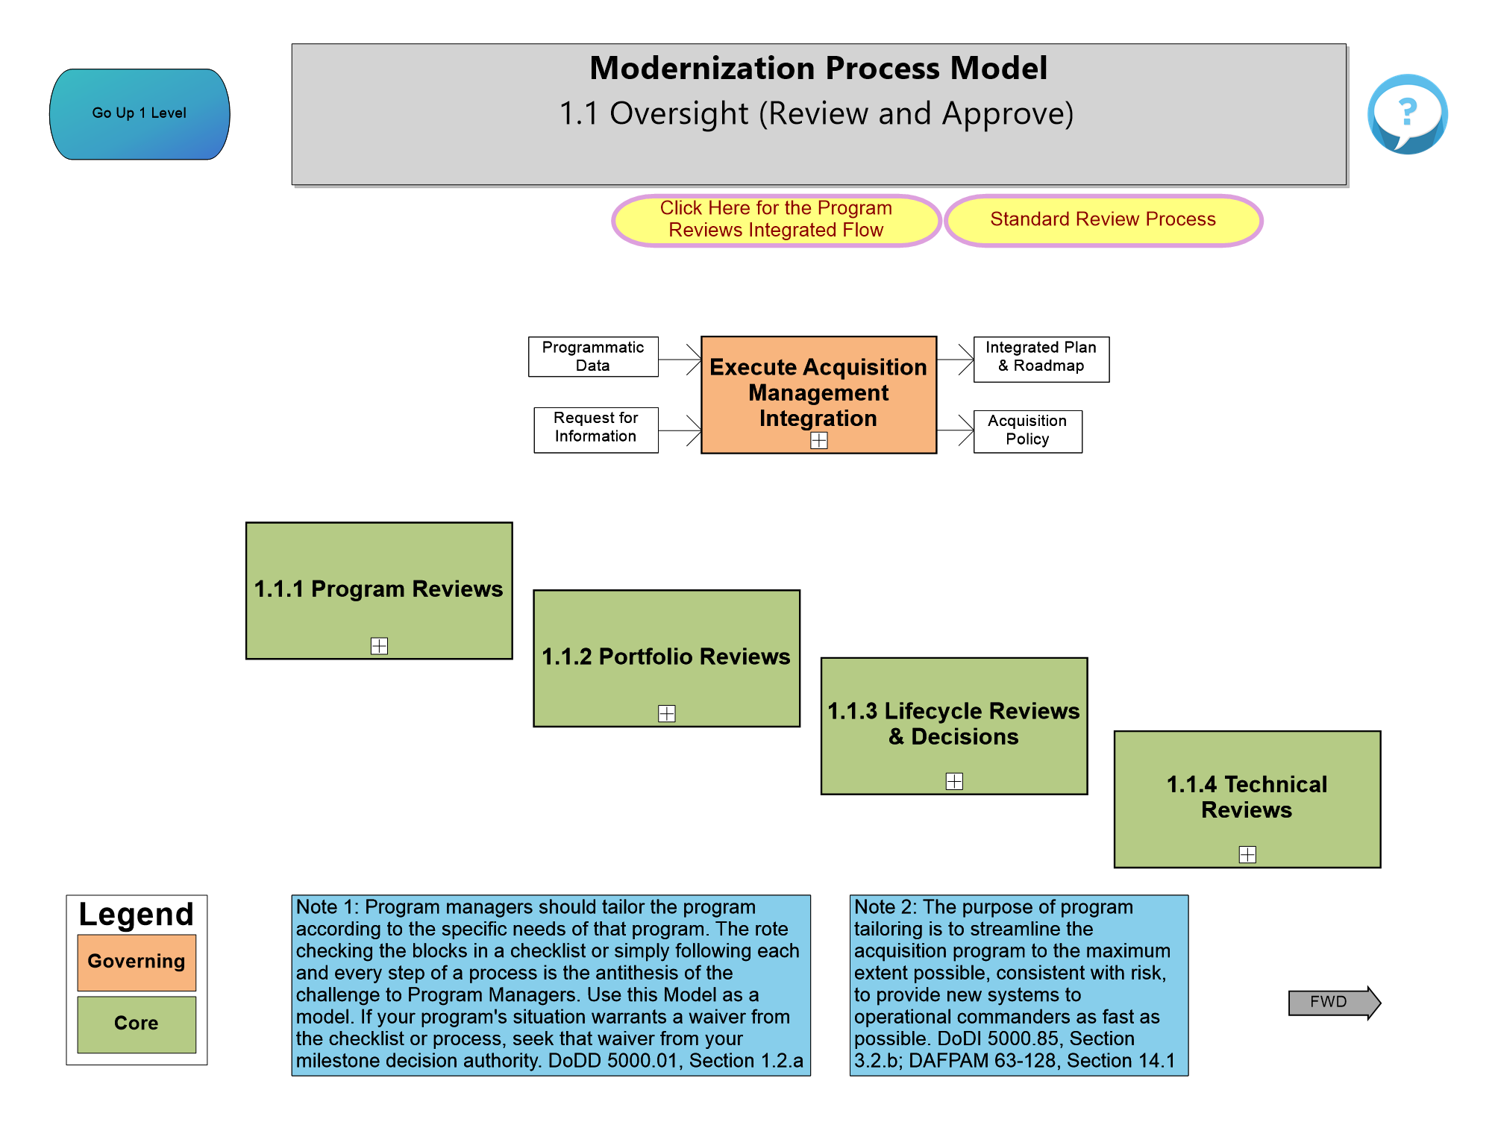
1.1 Oversight

Slide 13
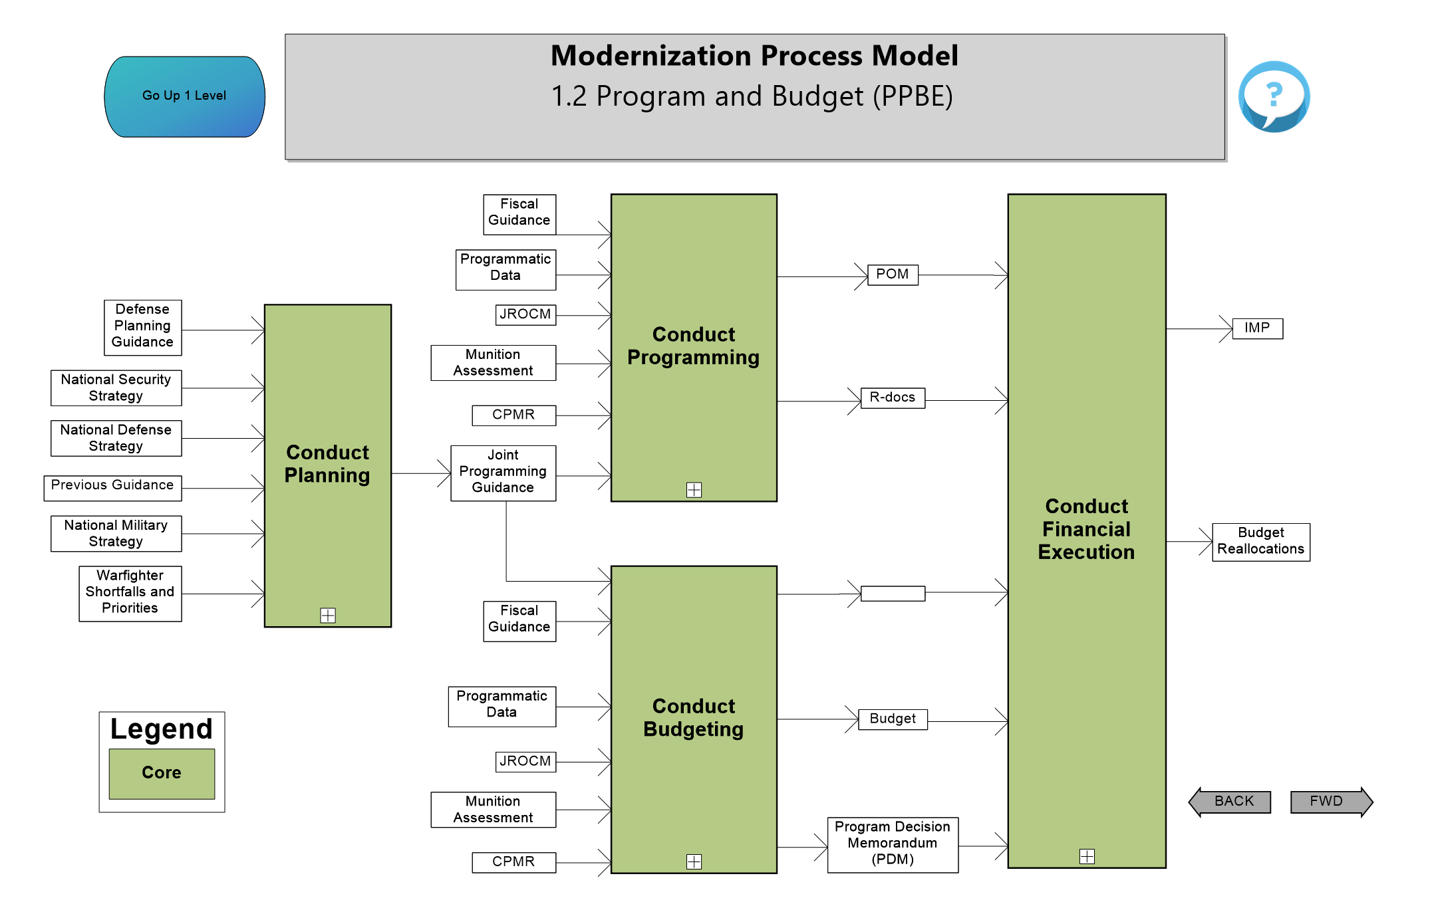
1.2 Program and Budget (PPBE)

Slide 14
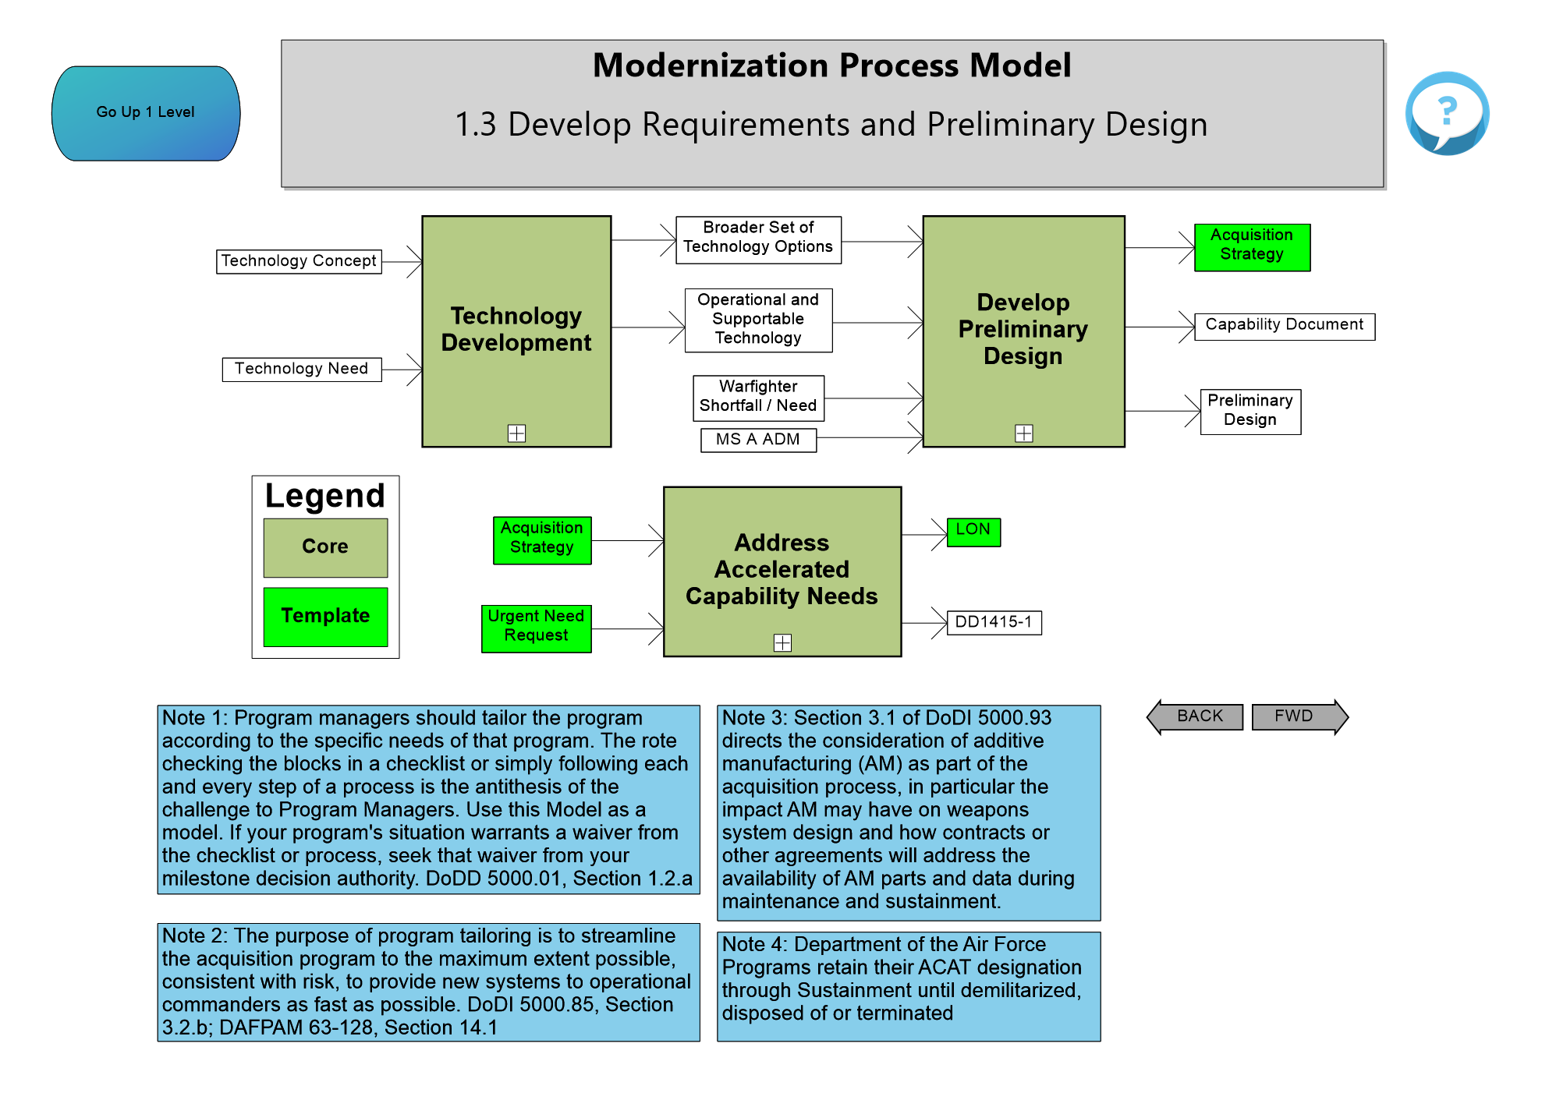
1.3 Develop Requirements and Preliminary Design

Slide 15
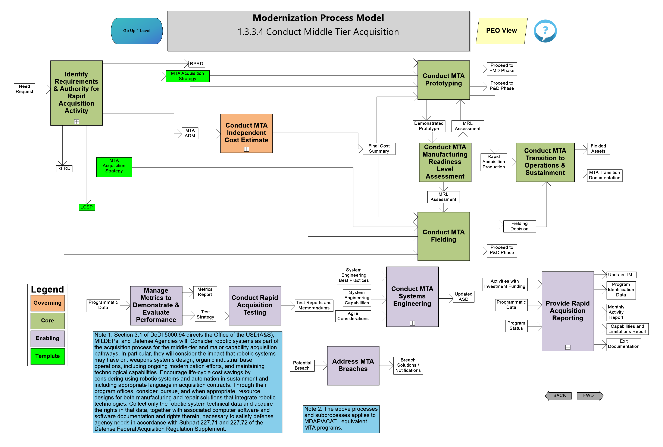
1.3.3.4 Conduct Rapid Acquisition Activities

Slide 16
1.4 Acquire

Slide 17
1.5 Conduct “Program” Management Tasks

Slide 18
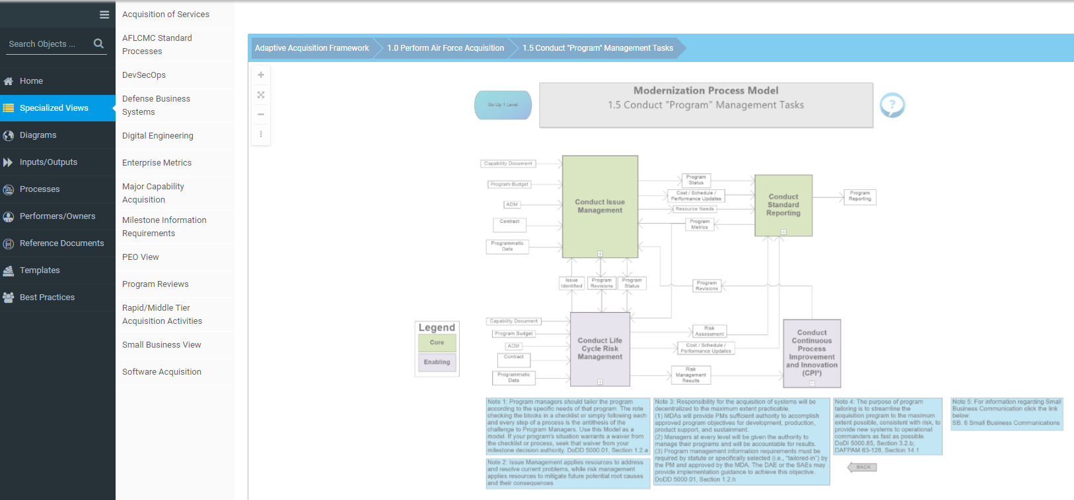
Specialized Views

Slide 19
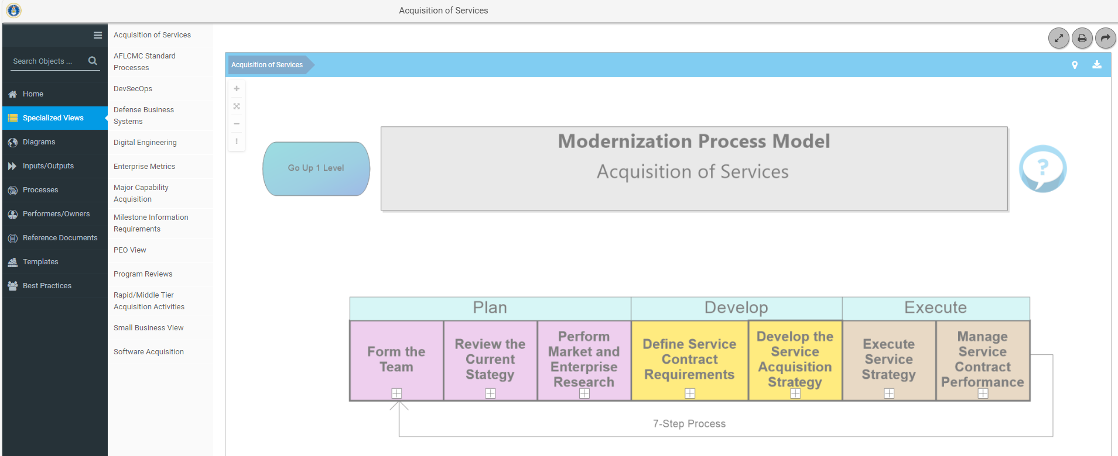
Acquisition of Services

Slide 20
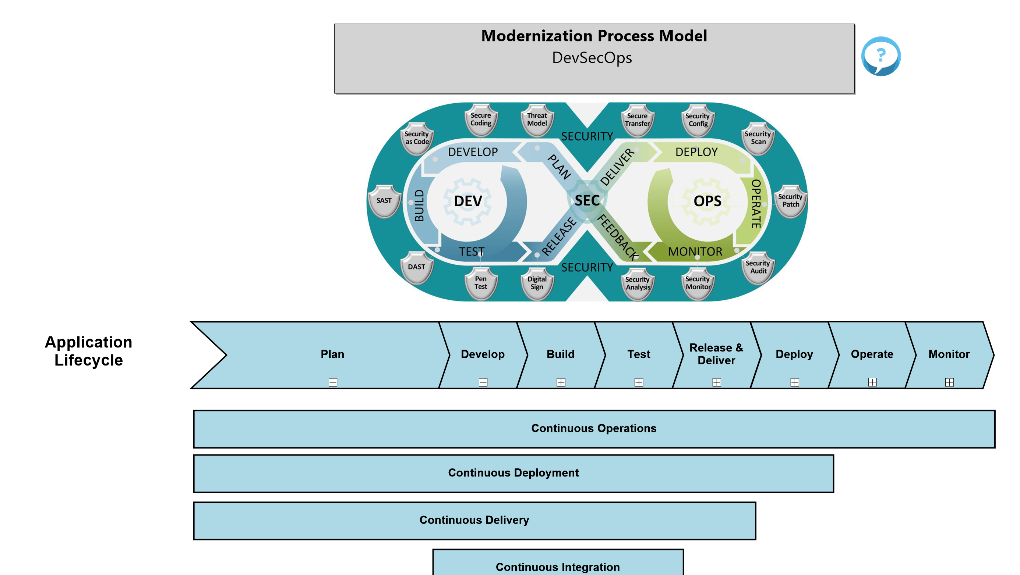
DevSecOps

Slide 21
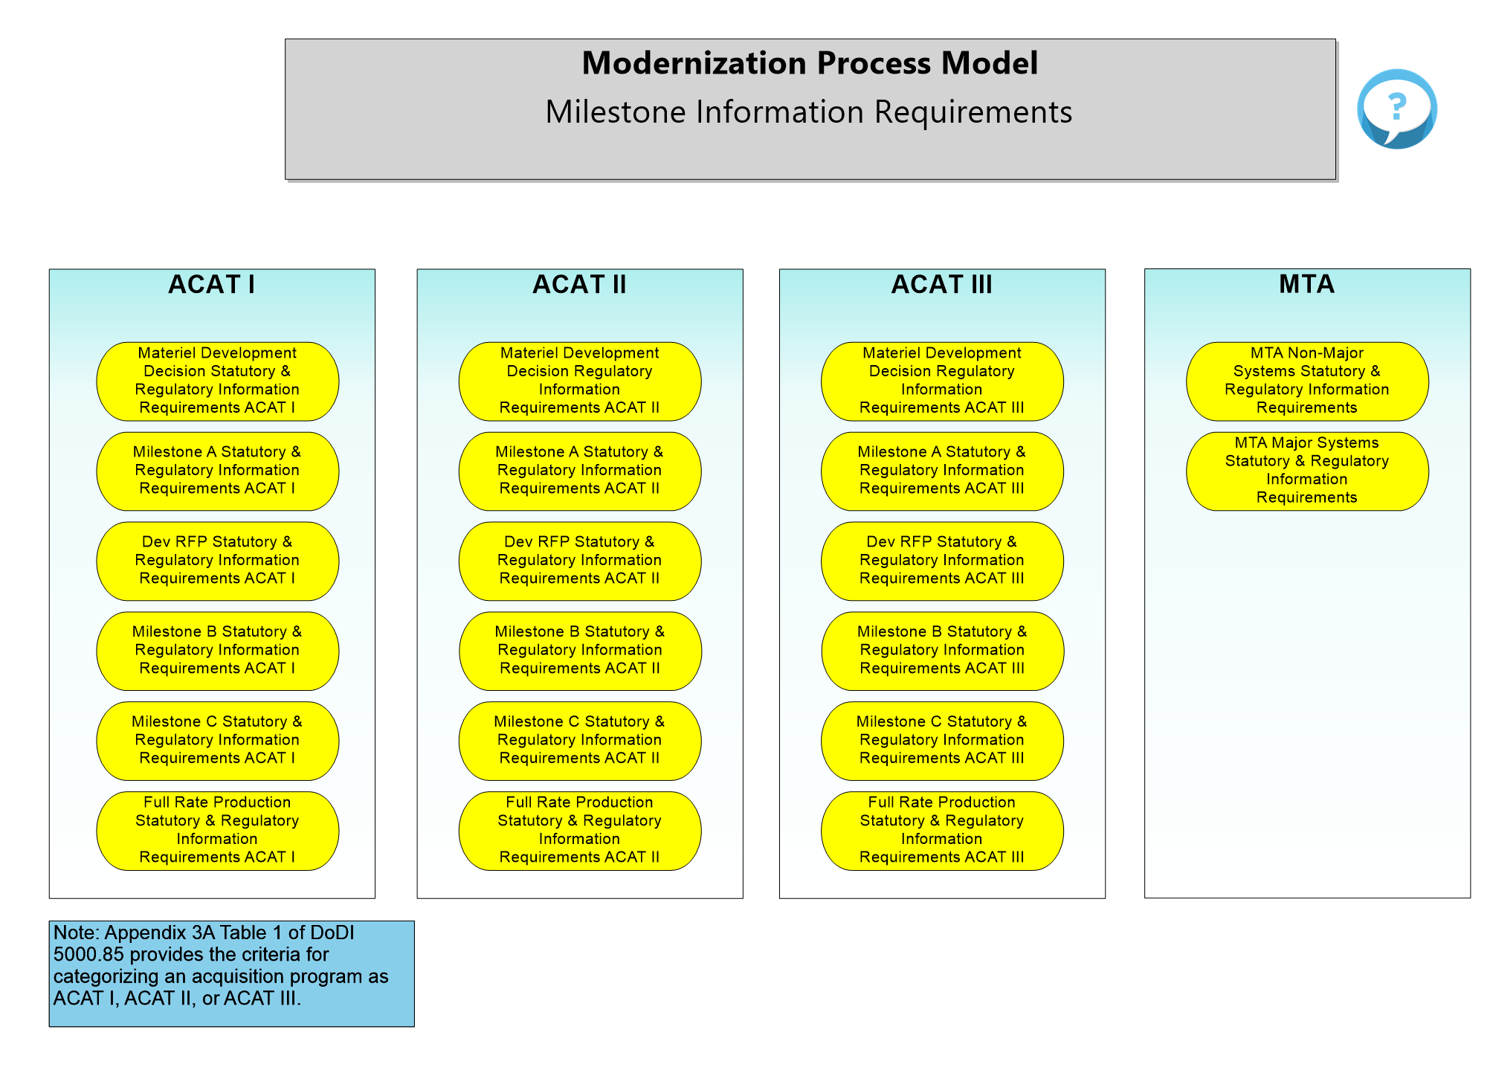
Milestone Information Requirements

Slide 22
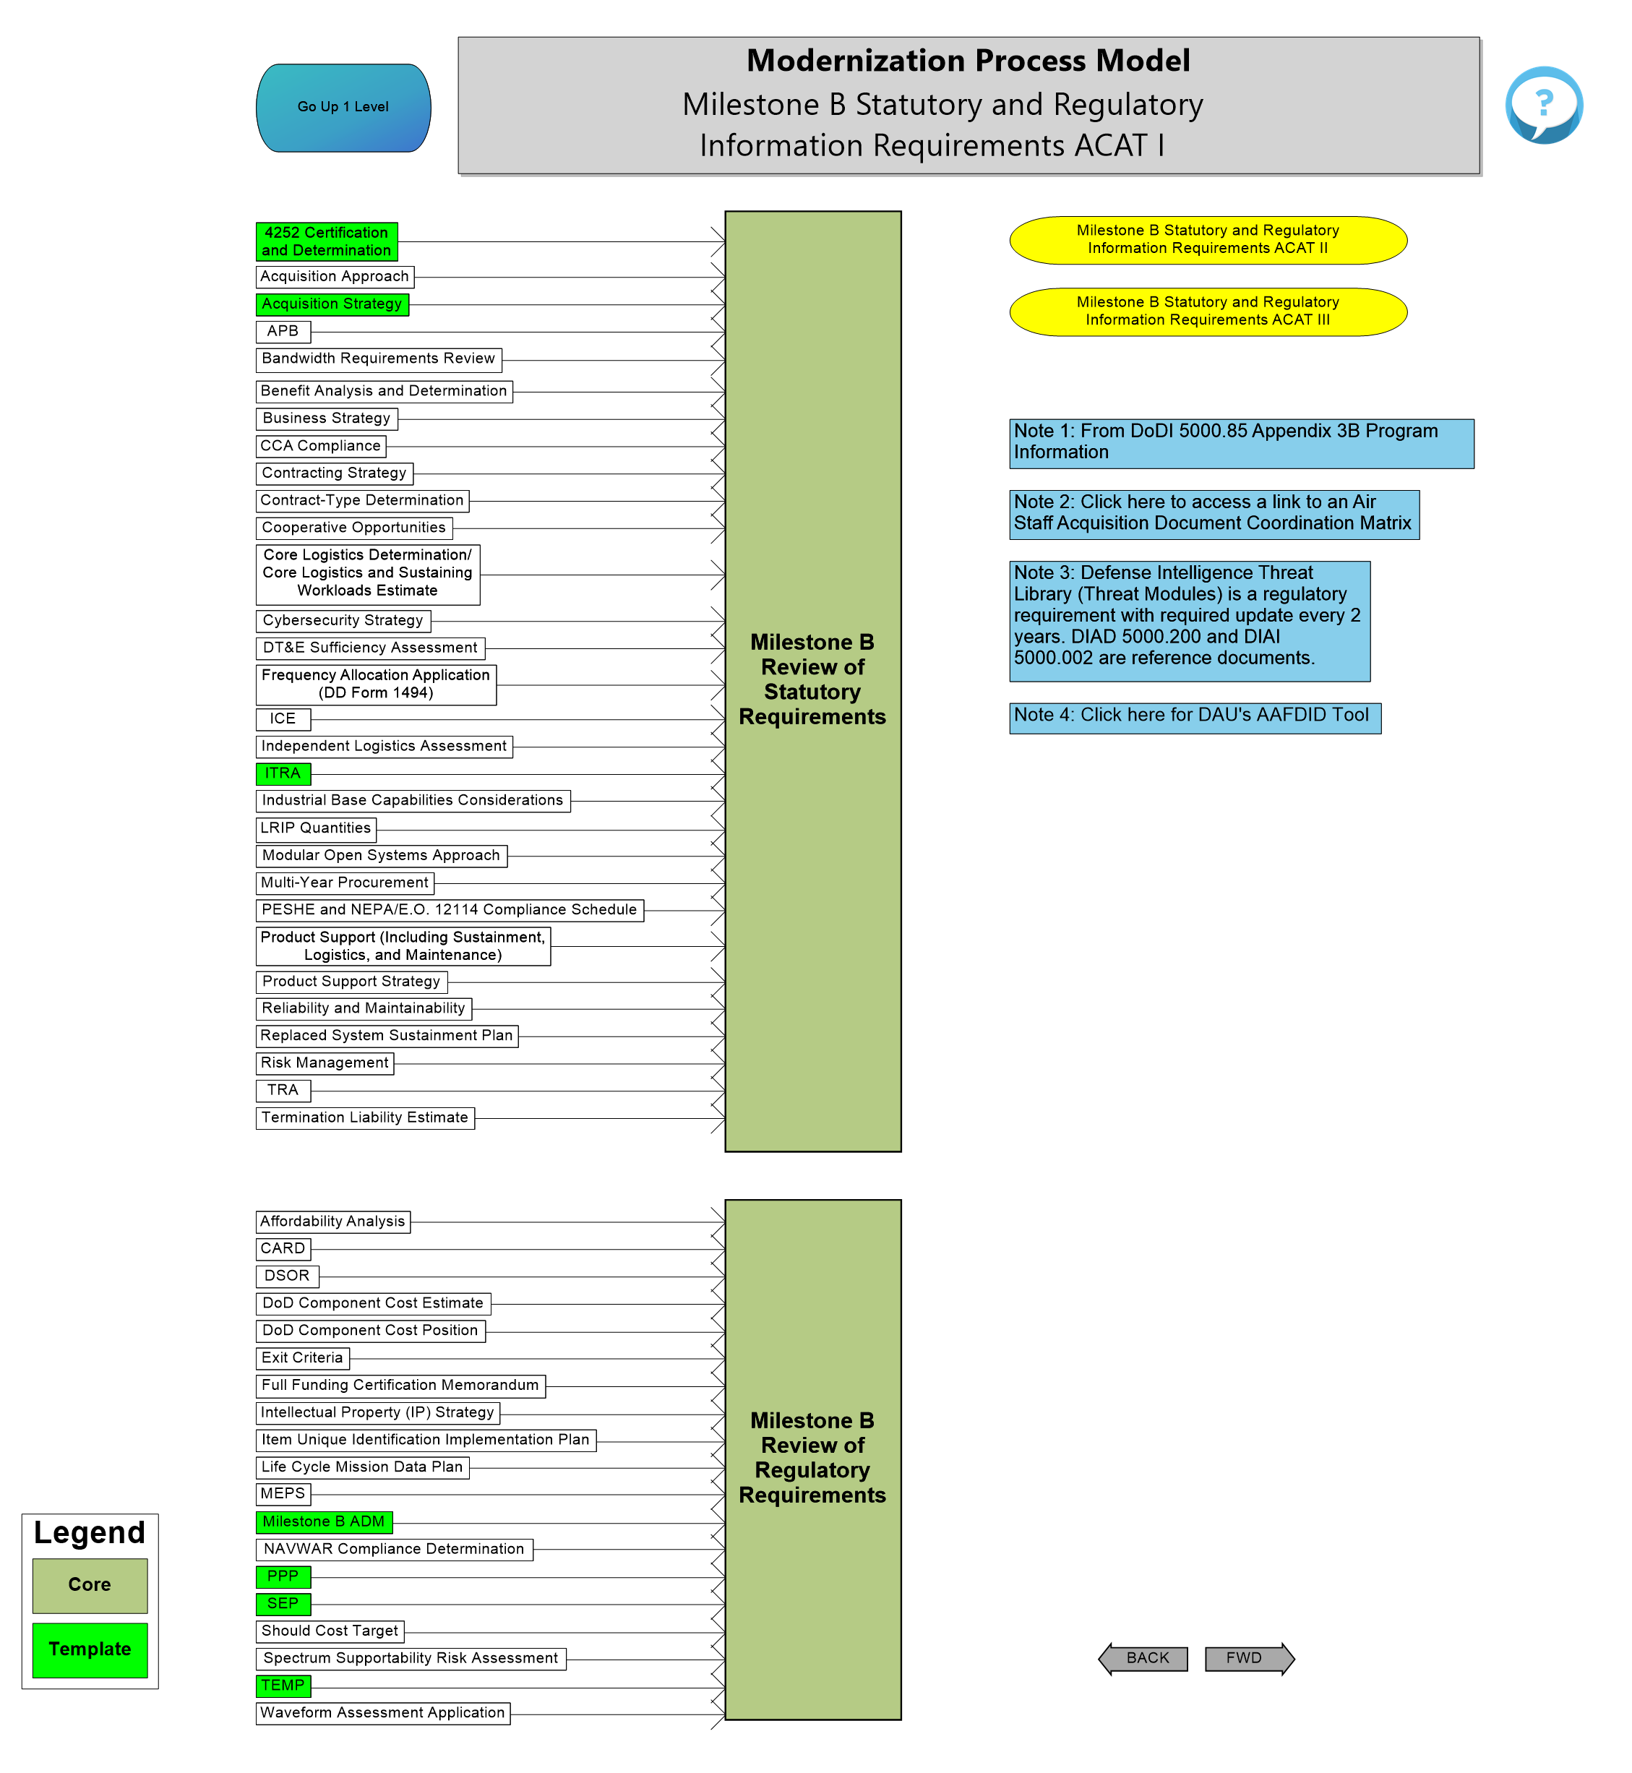
Milestone Information Requirements

Slide 23
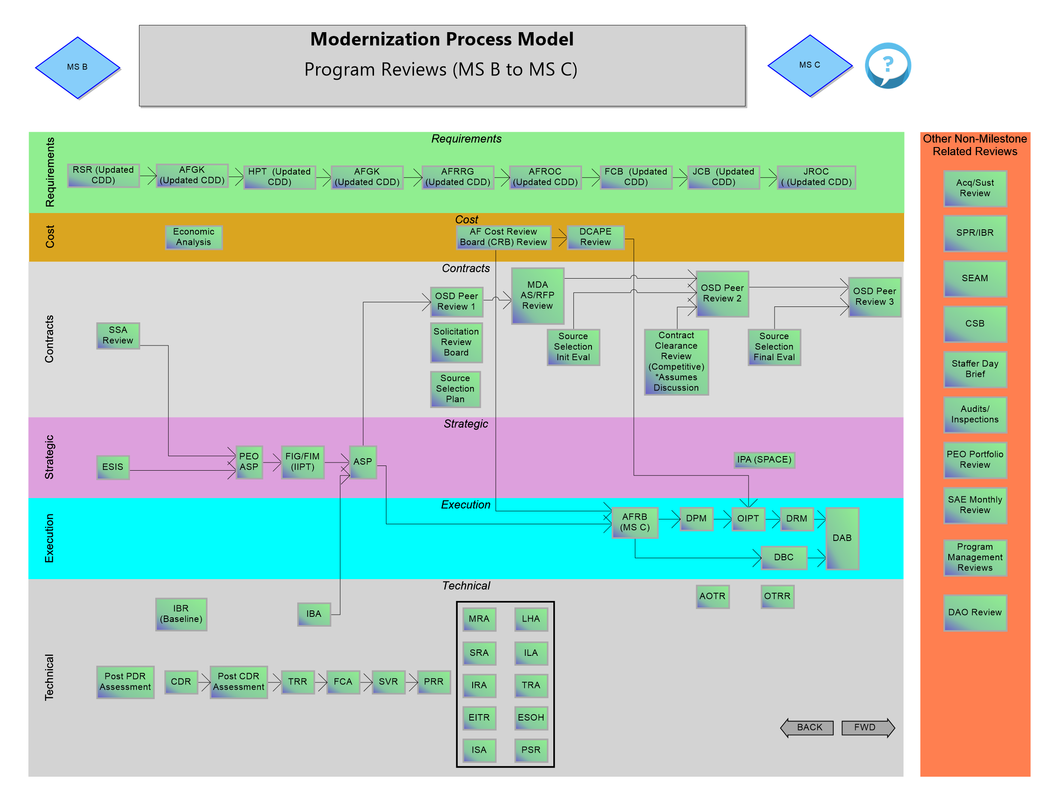
Program Reviews

Slide 24
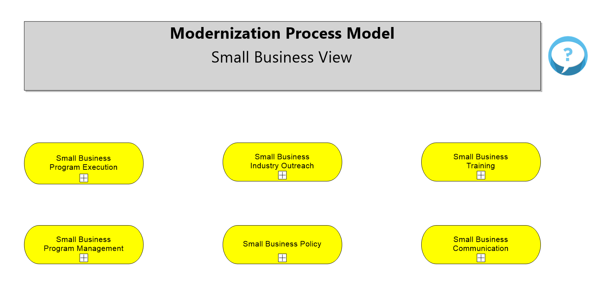
Small Business Views

Slide 25
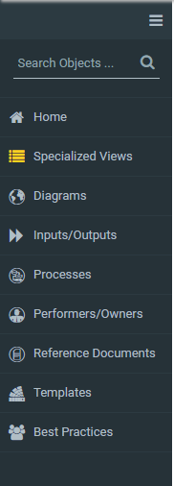
Content Navigation Defined
Condenses the Navigation Menu to Icons Only
Global Search- Allows user to search the entire model
Returns to AAF regardless of where you are in the model
Links to specific pages in the model
Pages in the model (Combination of Processes and Inputs/Outputs)
List of Process Inputs and Outputs and where they are used in the model
List of all the processes and where they are diagrammed in the model
List of all the Performers/ Owners with associated processes in the model
List of all the reference documents and where they are referenced in the model
List of all the templates with associated diagrams in the model
List of all the Best Practices Documents with associated processes in the model
Each Content area has two display options- Grid and List

Slide 26
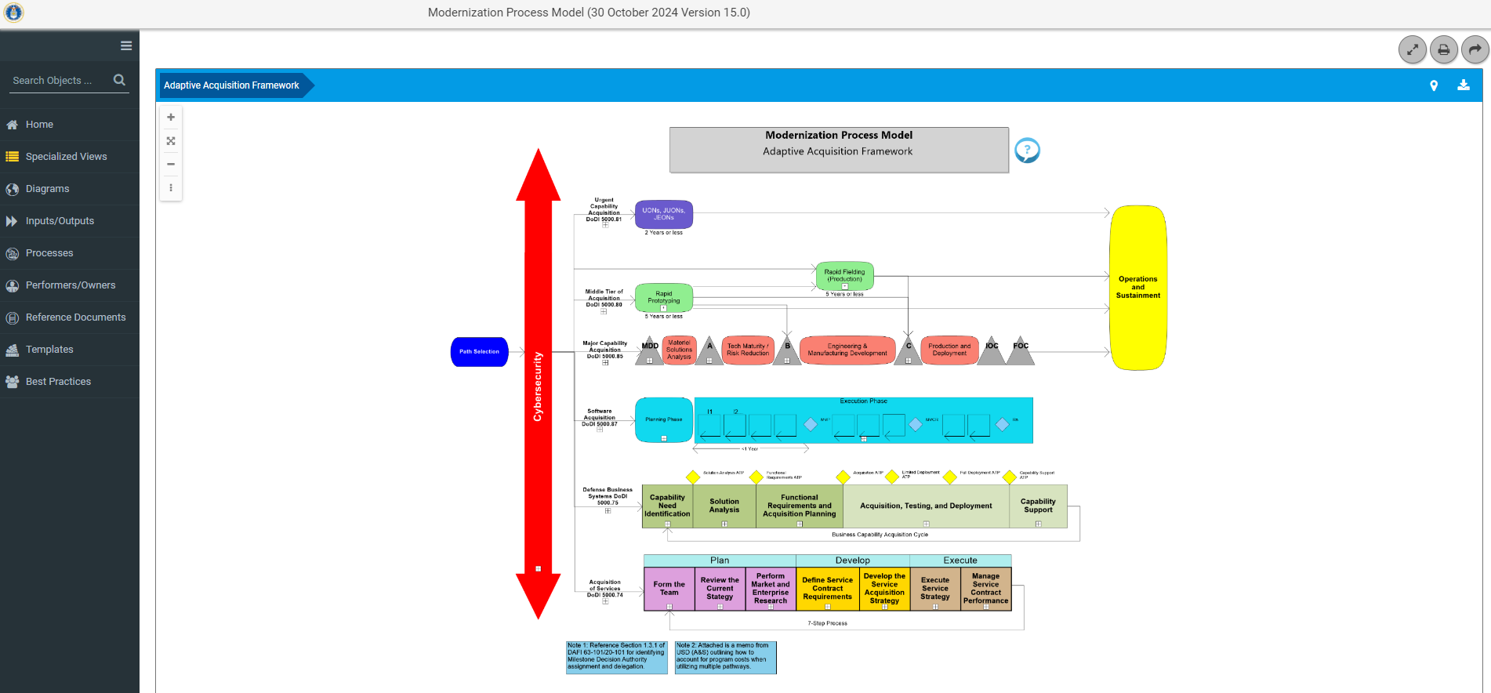
Global Search
Click here for Global Search

Slide 27
Diagrams
Click here for the Diagrams

Slide 28
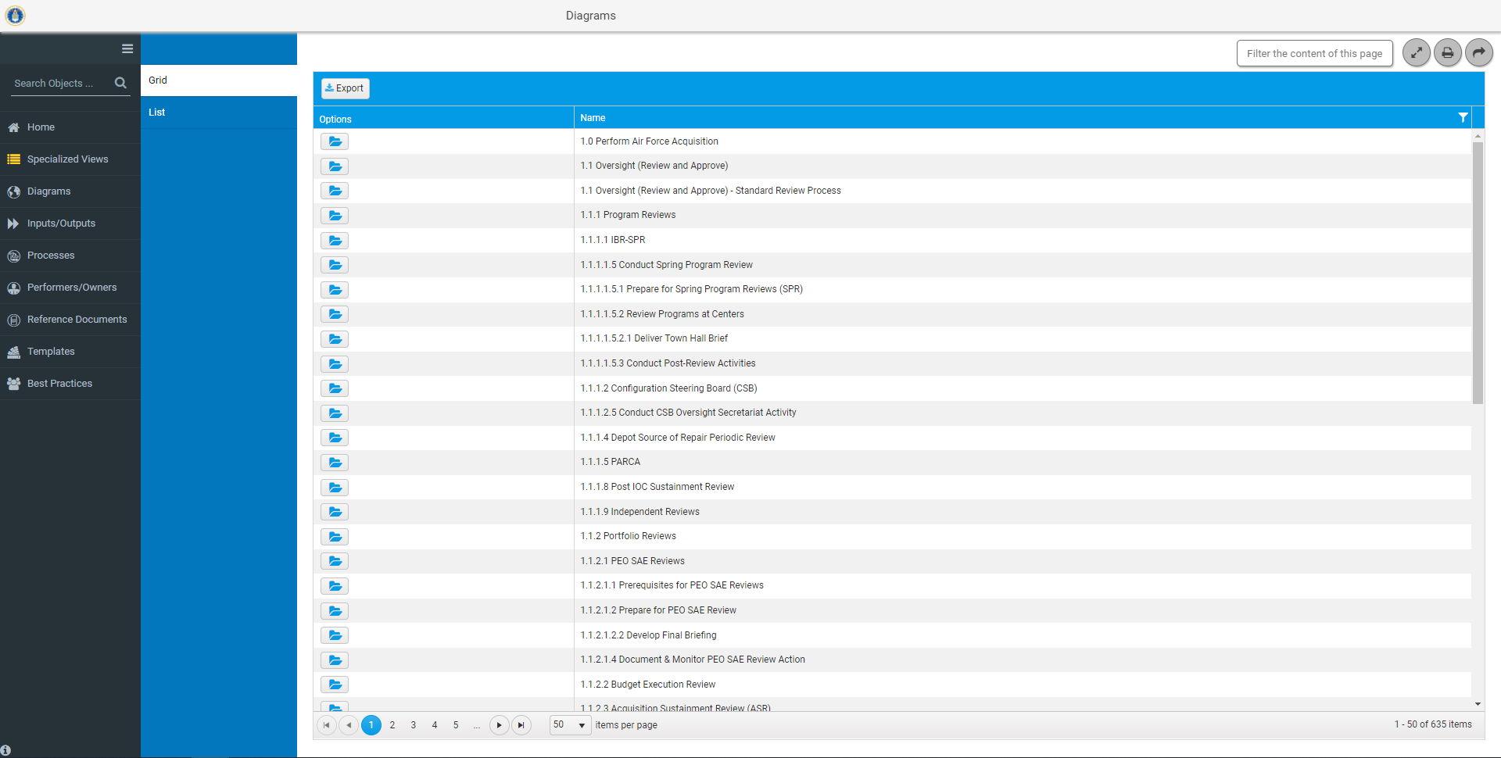
Diagrams Grid View
Click on folder to view the Diagram for Program Reviews

Slide 29
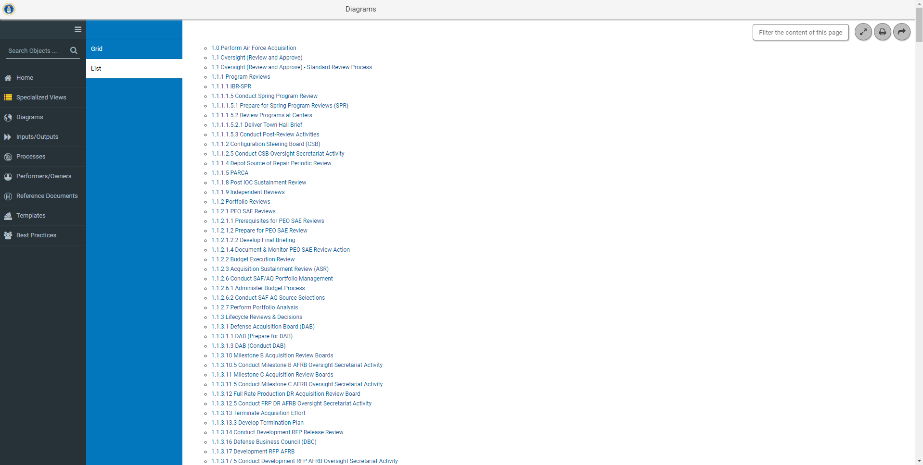
Diagrams List View
Click to view the Diagram for Program Reviews

Slide 30
Processes
Click here for the Processes

Slide 31
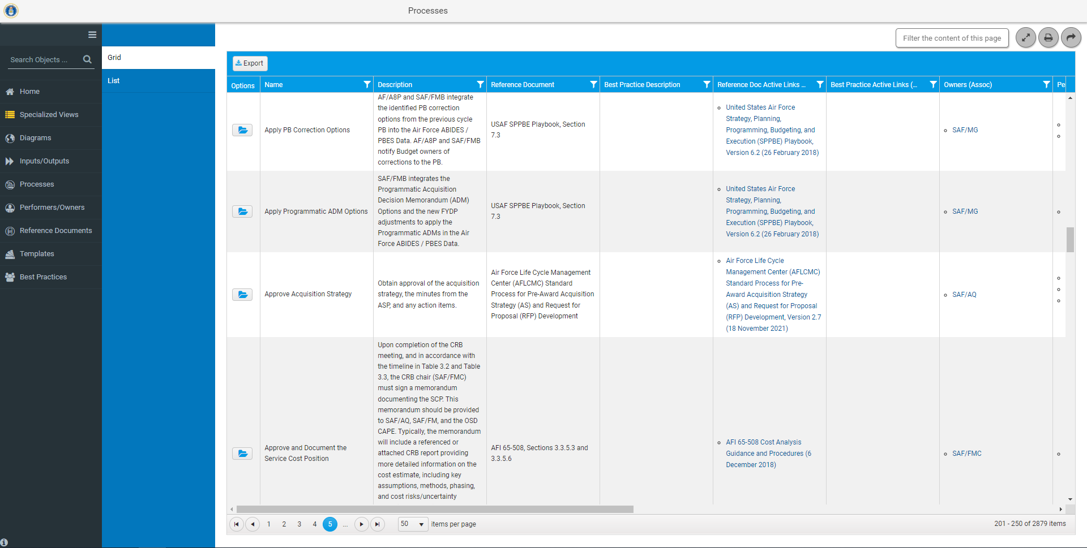
Processes Grid View
Click on folder for details on Approve Acquisition Strategy and a link to the diagram

Slide 32
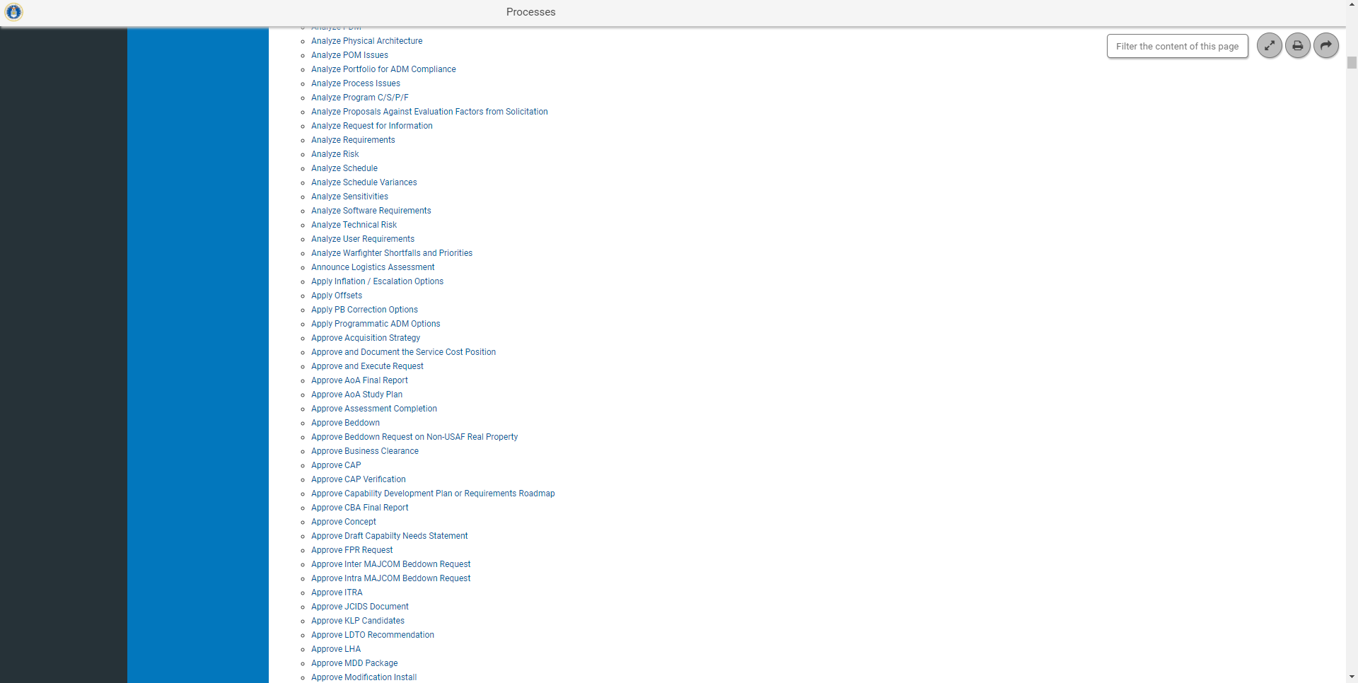
Processes List View
Click to go to a diagram for Approve Acquisition Strategy

Slide 33
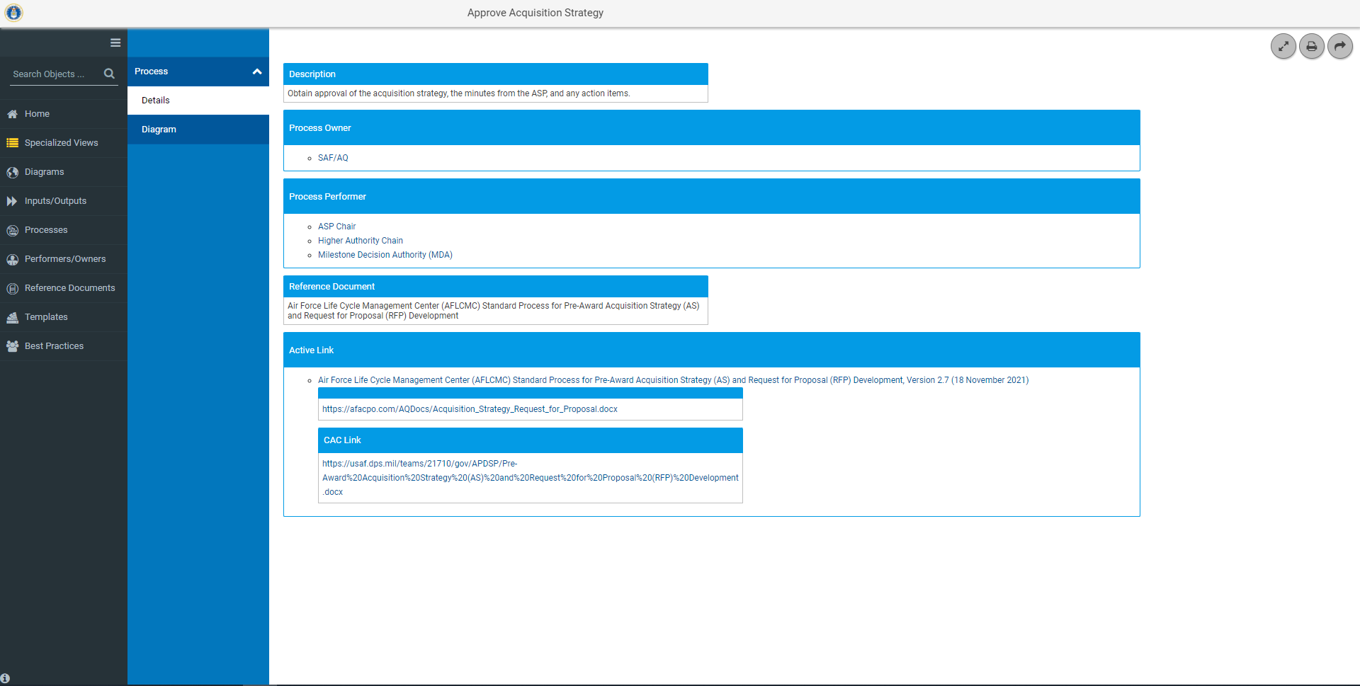
Processes Grid/List View Details
Name of the Process
Documented description for the purpose of the process
Organization(s) with the authority for the execution of the Process
Organization(s) or person(s) responsible for the execution of the process
Document that describes the process
Web address of the reference document
Details provides all metadata associated with a process

Slide 34
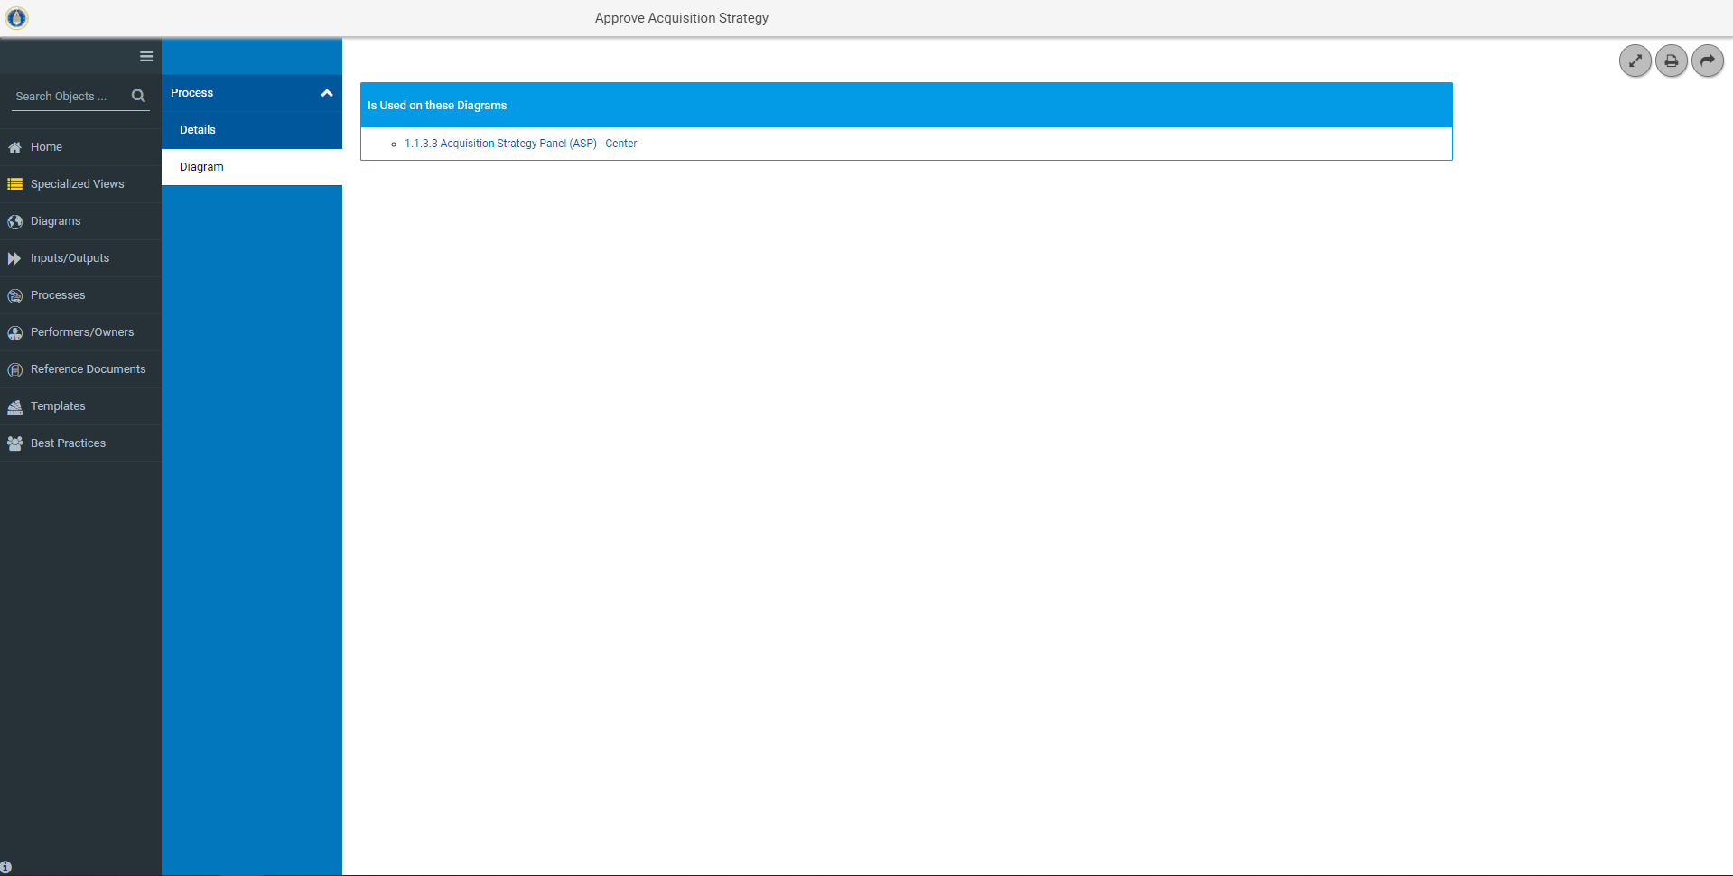
Processes Grid/List View Location
Link to Diagrams that use this process

Slide 35
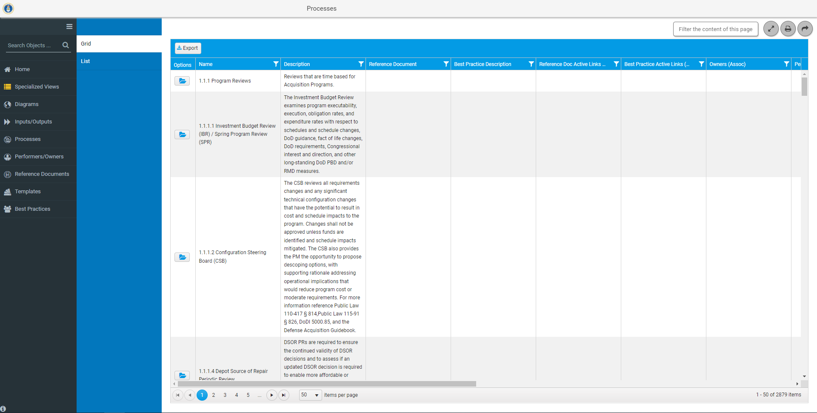
Search and Export
Search
Process metadata is exportable to Excel (with or without search criteria)
Focused Search

Slide 36
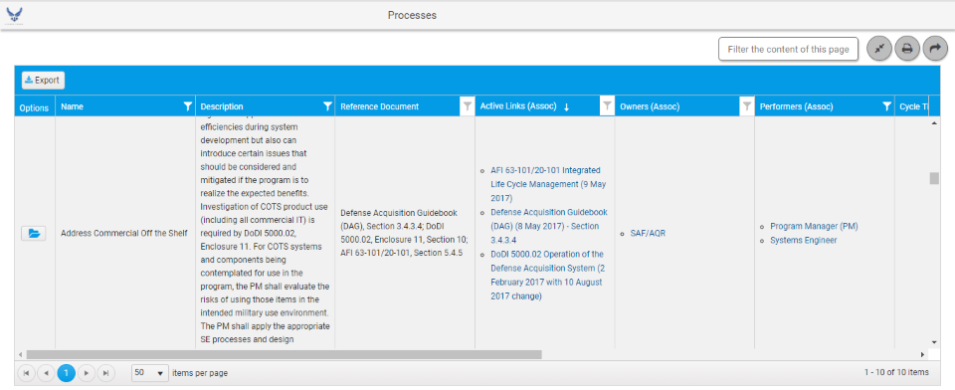
Focused Search
Focuses the search on selected metadata (columns). Allows search on one or multiple columns. Two columns (Description and Reference Document) allow searches on up to two conditions with the and/or option

Slide 37
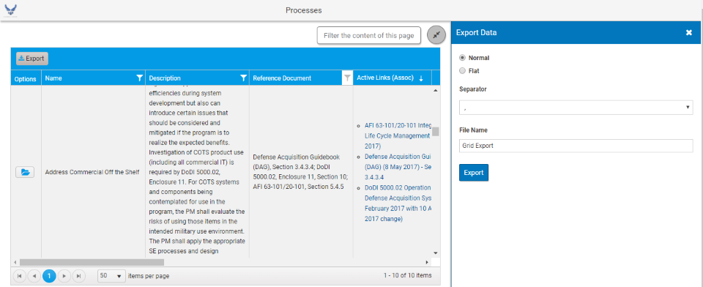
Export
Defaults to comma, Do not change
Name the file
Creates a CSV File in Excel
Notes:
Either open or save file.

Slide 38
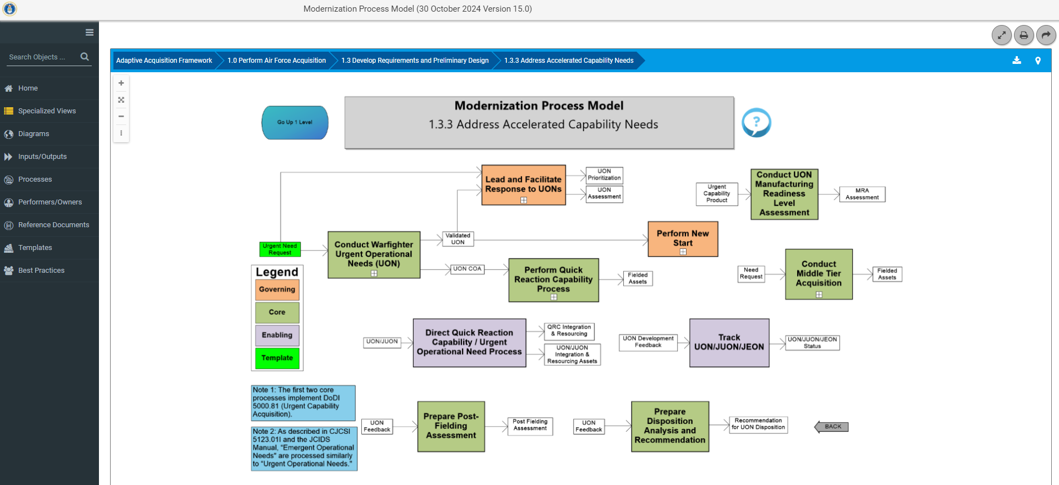
Breadcrumb
Shows the pages you have visited in the model

Slide 39
Links to Access the MPM
Direct MPM Link – afacpo.com
AF Portal – www.my.af.mil
Option under the Acquisition section of Quick Links
External Air Force Acquisition Page - ww3.safaq.hq.af.mil
Option under the Featured Links
Common Portal Environment-https://pmrt.altess.army.mil/pmrt/login.jsp
Links to MPM are located on ACE sites-AFLCMC, Hanscom, Hill, Robins, Space Force, and Tinker

Slide 40
Who Do I Talk To?
If you have questions, comments, or recommendations for improvements
Contact Mr. Brad Ferguson – (720) 333-6707 or brad.ferguson.2@us.af.mil
Contact Allen Farley – (304) 216-6308 or allen.farley@sptrm.com
Contact J.R. Dotson – (304) 641-1181 or john.dotson@sptrm.com
Contact SAF/AQXP – usaf.pentagon.saf-aq.mbx.saf-aqxp-cpi-wkflw@us.af.mil

Slide 41
Backup

Slide 42
Page Navigation Details
Navigate to Parent
Processes
Inputs/Outputs
Plus sign indicates process has tiers below it.
Click on the plus sign to Vertically Navigate the Model
Horizontally Navigate the Model
Notes:
Go up 1 Level- This feature allows the user to go one level up; for example: The page we are currently on is 1.3, the Go Up 1 Level box, will take you back to the 1.0 page.
Process Inputs and/or Outputs- These are the actions that kick off or follow a process step. These inputs/outputs are derived from policy, instructions, etc.
Process Name- This shows up on every page and defines what process you are looking at within the MPM.
Process Step- These process steps are taken from policy, instructions, etc. to lay out the appropriate steps within that particular process. If additional process decomposition details exist, a left click on the process will reveal such detail.
Vertically Navigate the Model-This feature will allow you to navigate down to appropriate process pages.
Horizontally Navigate the Model- This feature will allow you to navigate forward and back to appropriate process pages.

Slide 43
Processes
Process metadata
Click on Select COA to view process details.

Slide 44
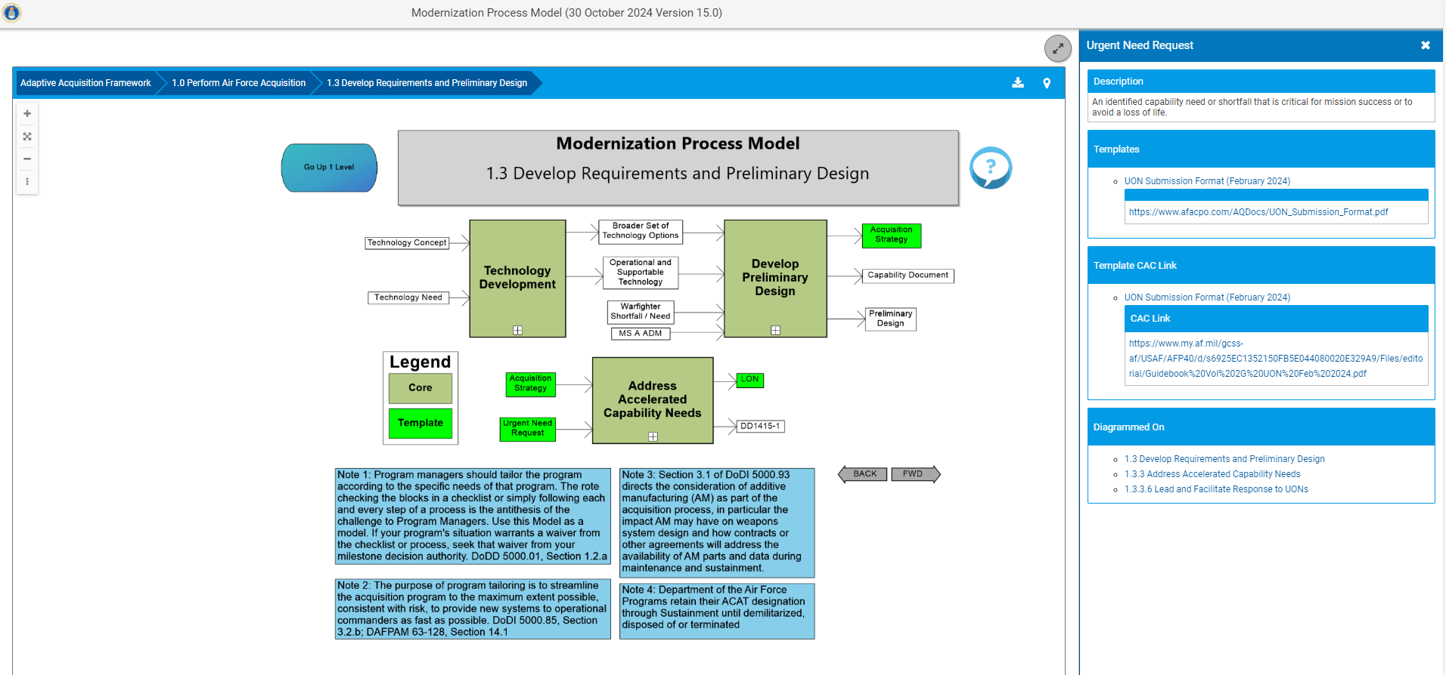
Input / Output Hyperlinks
Click on Urgent Need Request to view details.
Hyperlinks
Inputs/Outputs colored Green indicate a Template
Notes:
Diagrammed On indicates where else in the model Urgent Need Request appears.

Slide 45
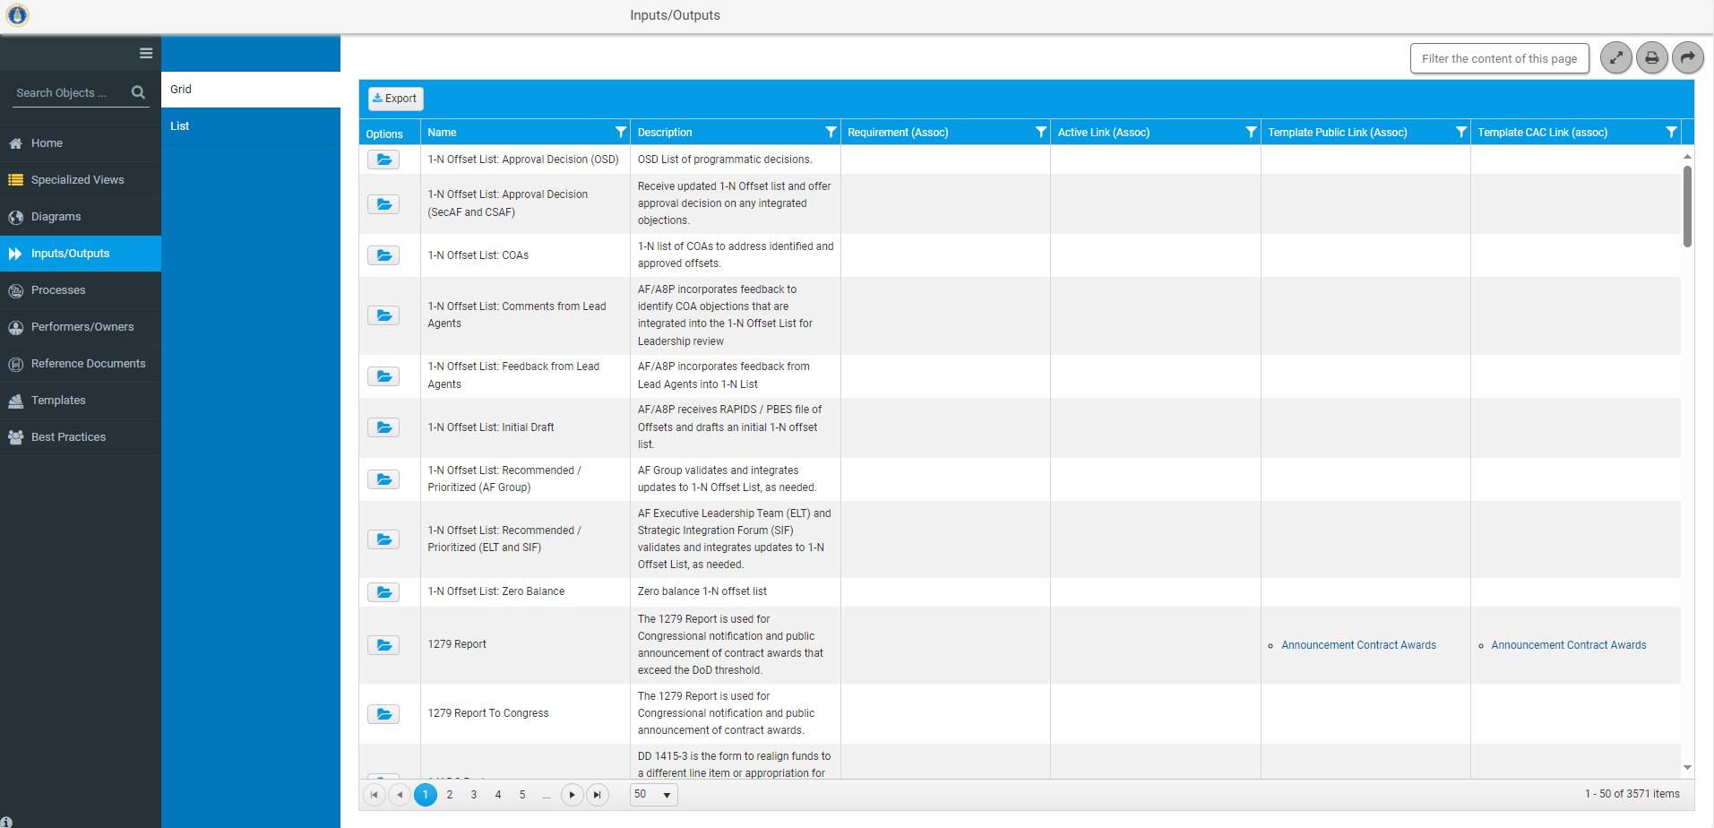
Inputs/Outputs
Click here for the Inputs/Outputs

Slide 46
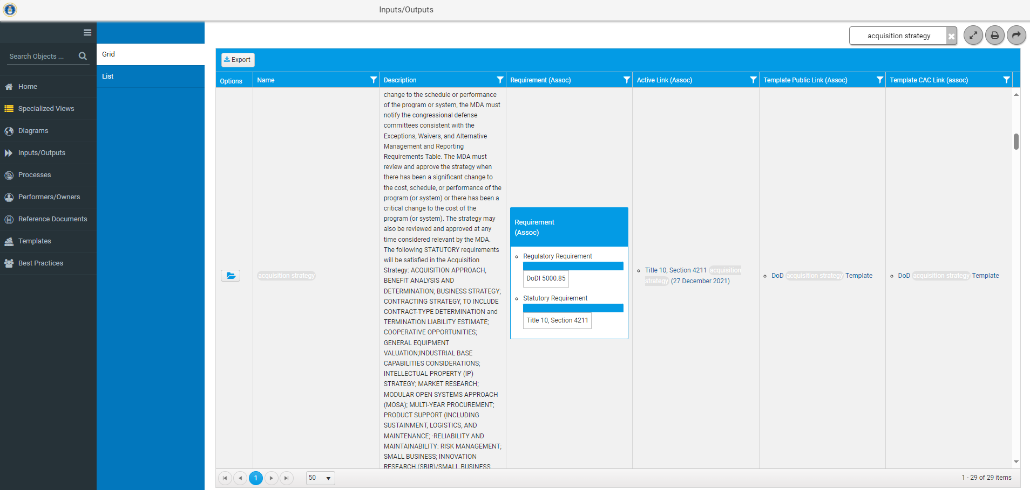
Inputs/Outputs Grid View
Filter for Acquisition Strategy
Click folder for Details of Acquisition Strategy

Slide 47
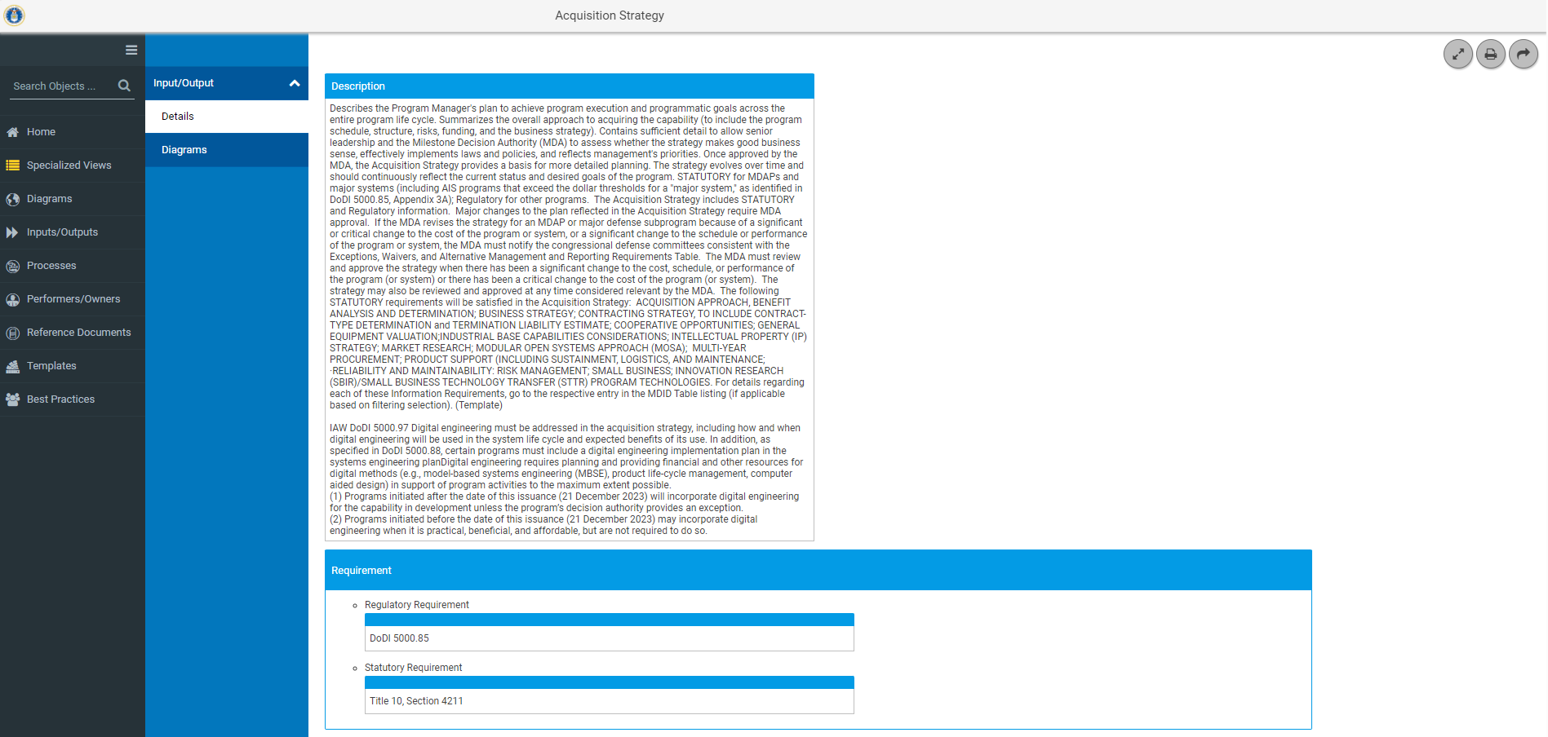
Inputs/Outputs Details
Description of Acquisition Strategy
Reference Documents that Govern Acquisition Strategy
Details provides all metadata associated with an Input/Output

Slide 48
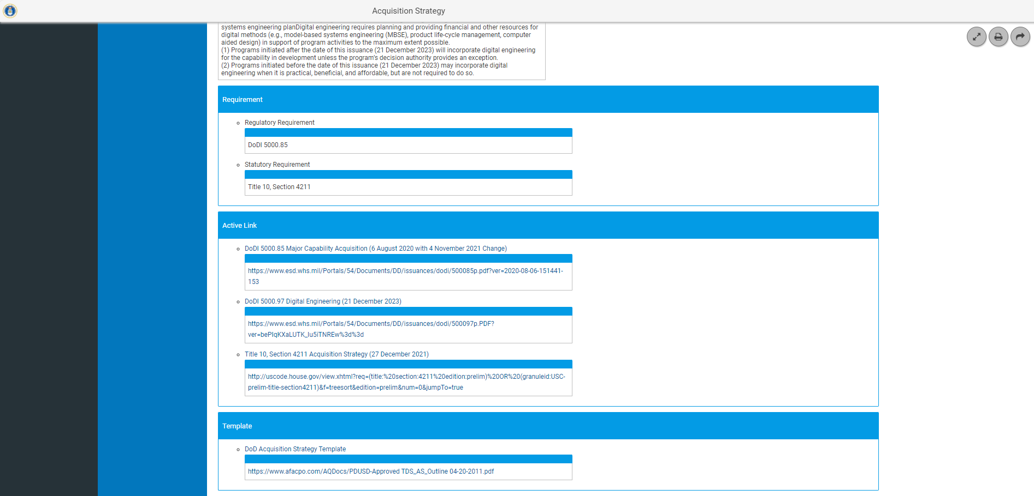
Inputs/Outputs Details-Continued
Reference Documents that Govern Acquisition Strategy
Link to Reference Documents
Link to Acquisition Strategy Template
Details provides all metadata associated with an Input/Output

Slide 49
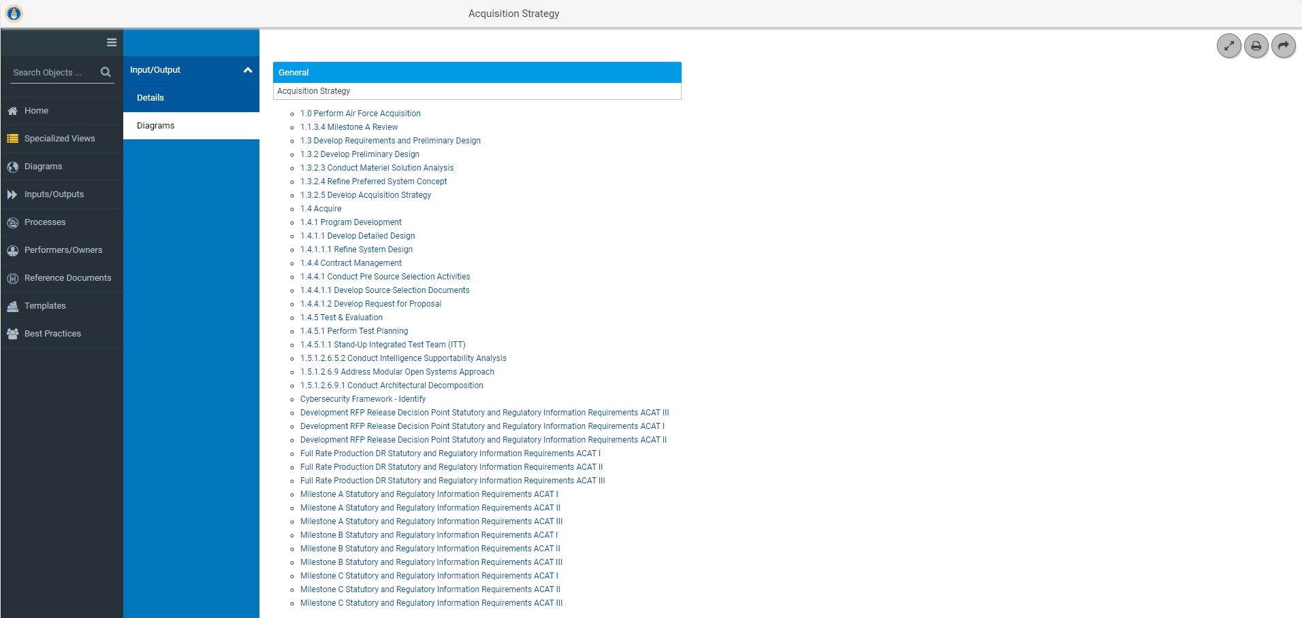
Inputs/Outputs Diagrams
Link to the Diagrams that use Acquisition Strategy as an input/output

Slide 50
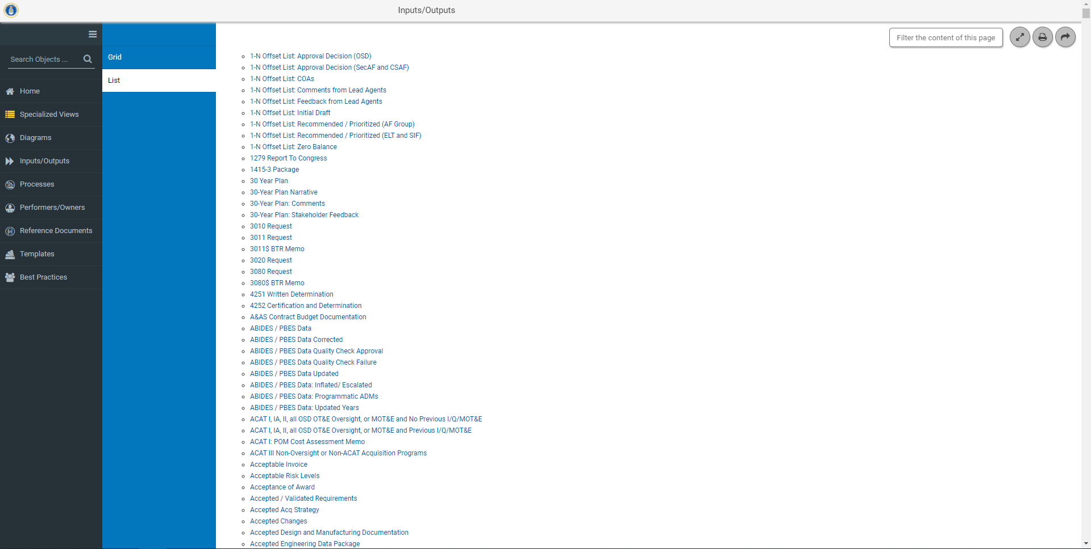
Inputs/Outputs List View
Click to view the details of 30 Year Plan

Slide 51
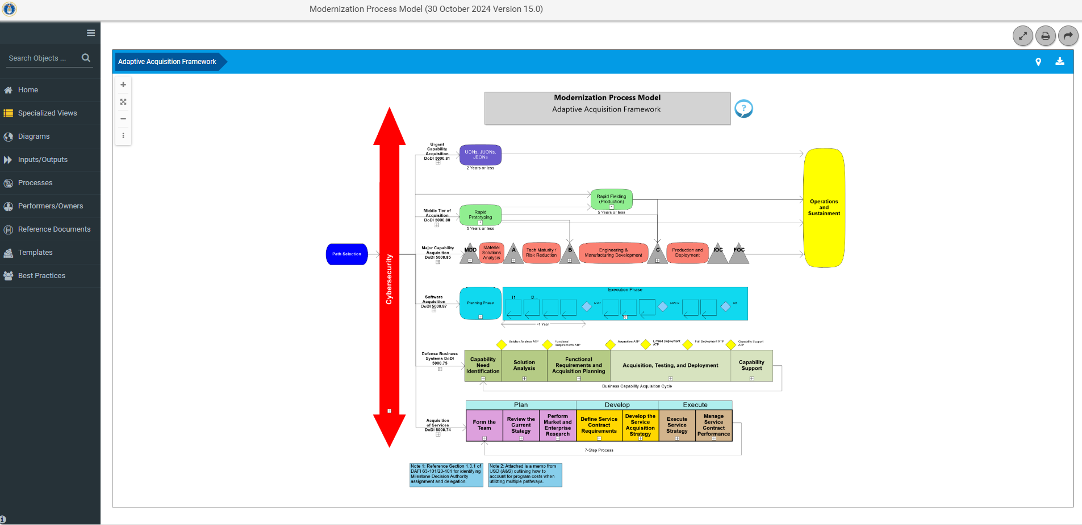
Performers/Owners
Click here for the Performers/ Owners

Slide 52
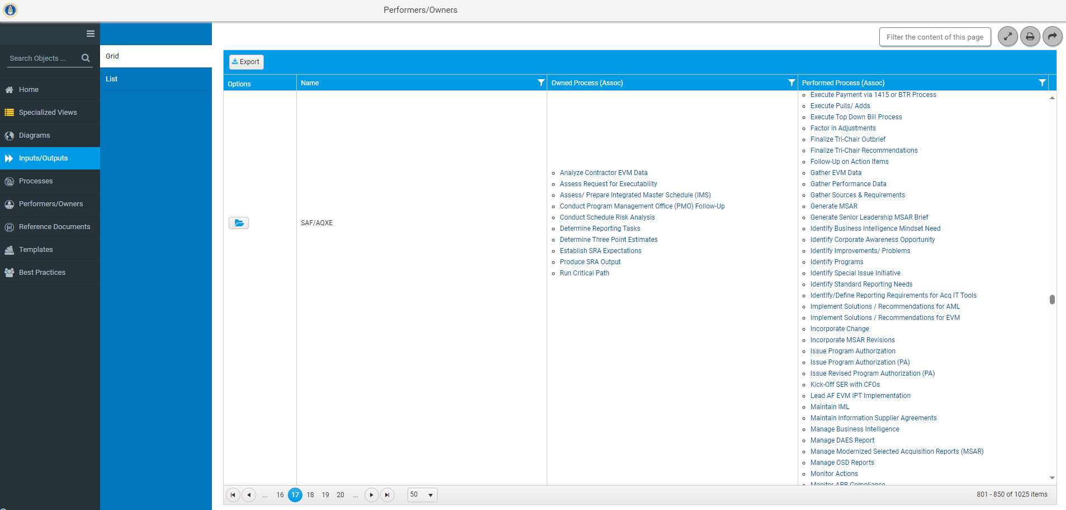
Performers/Owners Grid View
Processes for which SAF/AQXE is an owner
Processes for which SAF/AQXE is a performer
Click on folder for details on SAF/AQXE

Slide 53
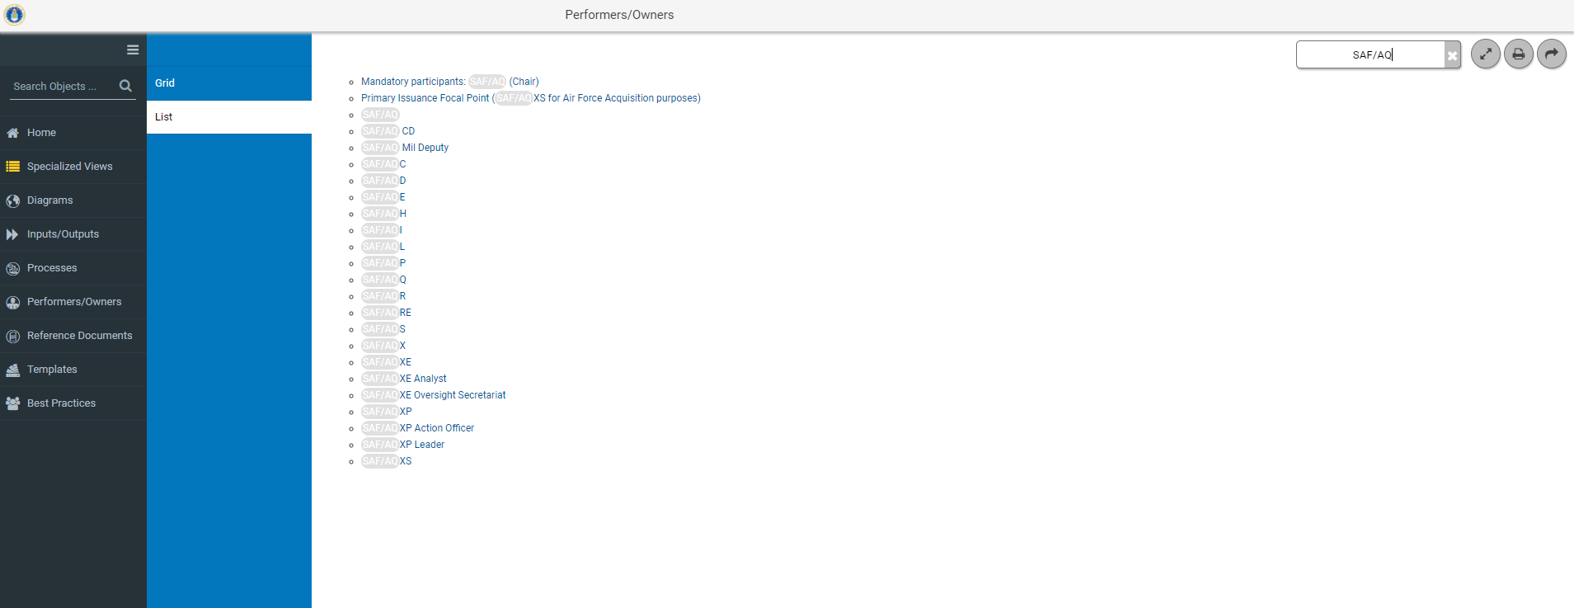
Performers/Owners List View
Use the filter function using SAF/AQX to filter the list
Click on SAF/AQXE to view details

Slide 54
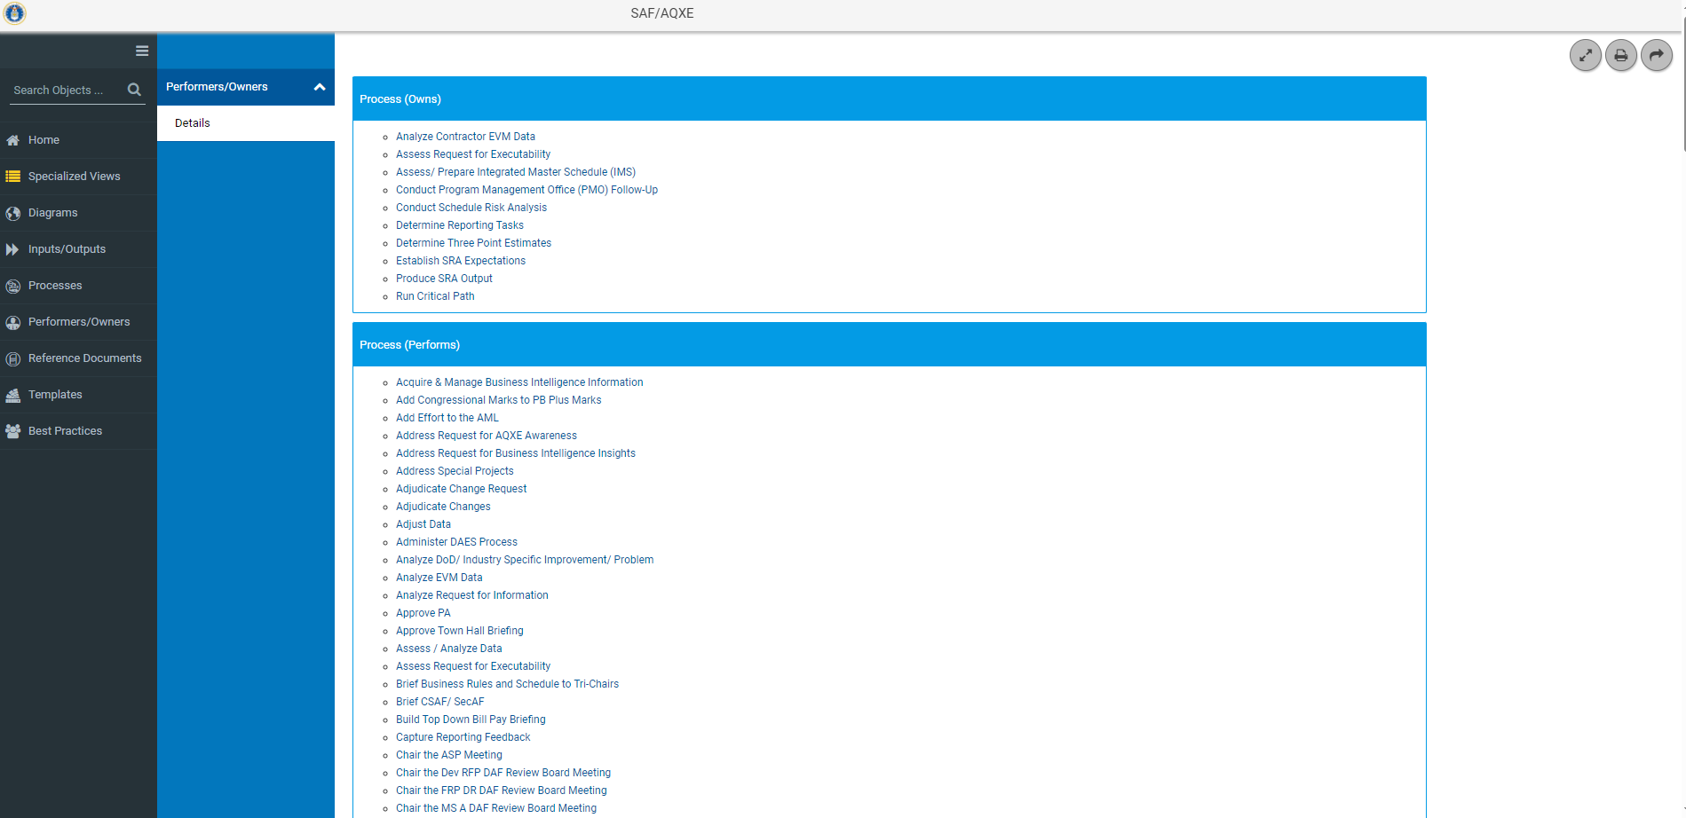
Performers/Owners Details
Provides a list of the Activities that SAF/AQXE Owns.
Link to Details and Diagram for Conduct Schedule Risk Analysis
Provides a list of the Activities that SAF/AQXE Performs.

Slide 55
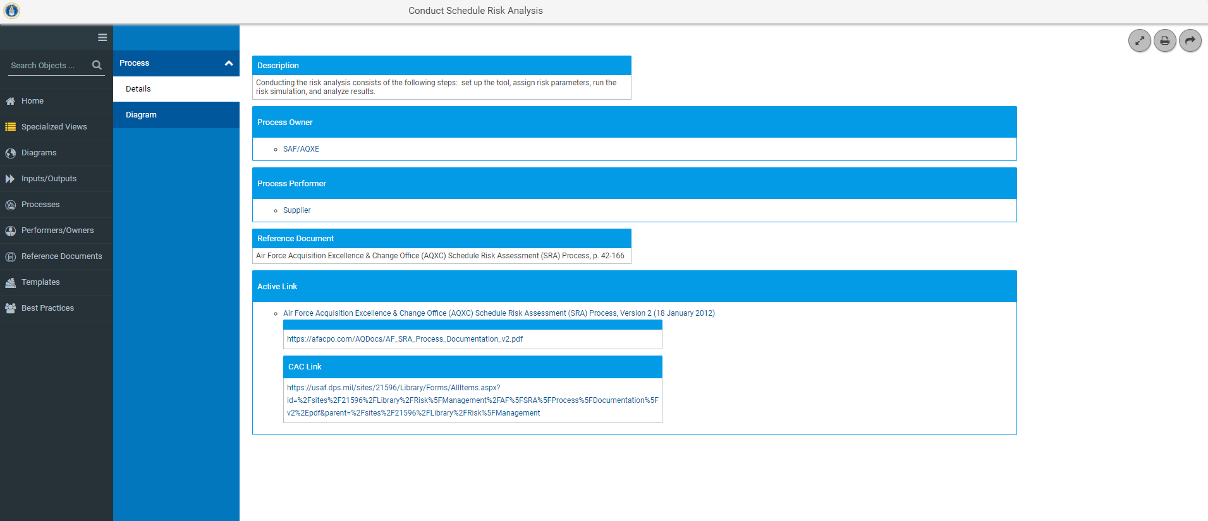
Performers/Owners Details
Metadata for Conduct Schedule Risk Analysis

Slide 56
Performers/Owners Details
Link to Diagram where Conduct Schedule Risk Assessment shows as a Process

Slide 57
Reference Documents
Click here for the Reference Documents
Notes:
Provides a link to all the reference documents used throughout the model. Two views either Grid View or List View

Slide 58
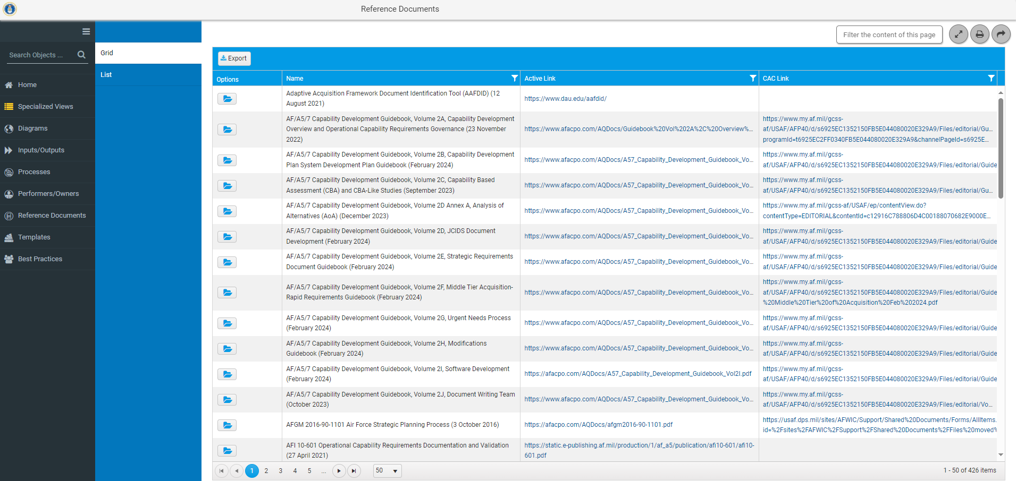
Reference Documents Grid View
Active Link provides a link to the reference document.
CAC Link provides a link to the reference document if its behind a Firewall. This is to ensure the user has the most current document.
Click on folder to view details on AF/A5/7 Capability Development Guidebook
Notes:
Options field opens additional detail regarding the reference document.
Source URL provides link to the Reference document

Slide 59
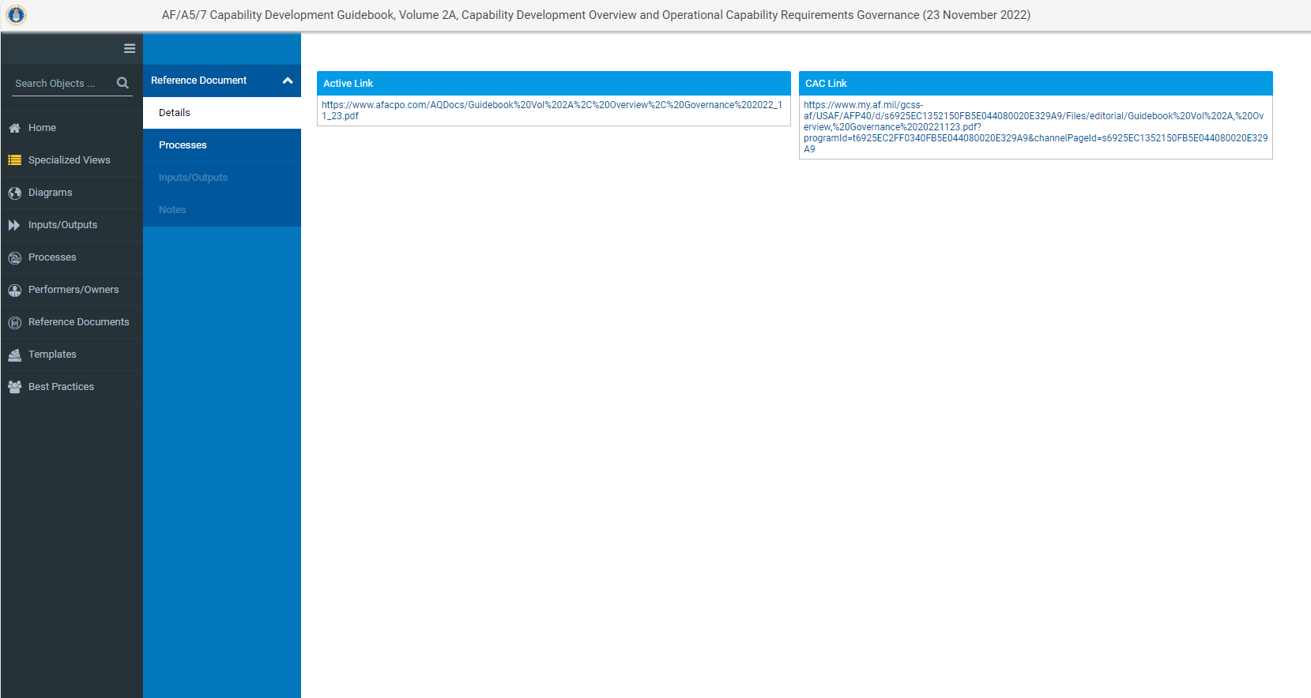
Reference Document Details
Name of Reference Document
Source URL provides a link to the reference document.

Slide 60
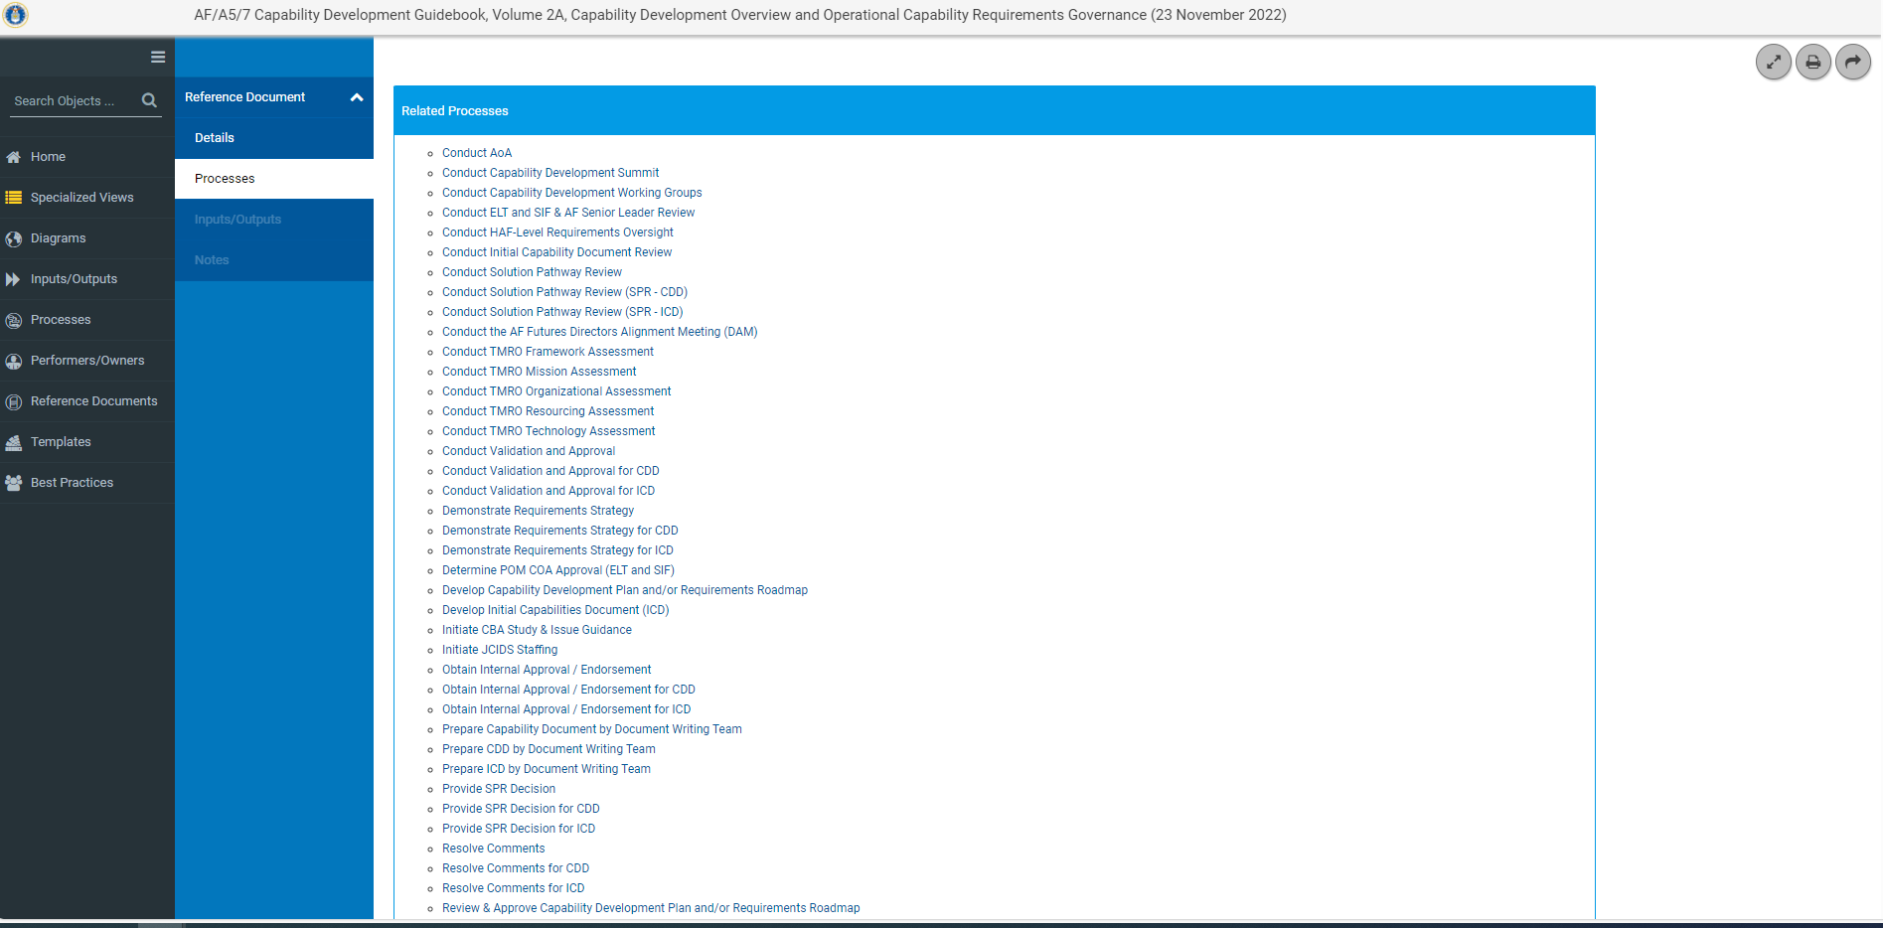
Reference Documents Processes
Identifies Processes and provides a link to details pages for processes in the model that use the AF/A5/7 Capability Development Guidebook as the Reference Document

Slide 61
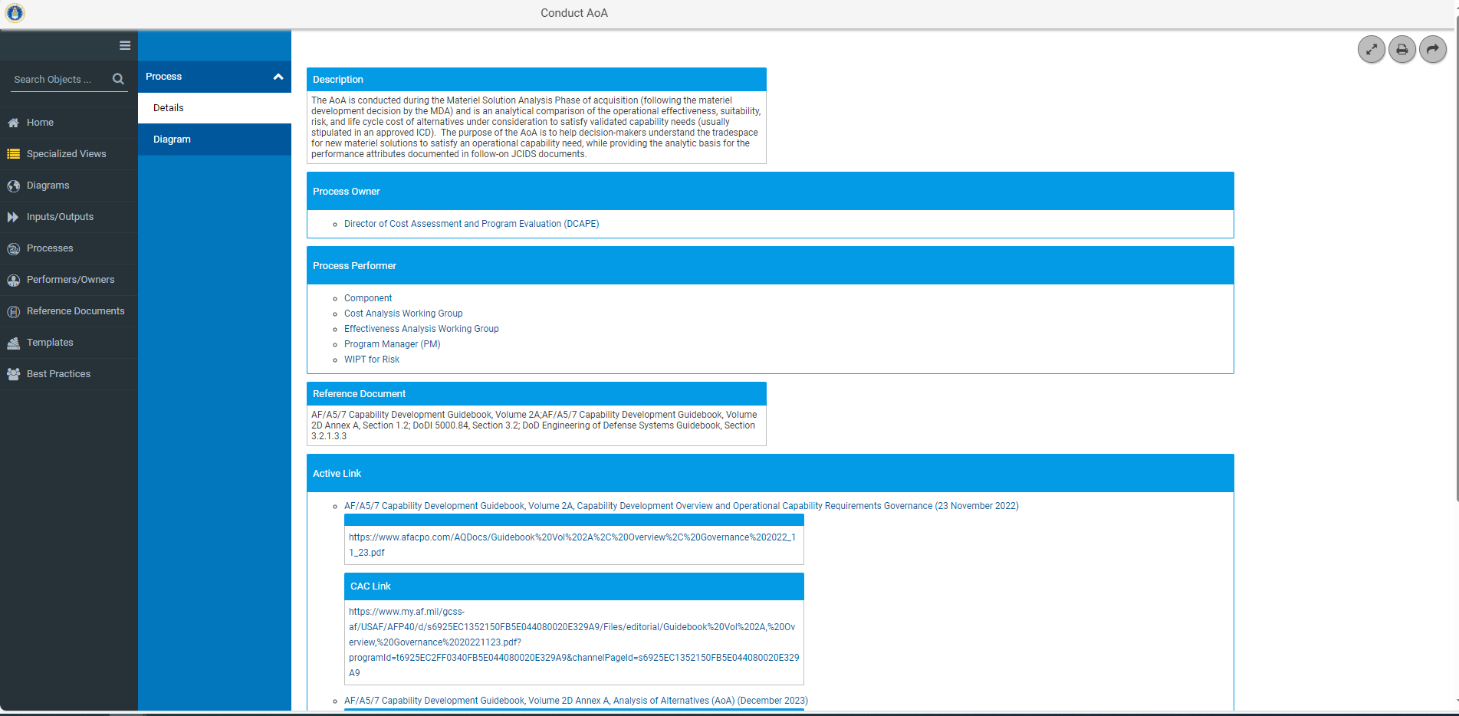
Reference Documents Process Metadata

Slide 62
Reference Documents Process
Link to the Conduct Materiel Solution Analysis Diagram. Conduct AoA is a process in this diagram

Slide 63
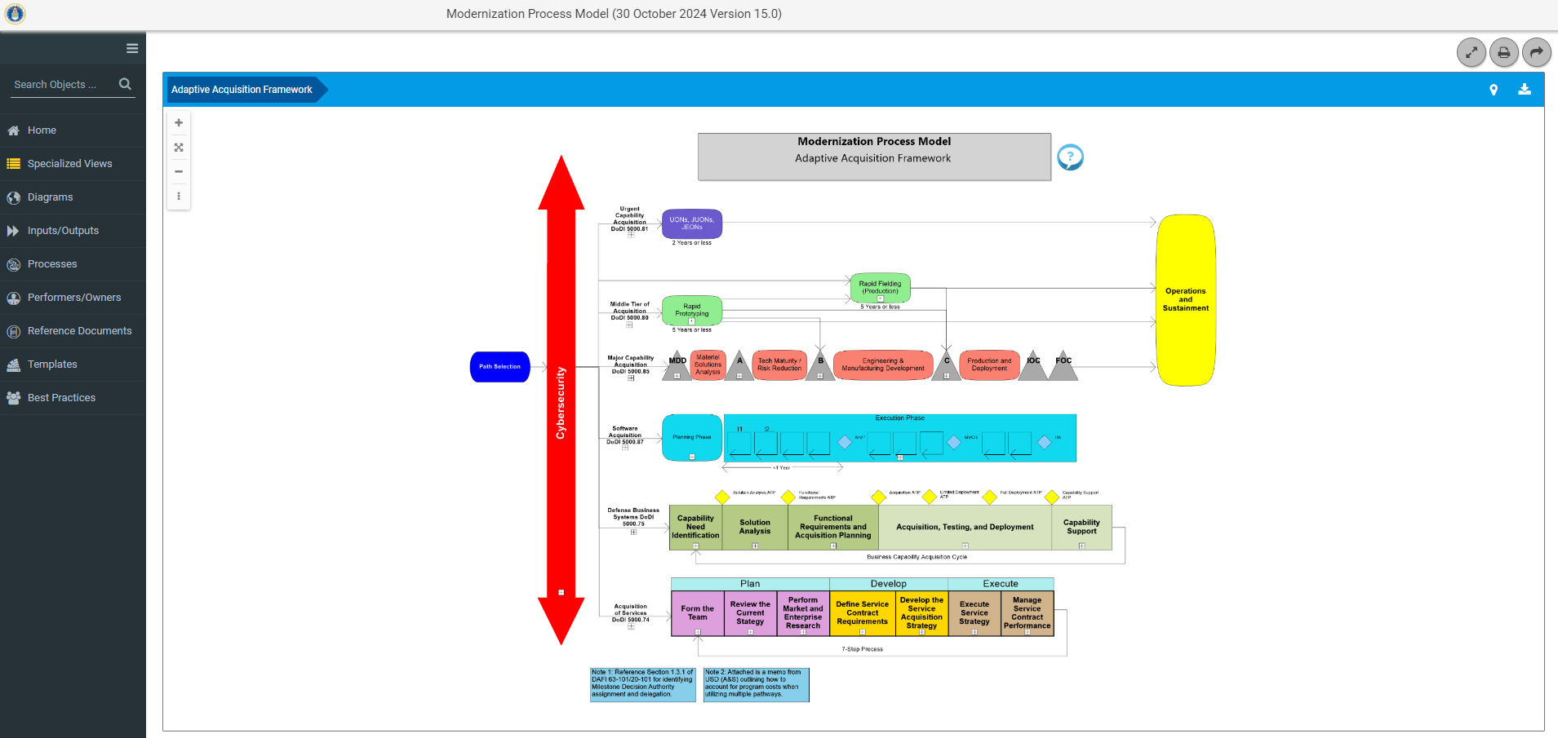
Templates
Click here to go to Templates
Notes:
Templates that are used in the MPM and their location within the model.

Slide 64
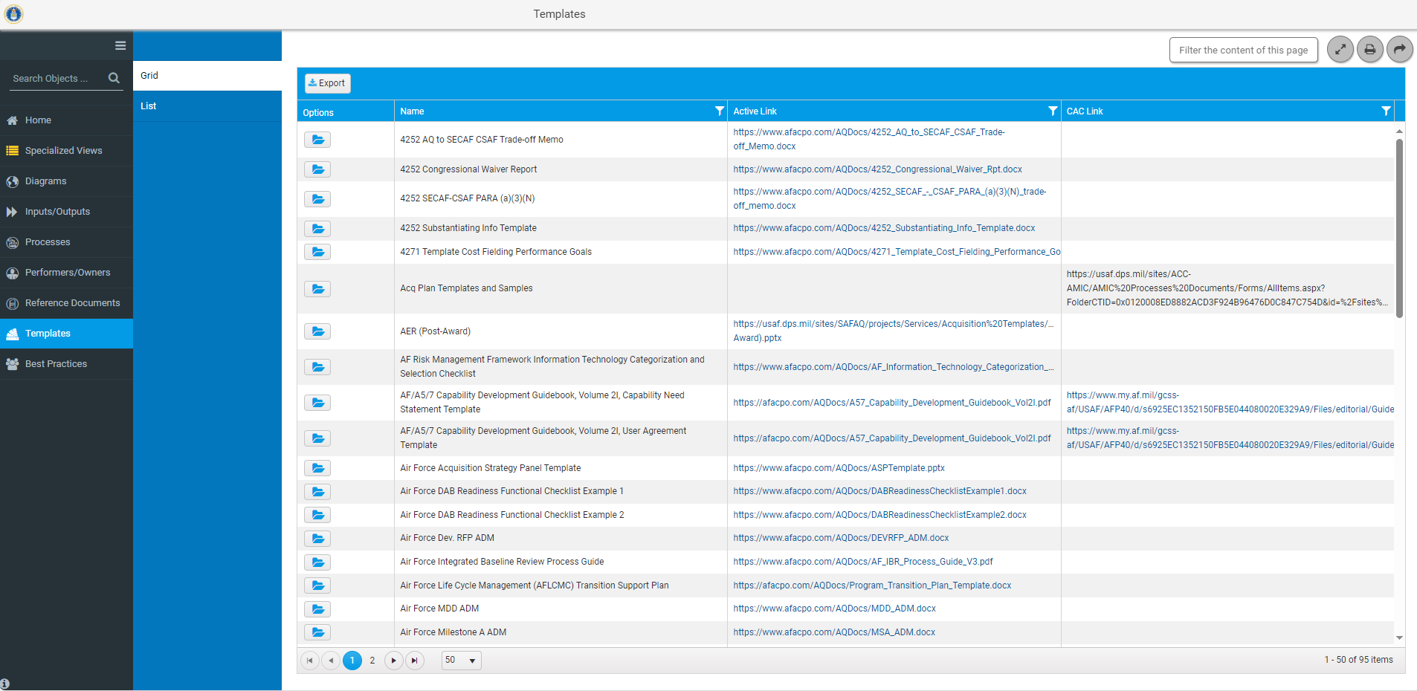
Templates Grid View
Click on Folder to view details and locations of Air Force Acquisition Strategy Panel Template in the MPM.

Slide 65
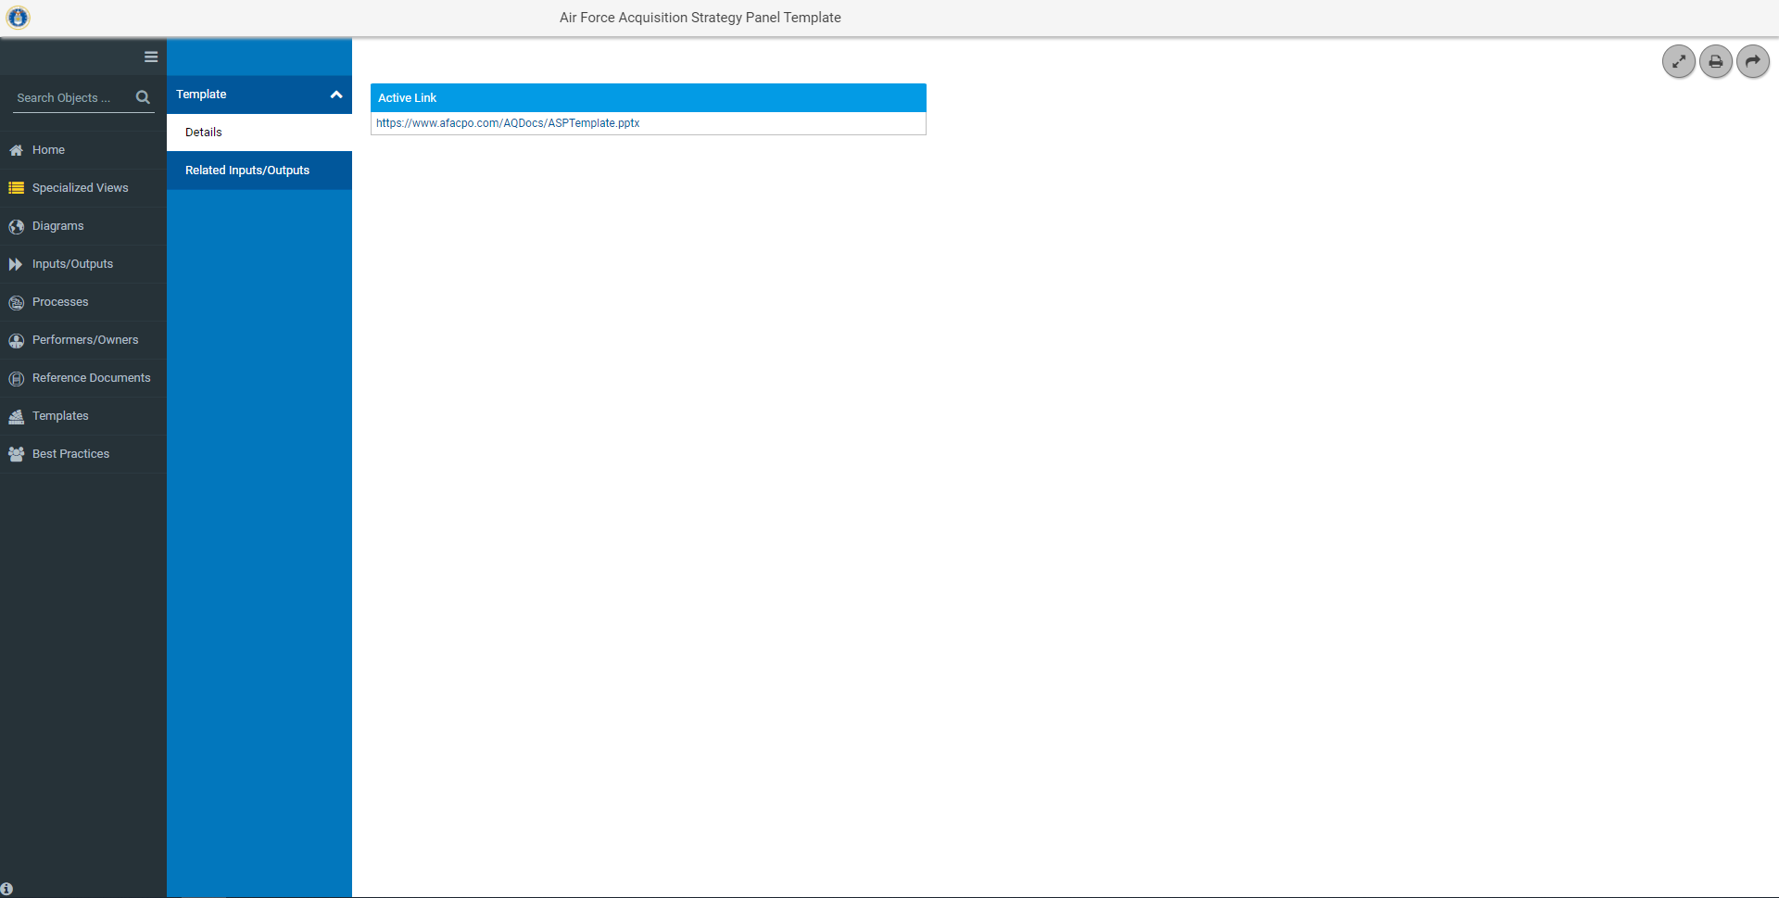
Templates Details
Click here to view the AF Acquisition Strategy Panel Template

Slide 66
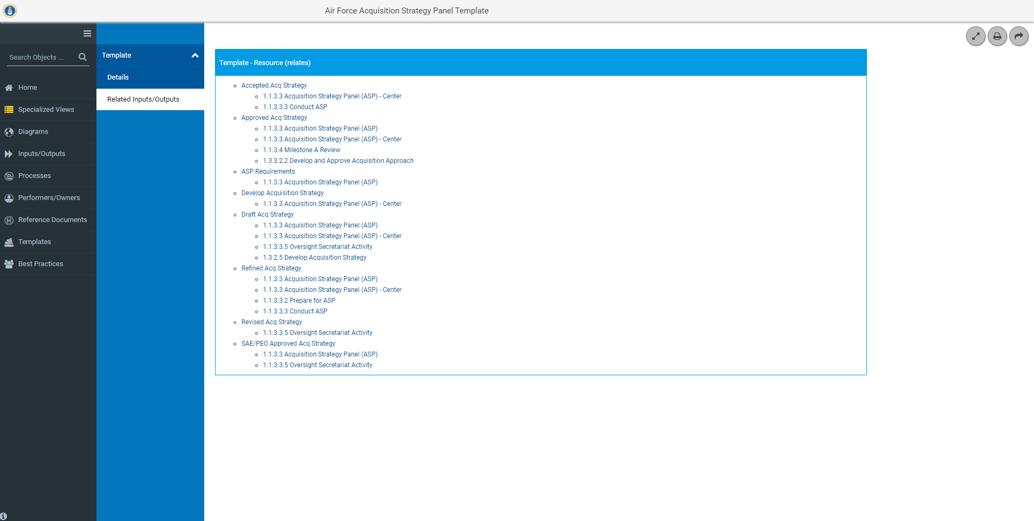
Template Locations
Provides a link to the Inputs/Outputs and the Diagrams they are on

Slide 67
Best Practices
Click here to go to Best Practices

Slide 68
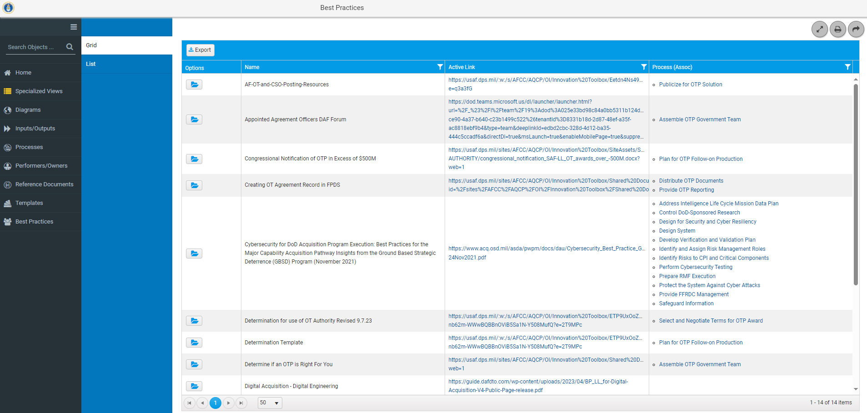
Best Practices Grid View
Hyperlink to the Best Practice Document
Associated processes where you can find the Best Practice

