Slide 1
Acquisition Process Model (APM) Update
SAF/AQXP
April 2024

Slide 2
Update Objectives
Review changes to the APM for DAFI 63-101/20-101
Digital Engineering
MSAR
Other Updates
Address questions and comments

Slide 3
DAFI 63-101/20-101 Overview
Removed acquisition pathway specific guidance
Creation of the United States Space Force
Two DAF Service Acquisition Executives
SAF/AQ is the SAE for DAF non-space programs
SAF/SQ is the SAE for space programs

Slide 4
Approach
Updated the APM in stages
Version 14.0
Updated exist processes already in the APM that referenced AFI 63-101/20-101
Added references to Space Force
Changed processes to appropriate reference documents
Version 14.1 Released 19 April
Additions to the model
Reference to Independent Technical Risk Assessment Guidebook
Added references to DAFI 63-101/20-101 and SD-22 to Diminishing Manufacturing Sources and Material Shortages
Added additional information on Intellectual Property

Slide 5
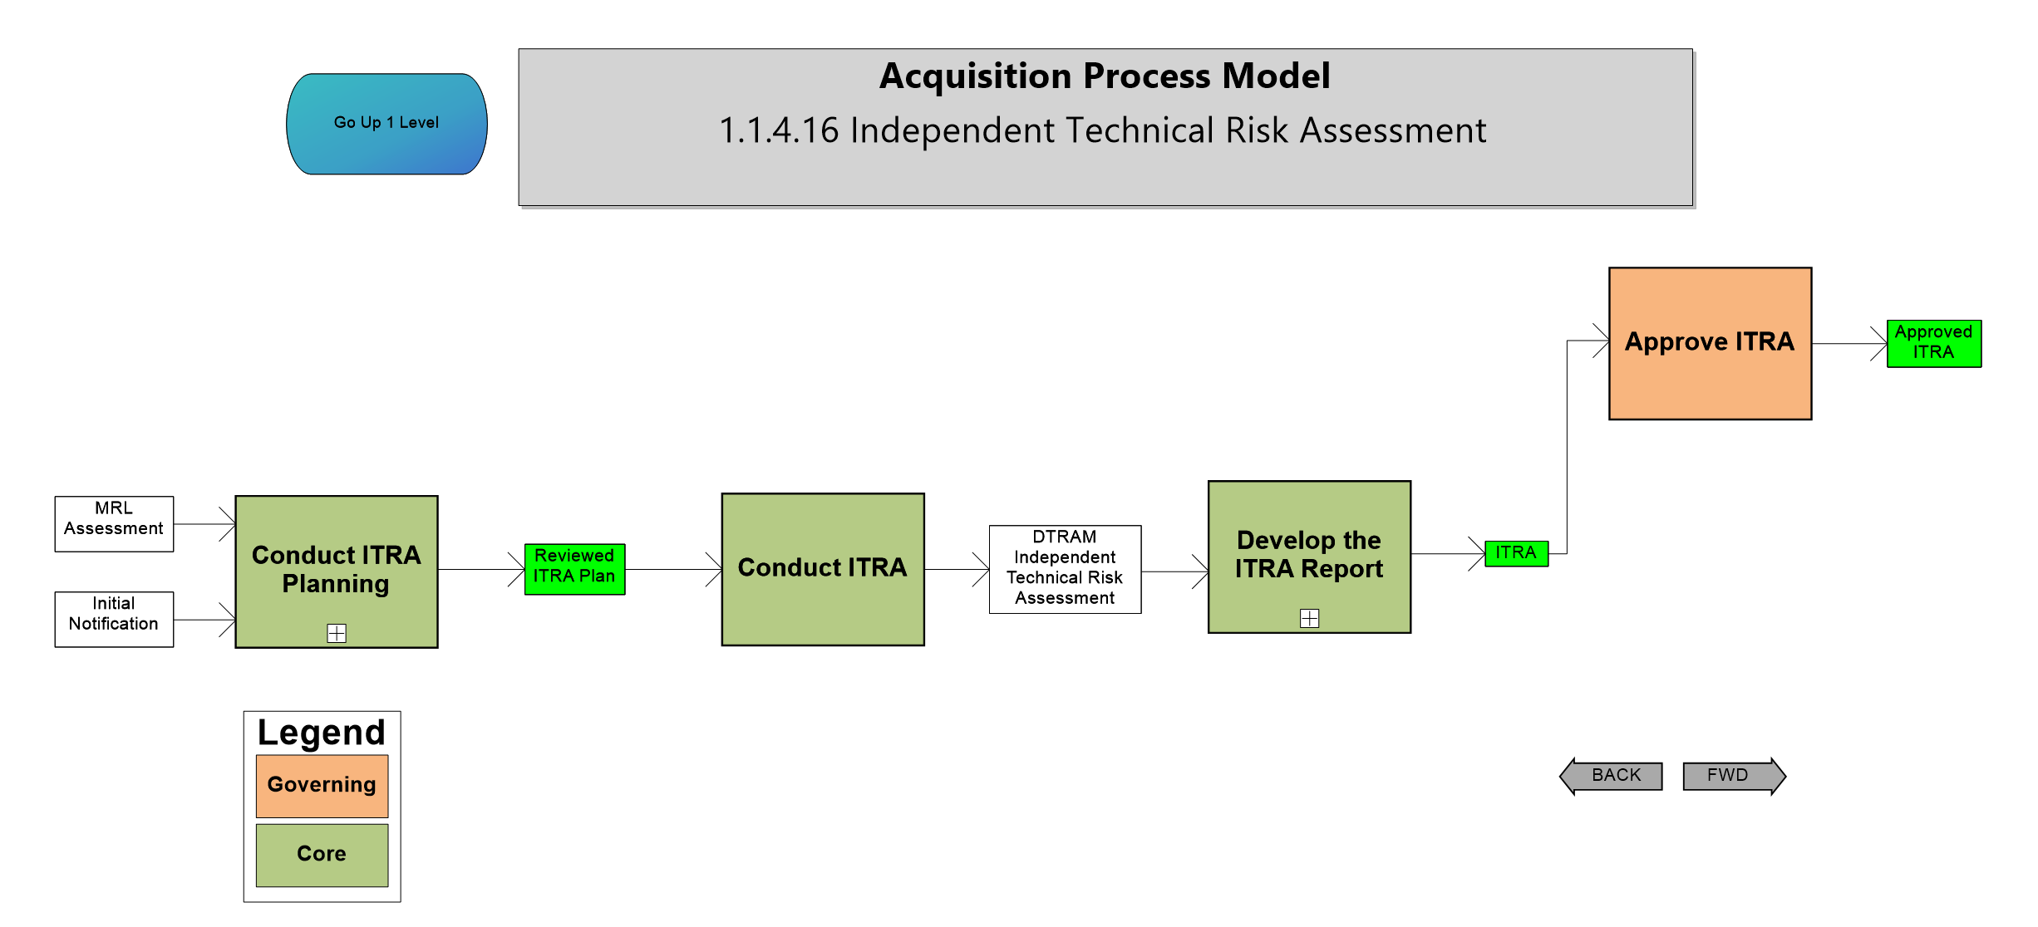
Independent Technical Risk Assessment

Slide 6
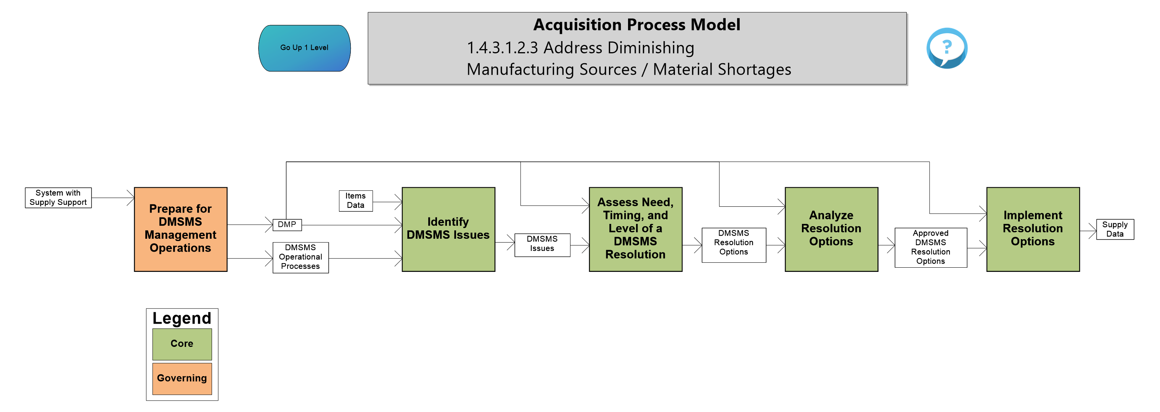
Address Diminishing Manufacturing Sources/Material Shortages

Slide 7
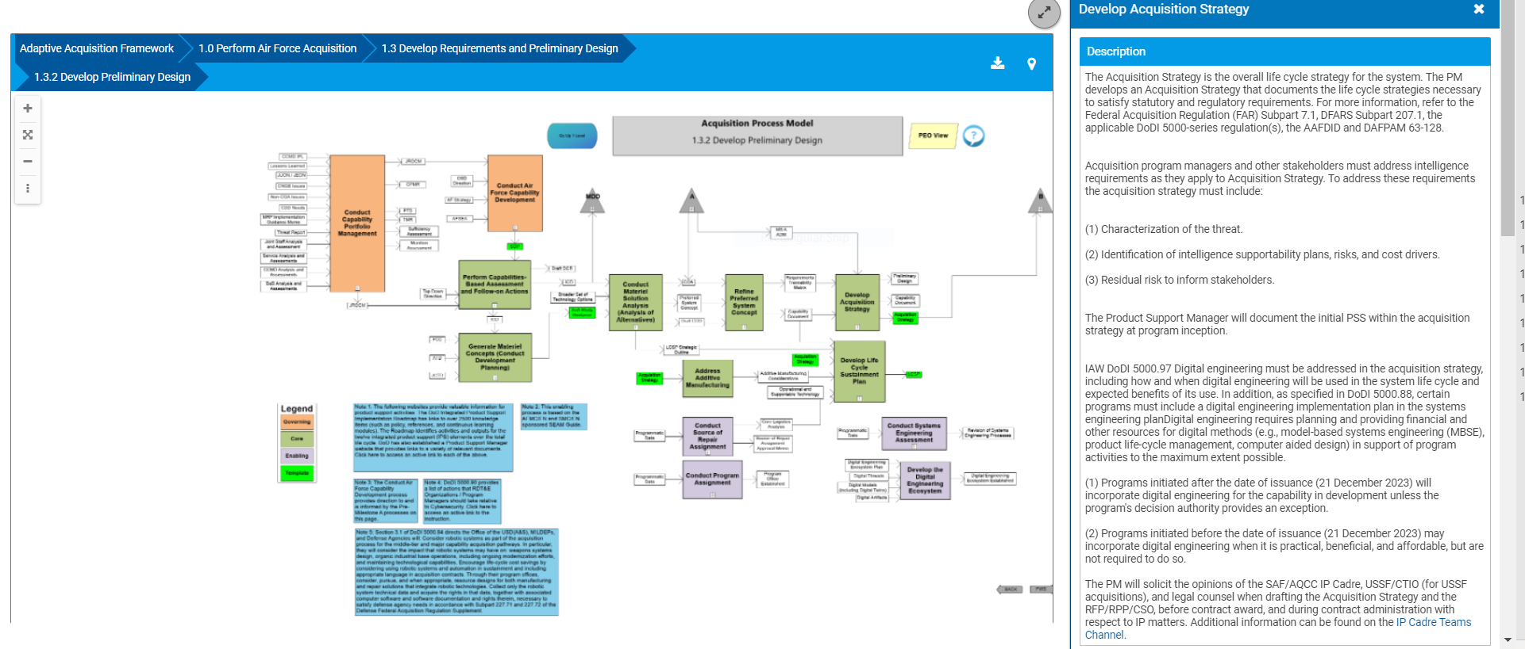
Intellectual Property

Slide 8
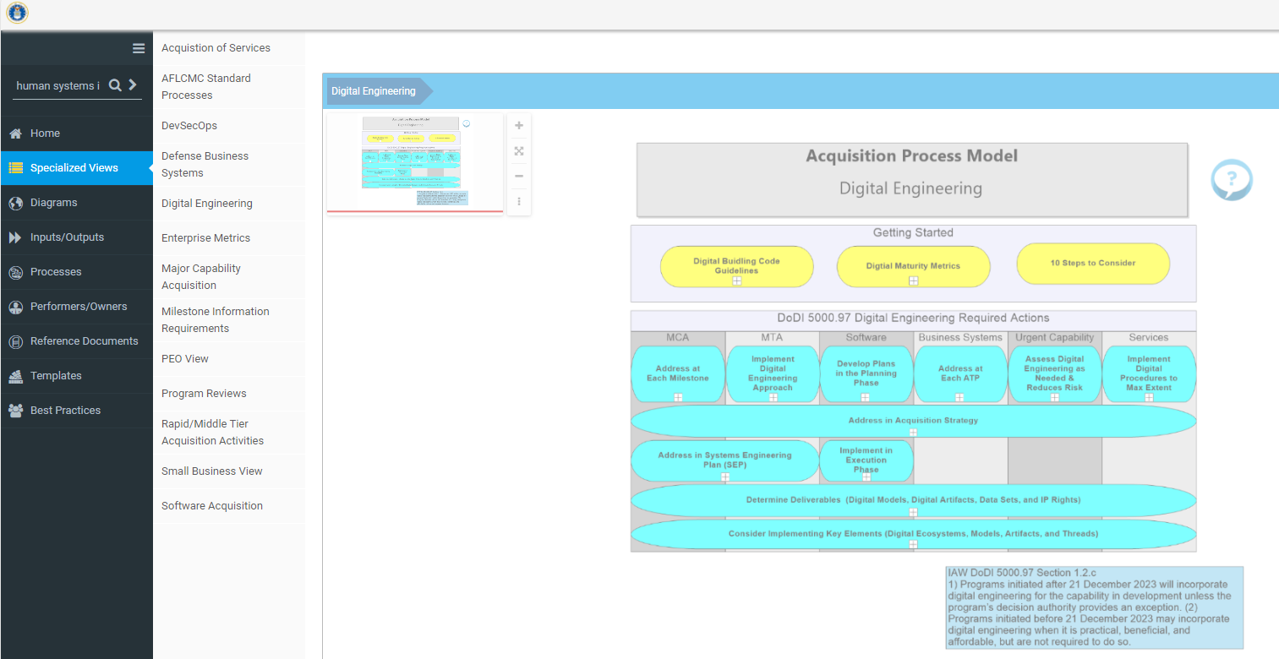
Specialized View – Digital Engineering

Slide 9
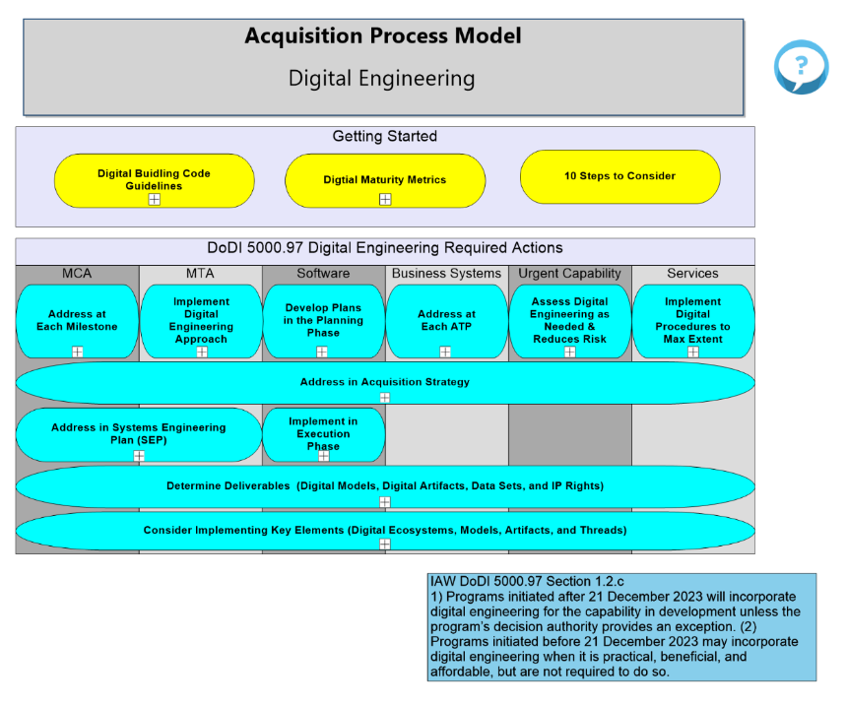
Digital Engineering
Digital Building Code Guidelines
Digital Maturity Metrics
10 Steps to Consider
DoDI 5000.97 Digital Engineering Required Actions
Notes:
2.7c – who is in going to run

Slide 10
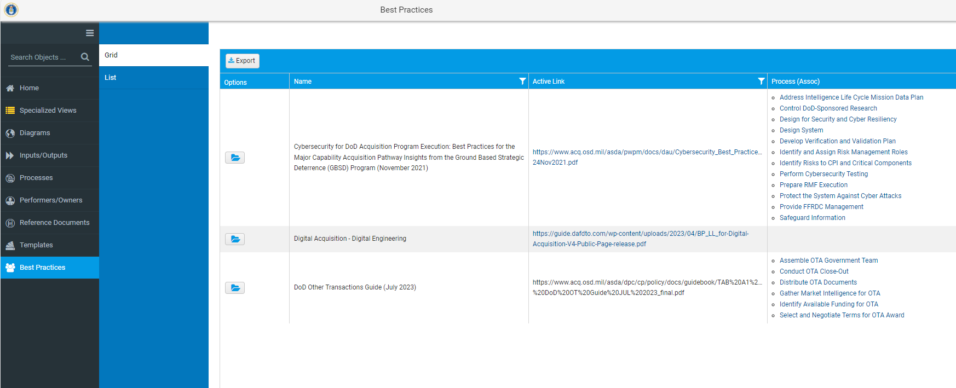
Best Practices – AF Digital Guide (BP/LL)

Slide 11
Modernized Selected Acquisition Report (MSAR)

Slide 12
Other Updates

Slide 13
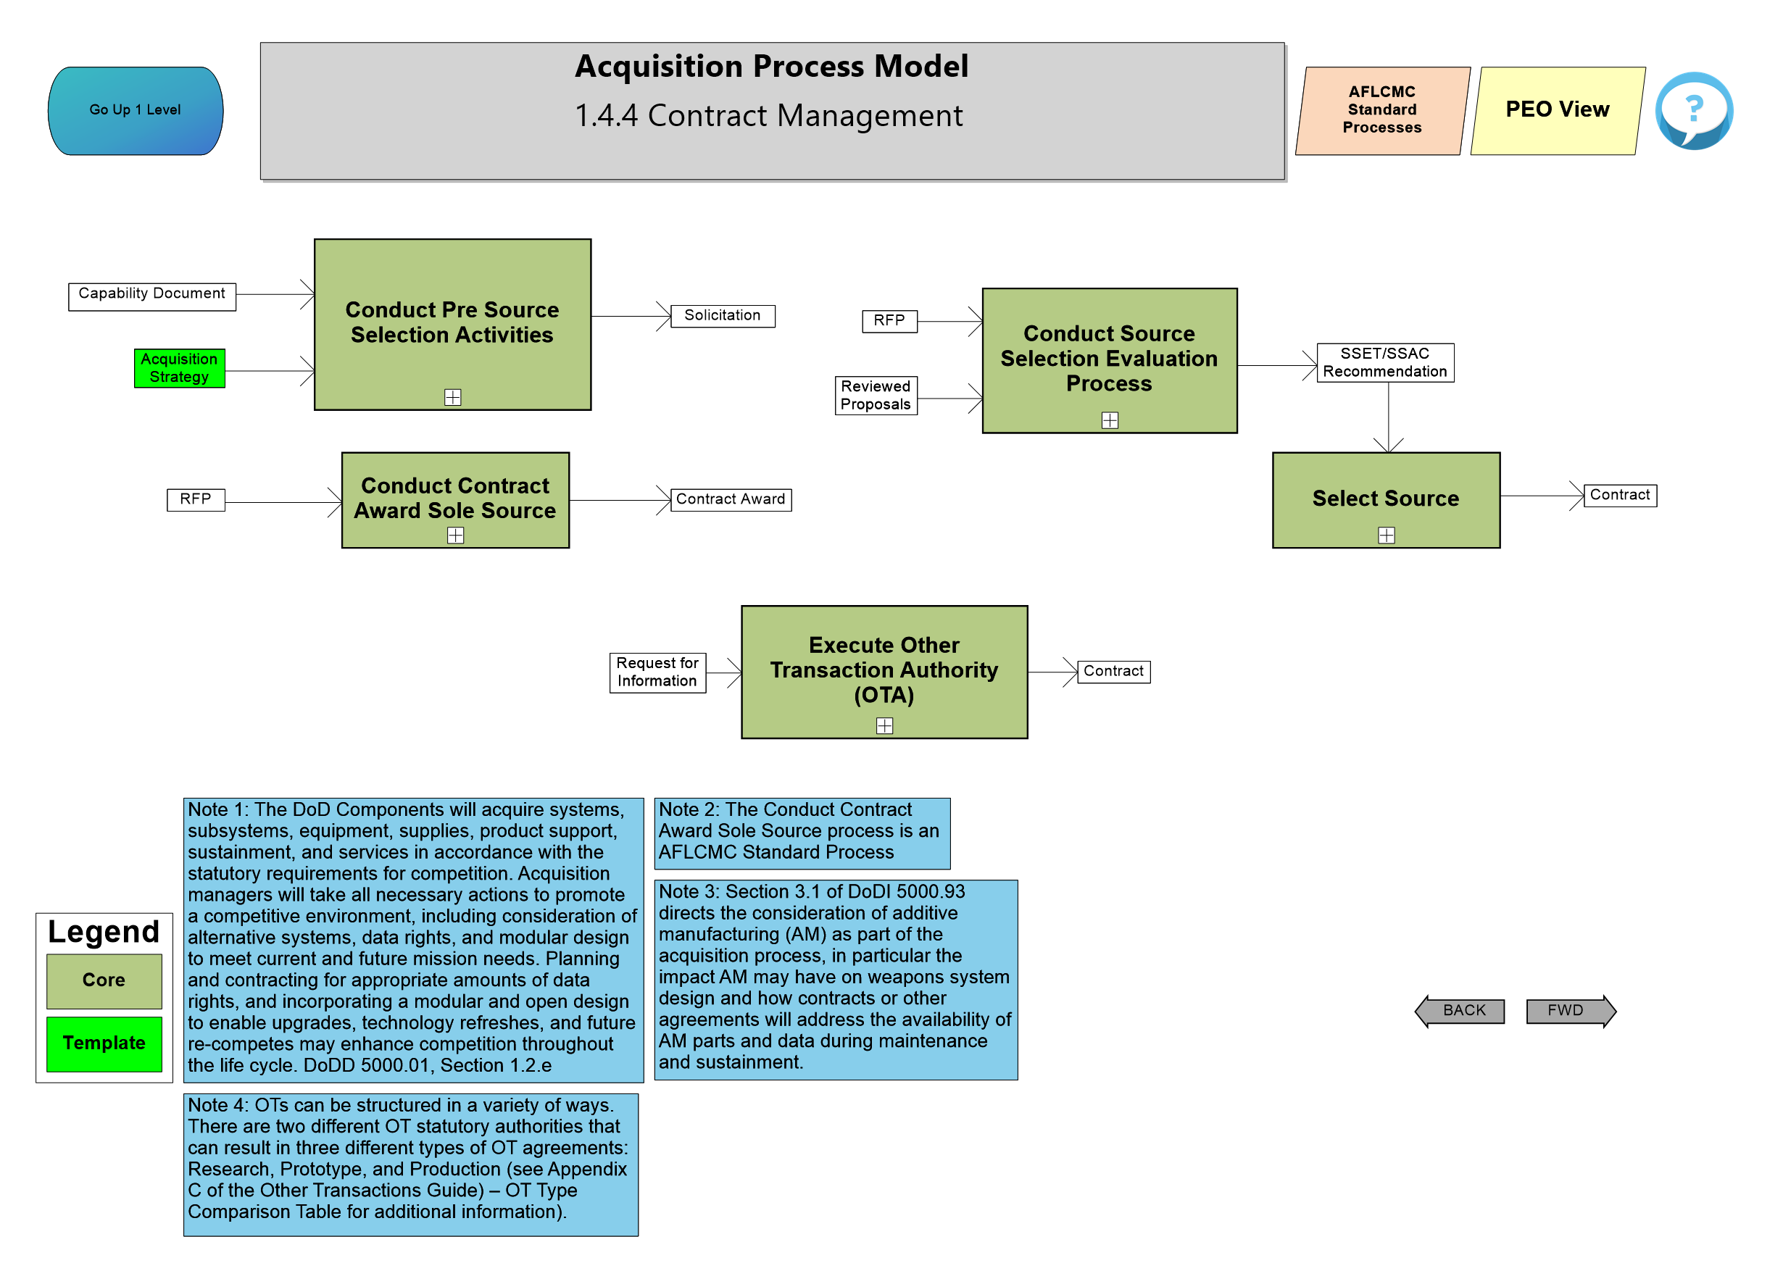
Other Transaction Authority

Slide 14
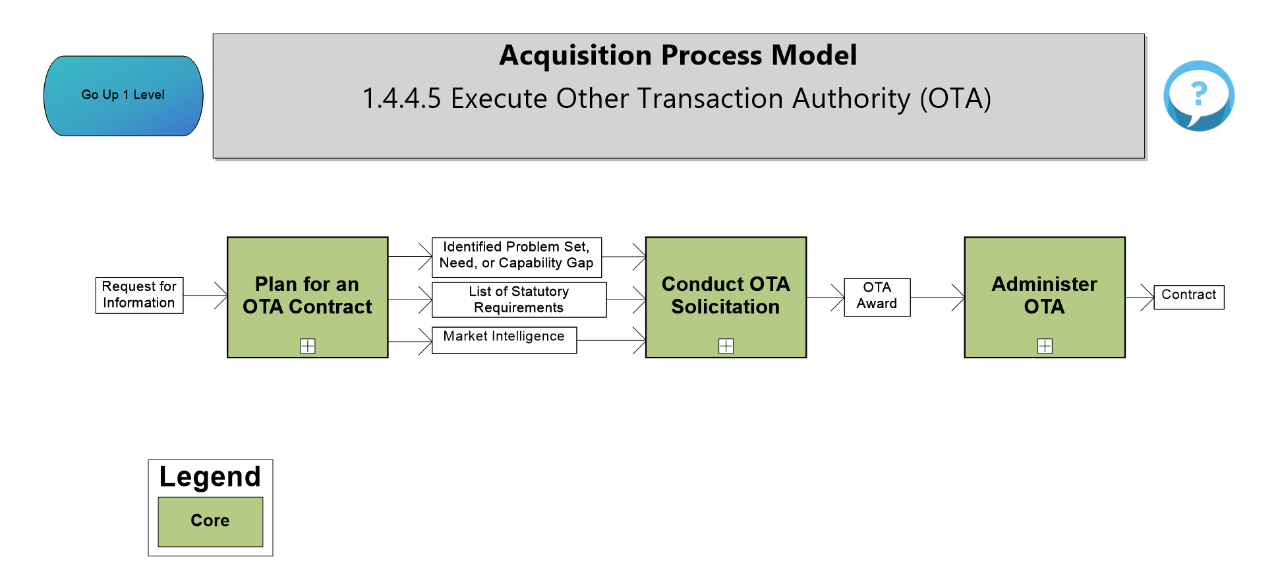
Other Transaction Authority

Slide 15
Upcoming Changes
Incorporating linkages to Acquisition Toolbox
CJCSI 3100.01F
Easier ways to access the Key Areas in the Model

Slide 16
Questions

Slide 17
Who Do I Talk To?
If you have questions, comments, or recommendations for improvements
Contact Mr. Brad Ferguson – (720) 333-6707 or brad.ferguson.2@us.af.mil
Contact Allen Farley – (304) 216-6308 or allen.farley@sptrm.com
Contact J.R. Dotson – (304) 641-1181 or john.dotson@sptrm.com
Contact SAF/AQXP – usaf.pentagon.saf-aq.mbx.saf-aqxp-cpi-wkflw@us.af.mil

