Slide 1
Acquisition Process Model (APM) Familiarization
SAF/AQXP
Notes:
Revised March 2024

Slide 2
Learning Objectives
Understand the purpose of the APM
Understand the process information within the APM
Understand the functionality of the APM
The APM – an integrated process perspective on the “Big A” acquisition process

Slide 3
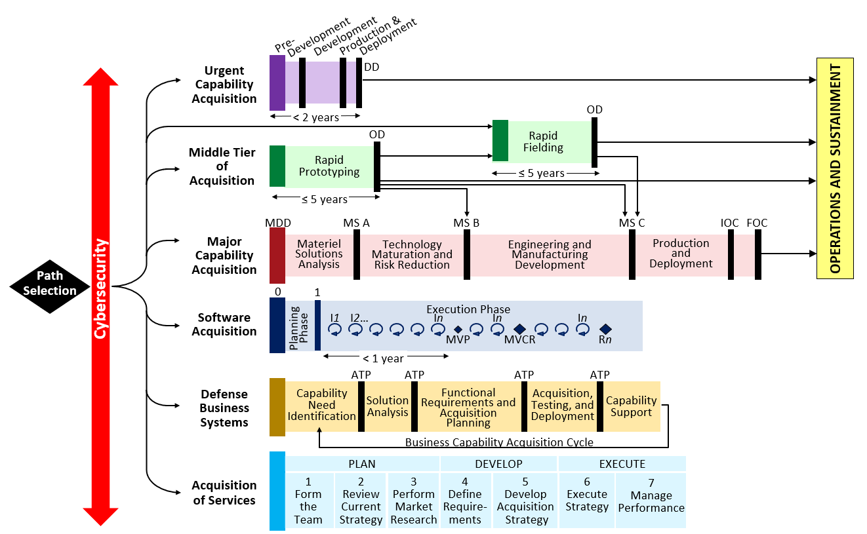
APM Purpose
The APM is the “as documented” process for Big A acquisition
Acquisition
Defense Acquisition System – DoDI 5000.xx, DAFI 63-101/20-101
Requirements
JCIDS Process – CJCSI 5123.01I, JCIDS Manual
Resources
PPBE Process – AFPD 90-6,
SPPBE Playbook
Notes:
. Updated on a continuous basis, the APM provides a variety of benefits
Establish standard definition and activities associated with AF Acquisition
Provide process decomposition from DAE/SAE through PM level actions
Serve as Standard Reference Model for all stakeholders
Provide common context for process improvement initiatives
Provide integration context for other external/related process models
Serves as the process component of the Acquisition Enterprise Architecture

Slide 4
APM Content
The APM incorporates a variety of valuable process perspectives from over 300 sources
Laws & Regulations
Title 10
Federal Acquisition Regulations, DAFFARS, DFARS
Directives and Instructions
DoDD/I 5000.xx
DAFI 63-101/20-101
DoDI 5000.89_DAFI 99-103
Program Manager Guidance
DAFMAN/PAM 63-xxx
Series of Guidebooks
AFLCMC Standard Processes

Slide 5
APM Citations
Institutionalized by SAF/AQ Memorandum on 11 Sept 2016.
Valuable tool to PEOs, PMs and their staffs in obtaining up-to-date acquisition guidance
Visual representation of the processes that programs are required to complete
5

Slide 6
APM Entry Screen

Slide 7
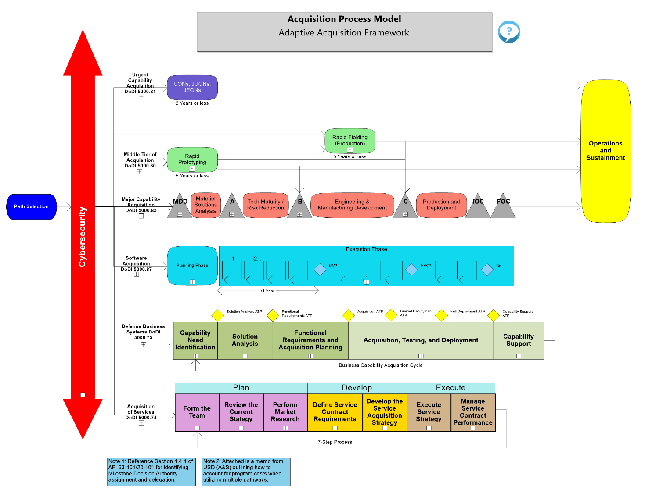
Adaptive Acquisition Framework

Slide 8
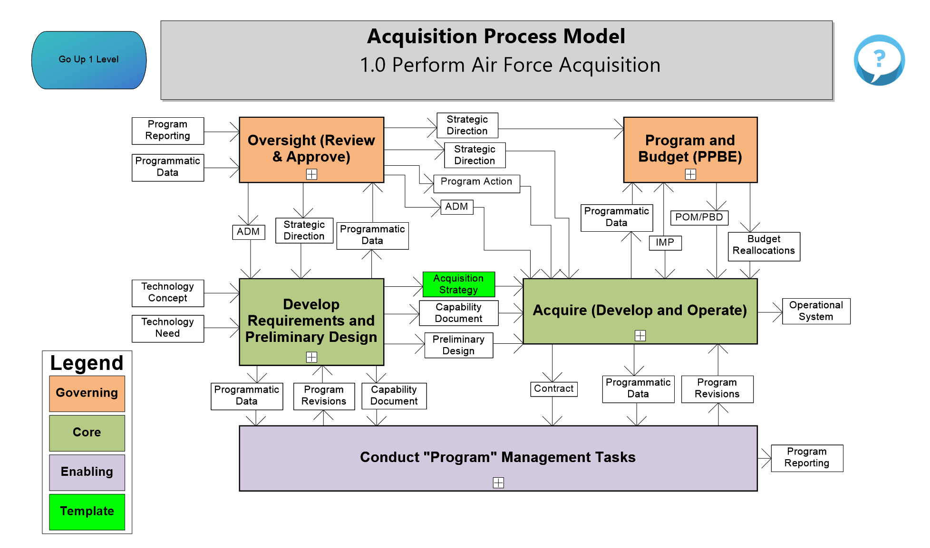
MCA Home Page
Process Box Color
Governing-The processes that guide or direct other processes
Core-The processes that create the required outputs from the organization
Enabling-The processes that support the execution of the core activities

Slide 9
Legend
Each diagram has a specific legend providing the meaning of the various colors used on the page.

Slide 10
Page Specific Question Function
Each diagram has an icon which provides the user a way to ask questions about a specific page.

Slide 11
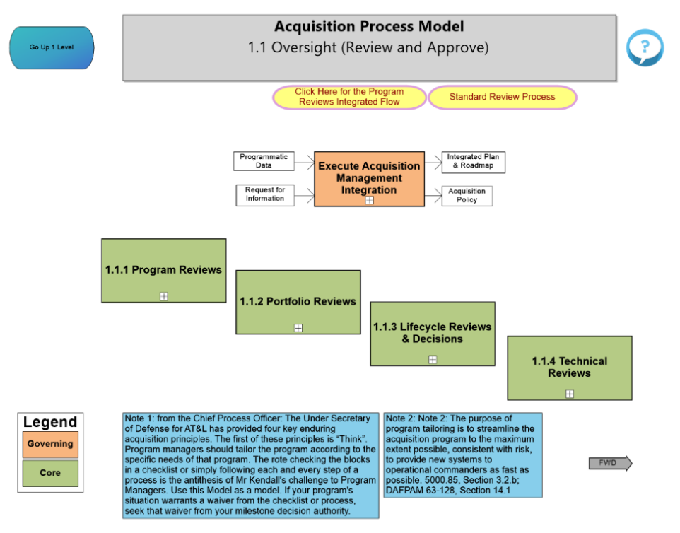
1.1 Oversight

Slide 12
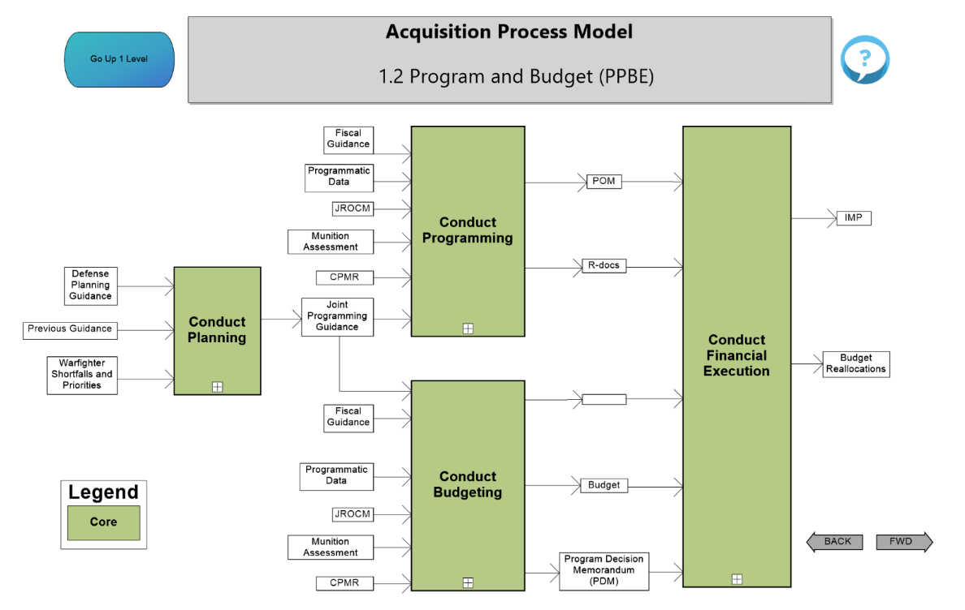
1.2 Program and Budget (PPBE)

Slide 13
1.3 Develop Requirements and Preliminary Design

Slide 14
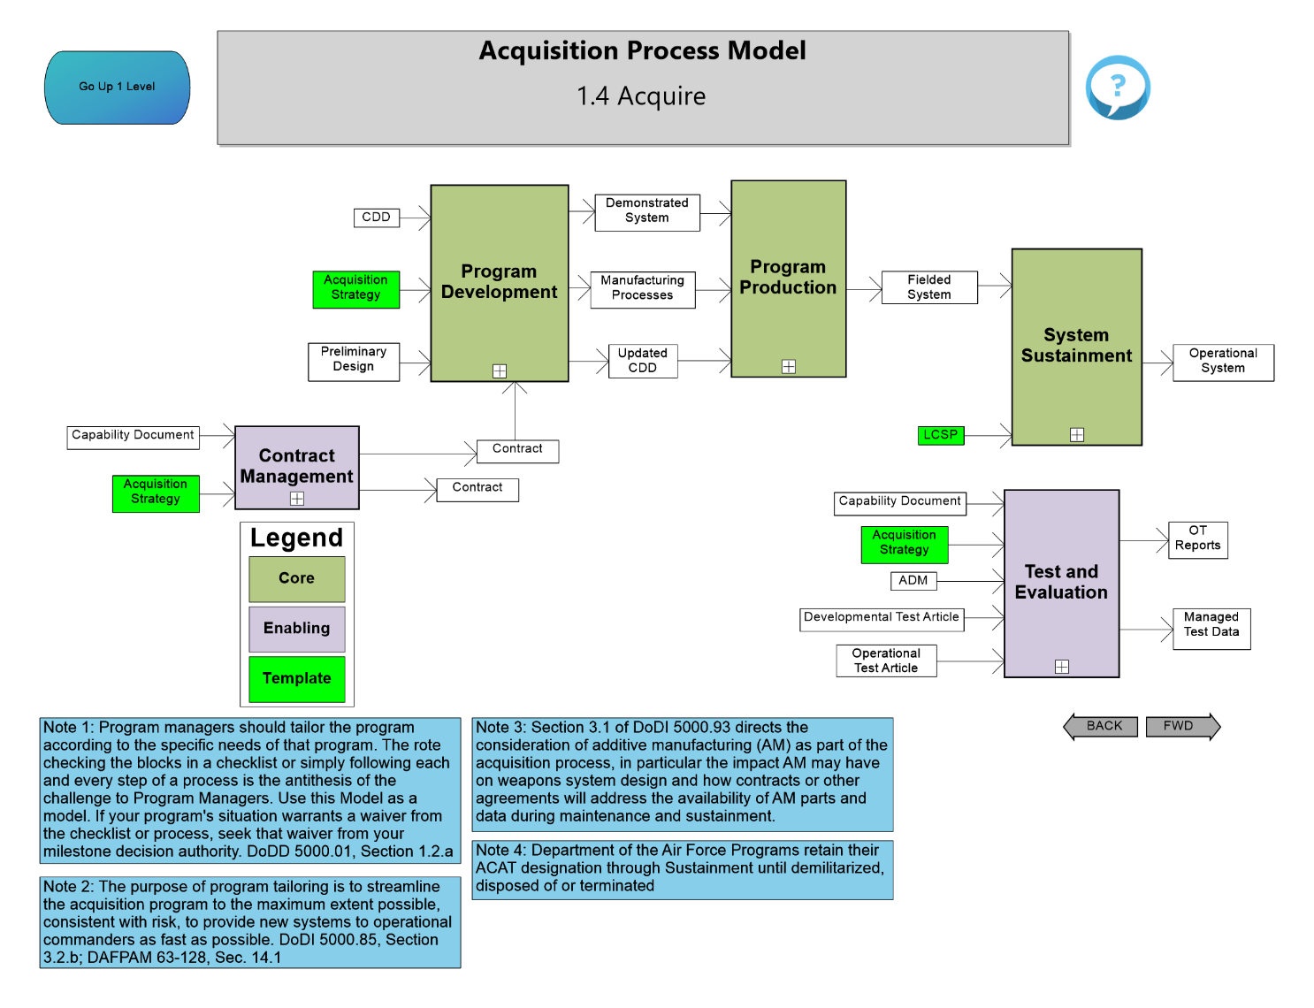
1.4 Acquire

Slide 15
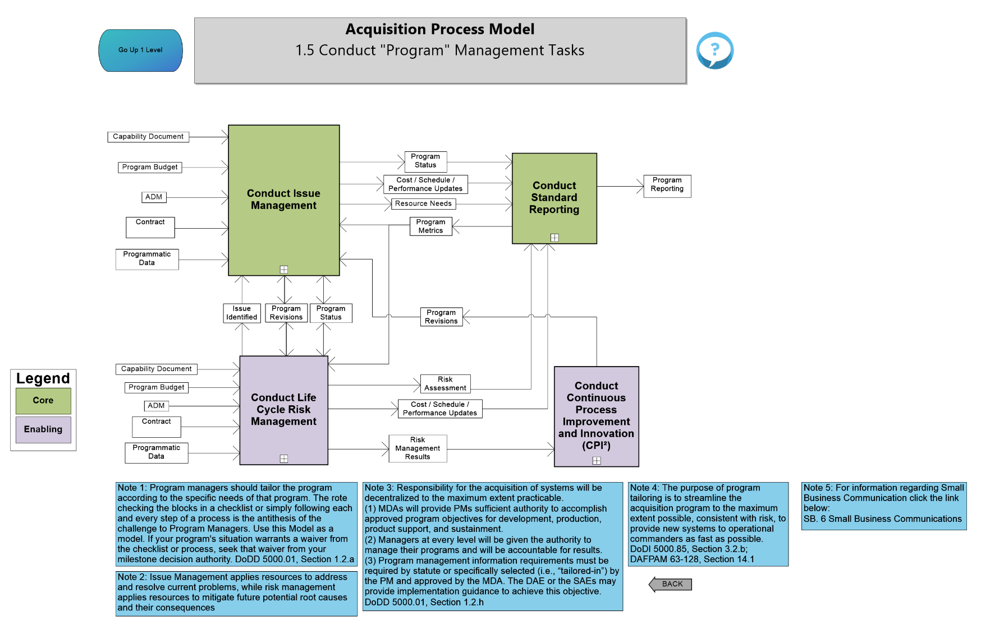
1.5 Conduct “Program” Management Tasks

Slide 16
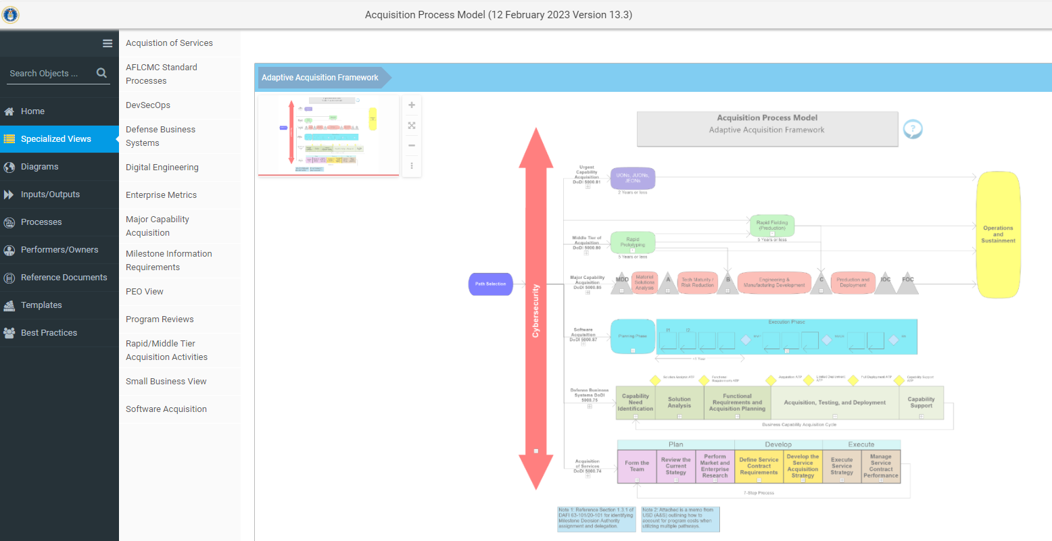
Specialized Views

Slide 17
DevSecOps

Slide 18
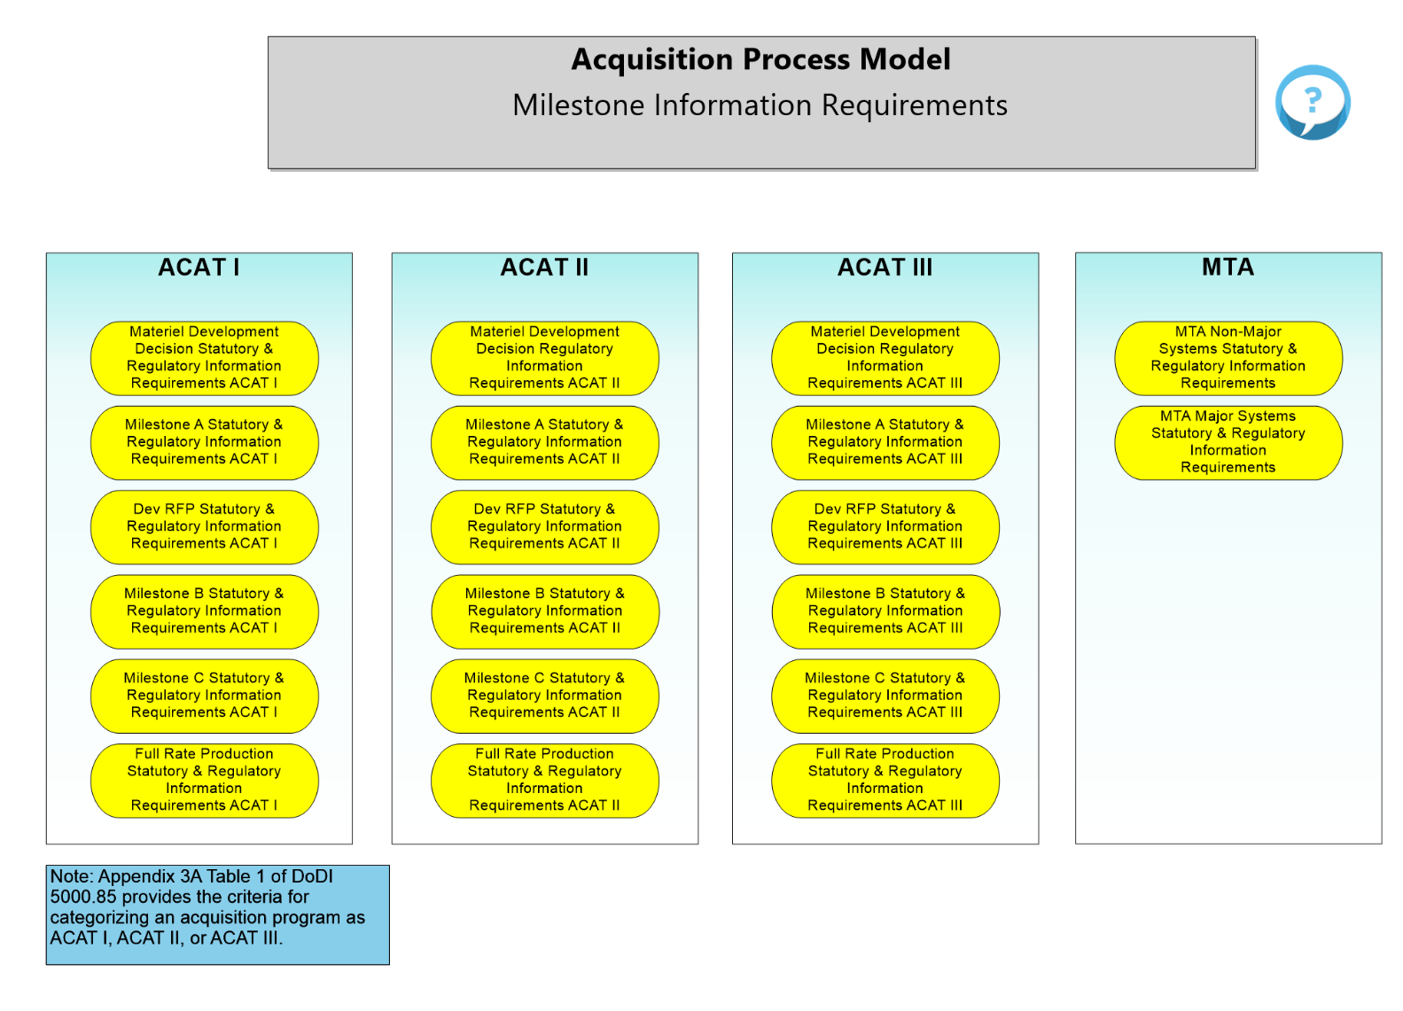
Milestone Information Requirements

Slide 19
Milestone Information Requirements

Slide 20
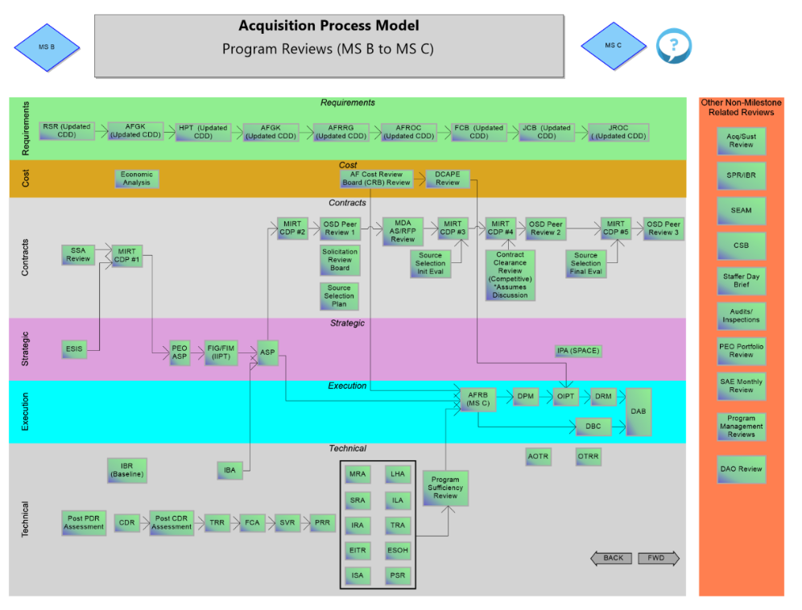
Program Reviews

Slide 21
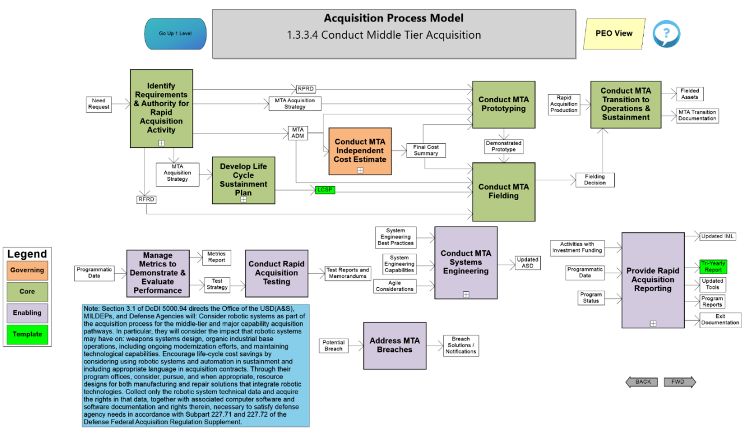
1.3.3.4 Conduct Rapid Acquisition Activities

Slide 22
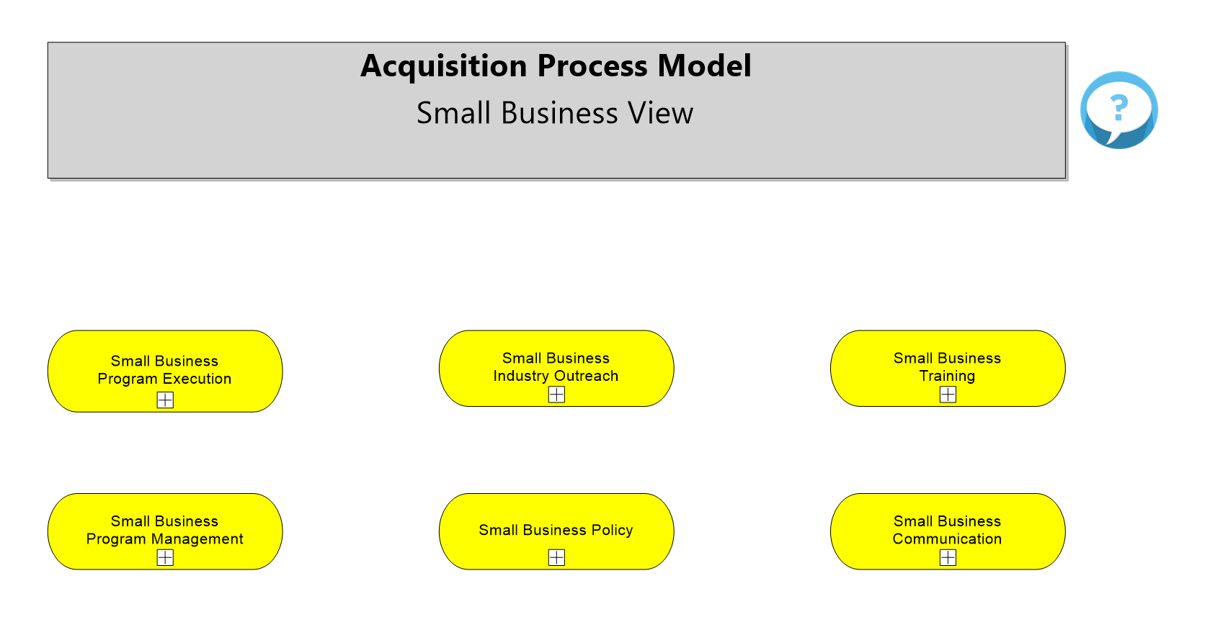
Small Business Views

Slide 23
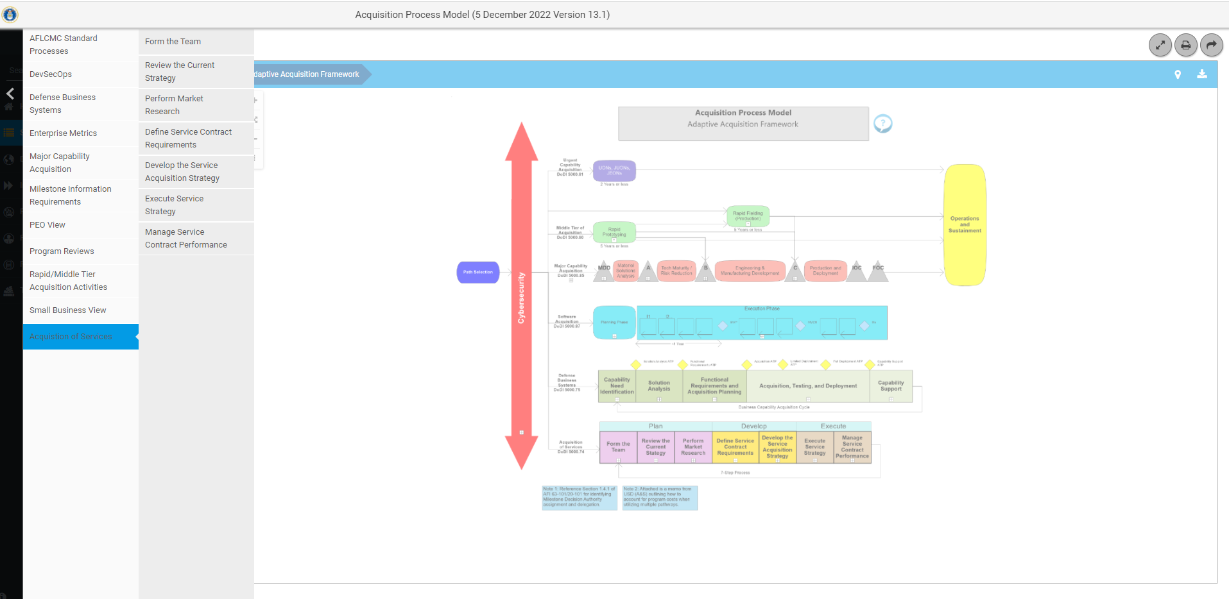
Acquisition of Services

Slide 24
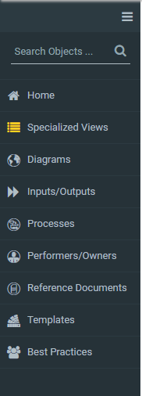
Content Navigation Defined
Condenses the Navigation Menu to Icons Only
Global Search- Allows user to search the entire model
Returns to AAF regardless of where you are in the model
Links to specific pages in the model
Pages in the model (Combination of Processes and Inputs/Outputs)
List of Process Inputs and Outputs and where they are used in the model
List of all the processes and where they are diagrammed in the model
List of all the Performers/ Owners with associated processes in the model
List of all the reference documents and where they are referenced in the model
List of all the templates with associated diagrams in the model
List of all the Best Practices Documents with associated processes in the model
Each Content area has two display options- Grid and List

Slide 25
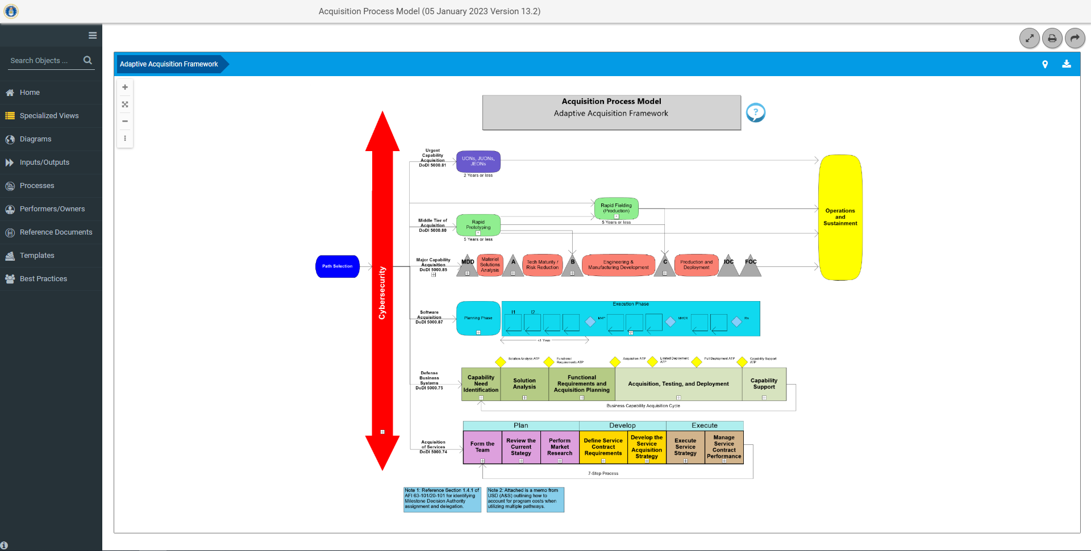
Global Search
Click here for Global Search

Slide 26
Diagrams
Click here for the Diagrams

Slide 27
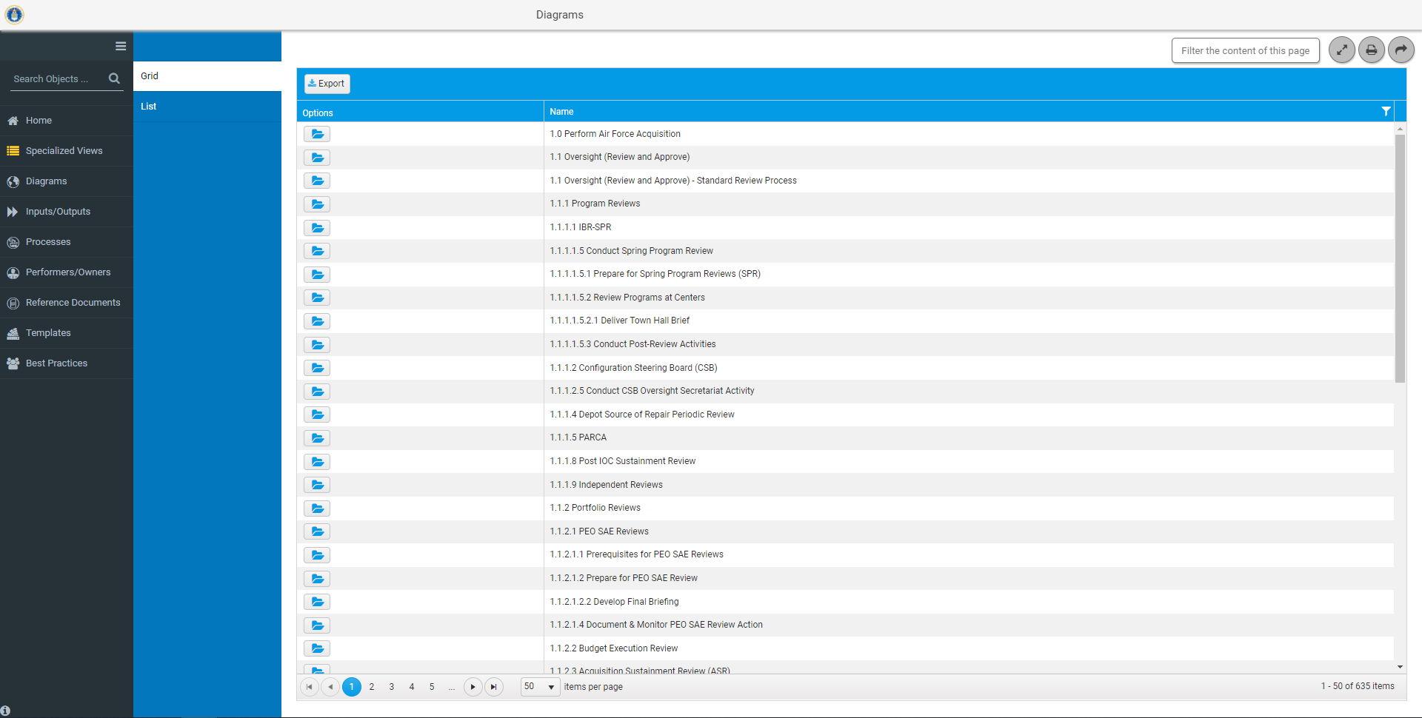
Diagrams Grid View
Click on folder to view the Diagram for Program Reviews

Slide 28
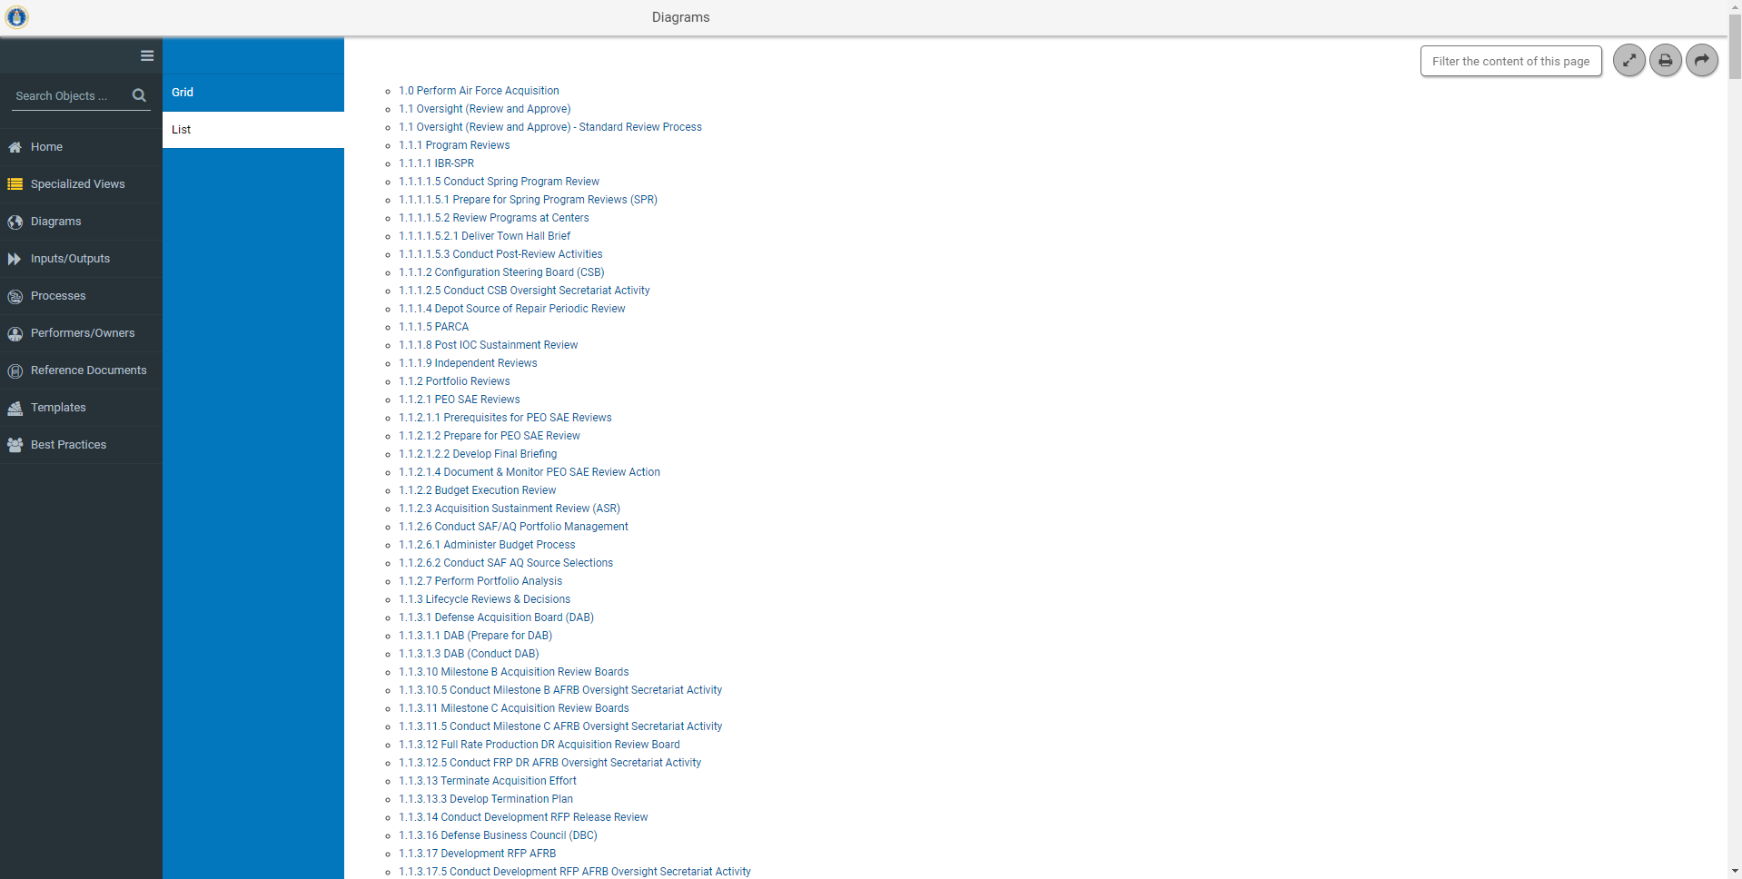
Diagrams List View
Click to view the Diagram for Program Reviews

Slide 29
Processes
Click here for the Processes

Slide 30
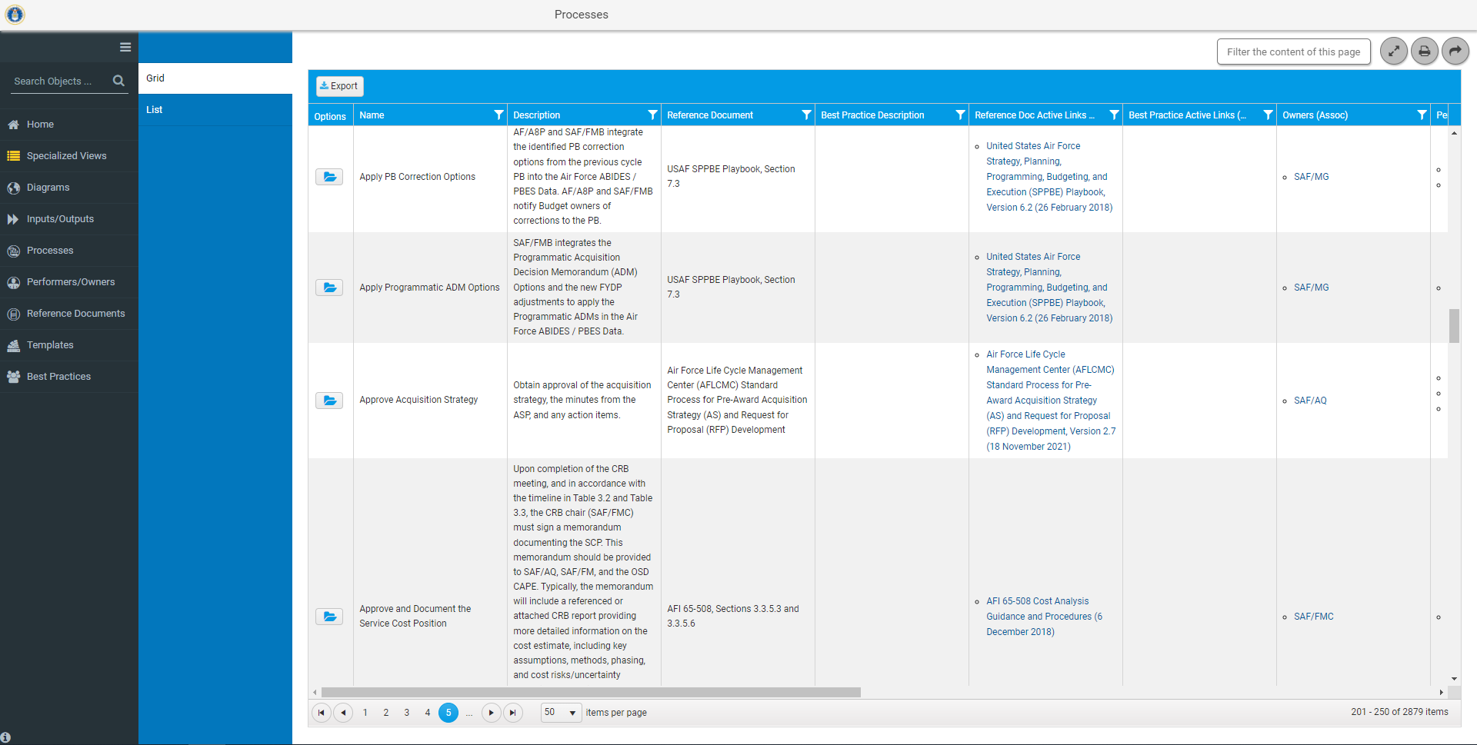
Processes Grid View
Click on folder for details on Approve Acquisition Strategy and a link to the diagram

Slide 31
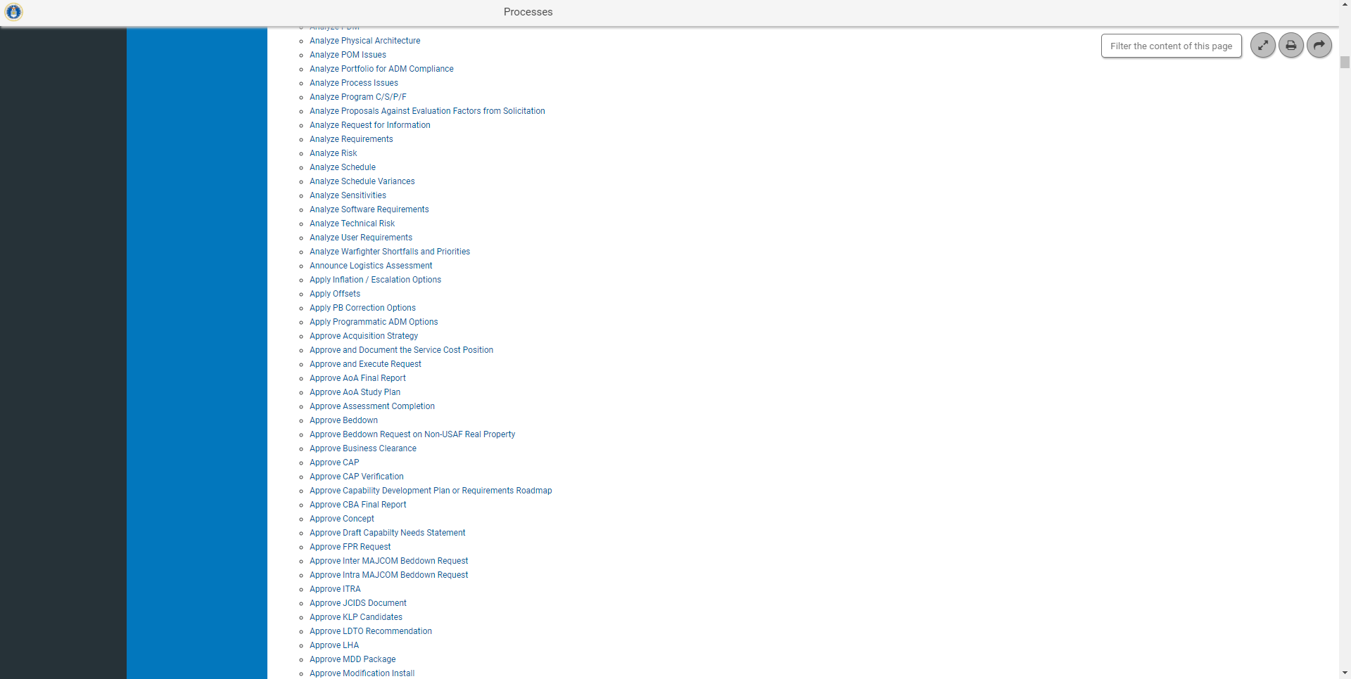
Processes List View
Click to go to a diagram for Approve Acquisition Strategy

Slide 32
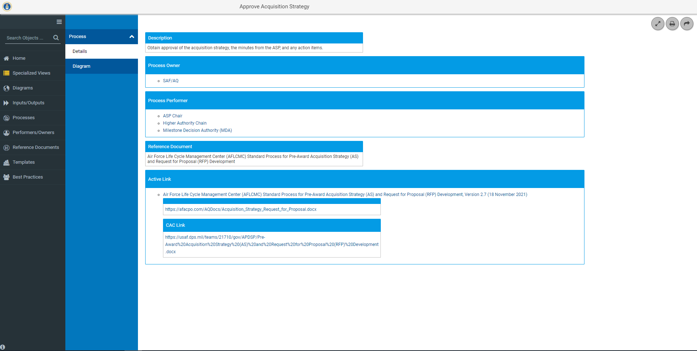
Processes Grid/List View Details
Name of the Process
Documented description for the purpose of the process
Organization(s) with the authority for the execution of the Process
Organization(s) or person(s) responsible for the execution of the process
Document that describes the process
Web address of the reference document
Details provides all metadata associated with a process

Slide 33
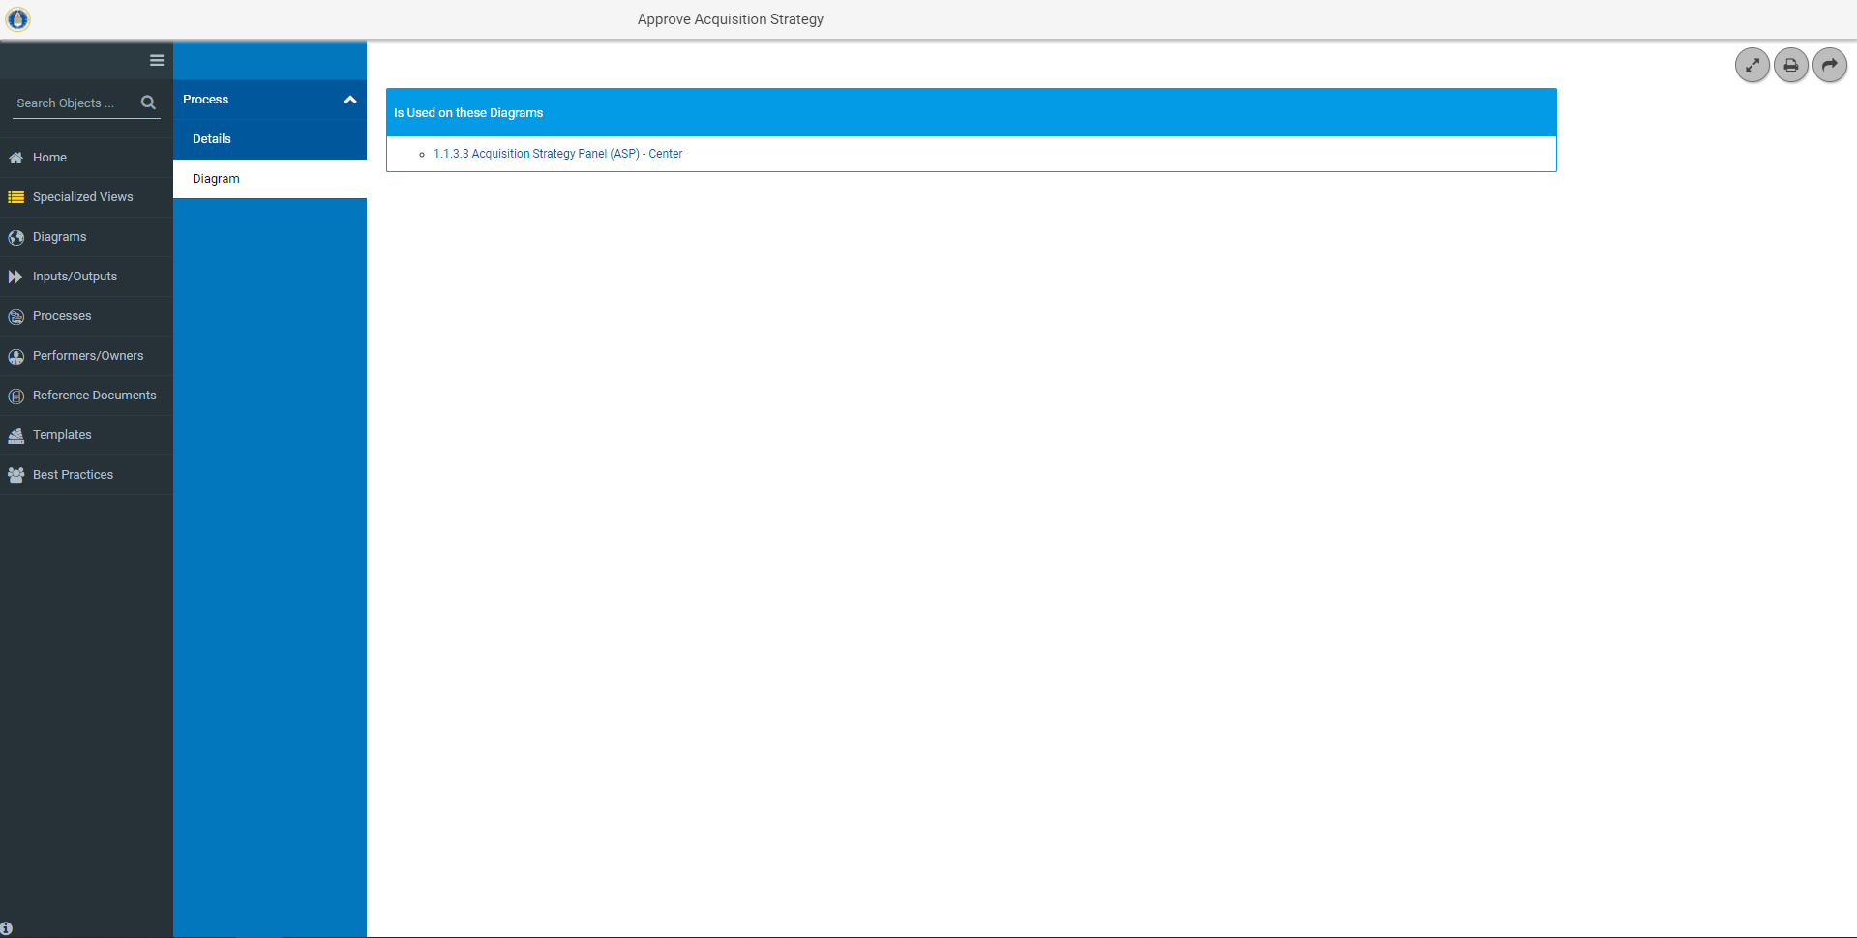
Processes Grid/List View Location
Link to Diagrams that use this process

Slide 34
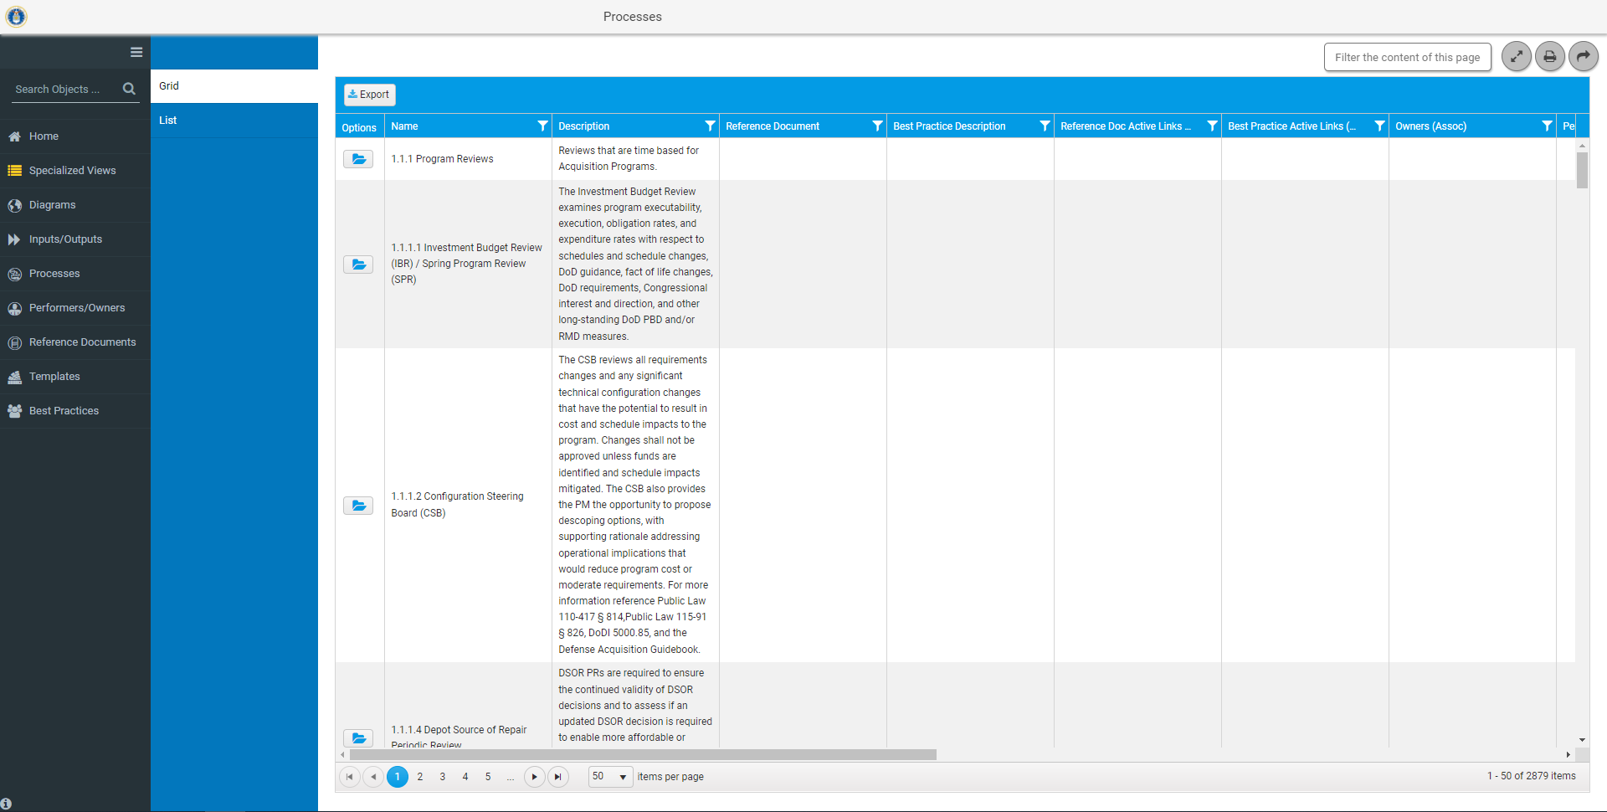
Search and Export
Search
Process metadata is exportable to Excel (with or without search criteria)
Focused Search

Slide 35
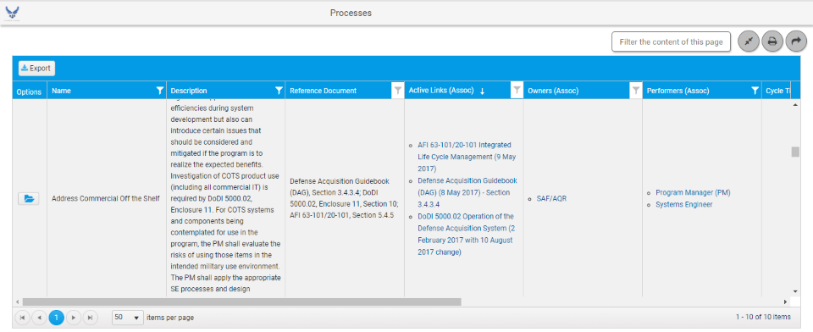
Focused Search
Focuses the search on selected metadata (columns). Allows search on one or multiple columns. Two columns (Description and Reference Document) allow searches on up to two conditions with the and/or option

Slide 36
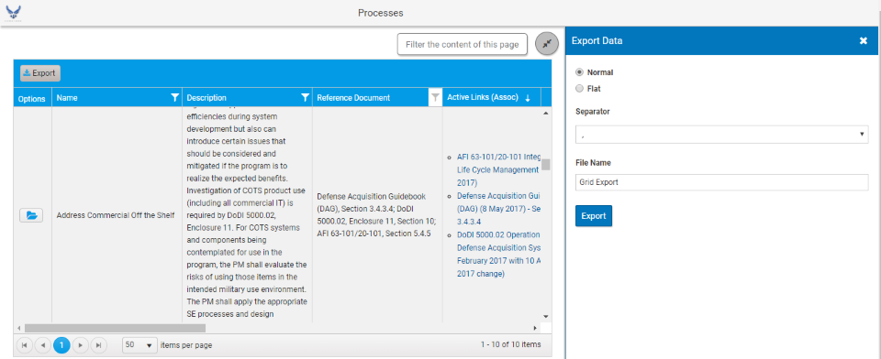
Export
Defaults to comma, Do not change
Name the file
Creates a CSV File in Excel
Notes:
Either open or save file.

Slide 37
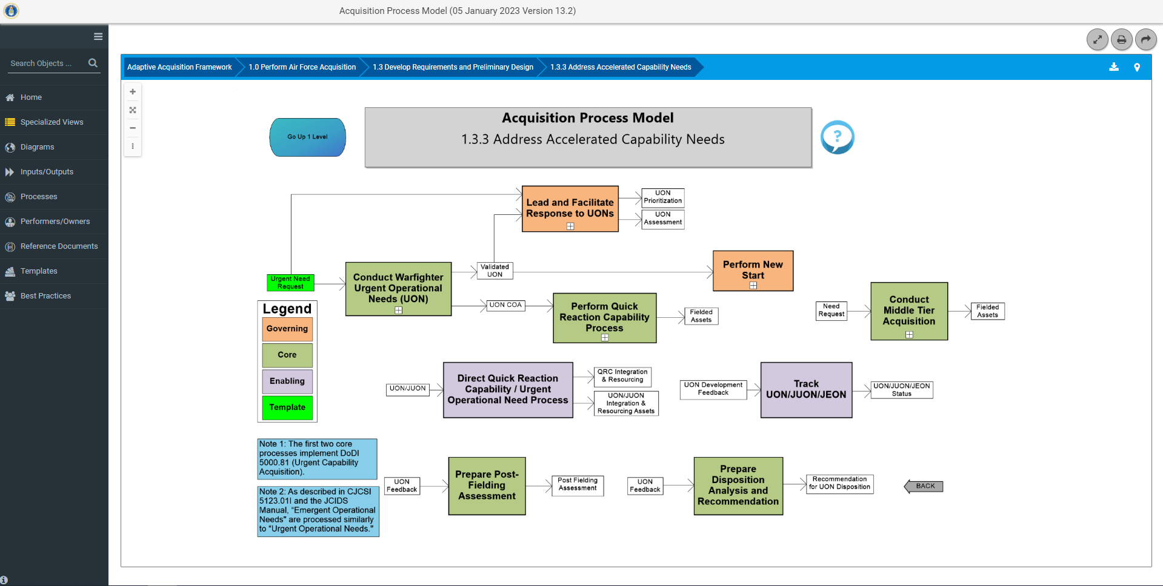
Breadcrumb
Shows the pages you have visited in the model

Slide 38
Links to Access the APM
Direct APM Link – afacpo.com
AF Portal – www.my.af.mil
Option under the Acquisition section of Quick Links
External Air Force Acquisition Page - ww3.safaq.hq.af.mil
Option under the Featured Links
Common Portal Environment-https://pmrt.altess.army.mil/pmrt/login.jsp
Links to APM are located on ACE sites-AFLCMC, Hanscom, Hill, Robins, Space Force, and Tinker

Slide 39
Who Do I Talk To?
If you have questions, comments, or recommendations for improvements
Contact Mr. Brad Ferguson – (720) 333-6707 or brad.ferguson.2@us.af.mil
Contact Allen Farley – (304) 216-6308 or allen.farley@sptrm.com
Contact J.R. Dotson – (304) 641-1181 or john.dotson@sptrm.com
Contact SAF/AQXP – usaf.pentagon.saf-aq.mbx.saf-aqxp-cpi-wkflw@us.af.mil

Slide 40
Backup

Slide 41
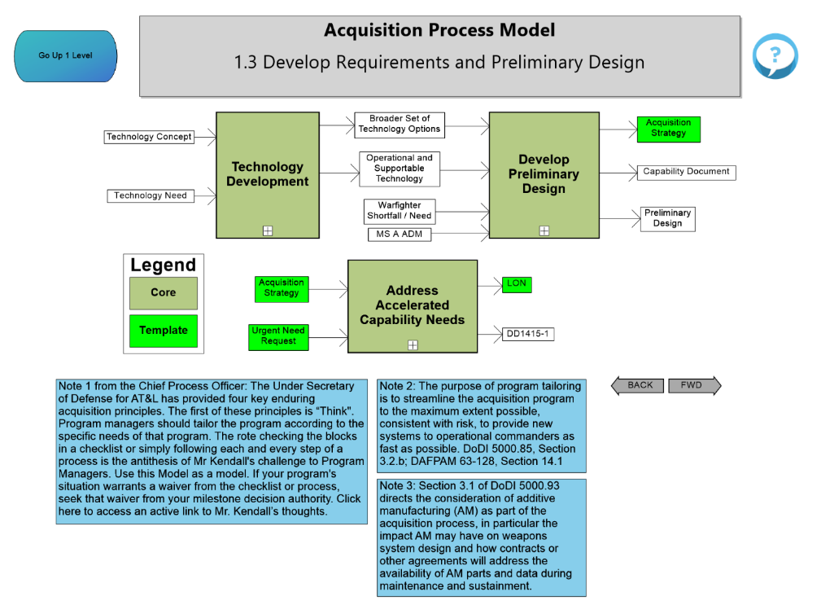
Page Navigation Details
Navigate to Parent
Processes
Inputs/Outputs
Plus sign indicates process has tiers below it.
Click on the plus sign to Vertically Navigate the Model
Horizontally Navigate the Model
Notes:
Go up 1 Level- This feature allows the user to go one level up; for example: The page we are currently on is 1.3, the Go Up 1 Level box, will take you back to the 1.0 page.
Process Inputs and/or Outputs- These are the actions that kick off or follow a process step. These inputs/outputs are derived from policy, instructions, etc.
Process Name- This shows up on every page and defines what process you are looking at within the APM.
Process Step- These process steps are taken from policy, instructions, etc. to lay out the appropriate steps within that particular process. If additional process decomposition details exist, a left click on the process will reveal such detail.
Vertically Navigate the Model-This feature will allow you to navigate down to appropriate process pages.
Horizontally Navigate the Model- This feature will allow you to navigate forward and back to appropriate process pages.

Slide 42
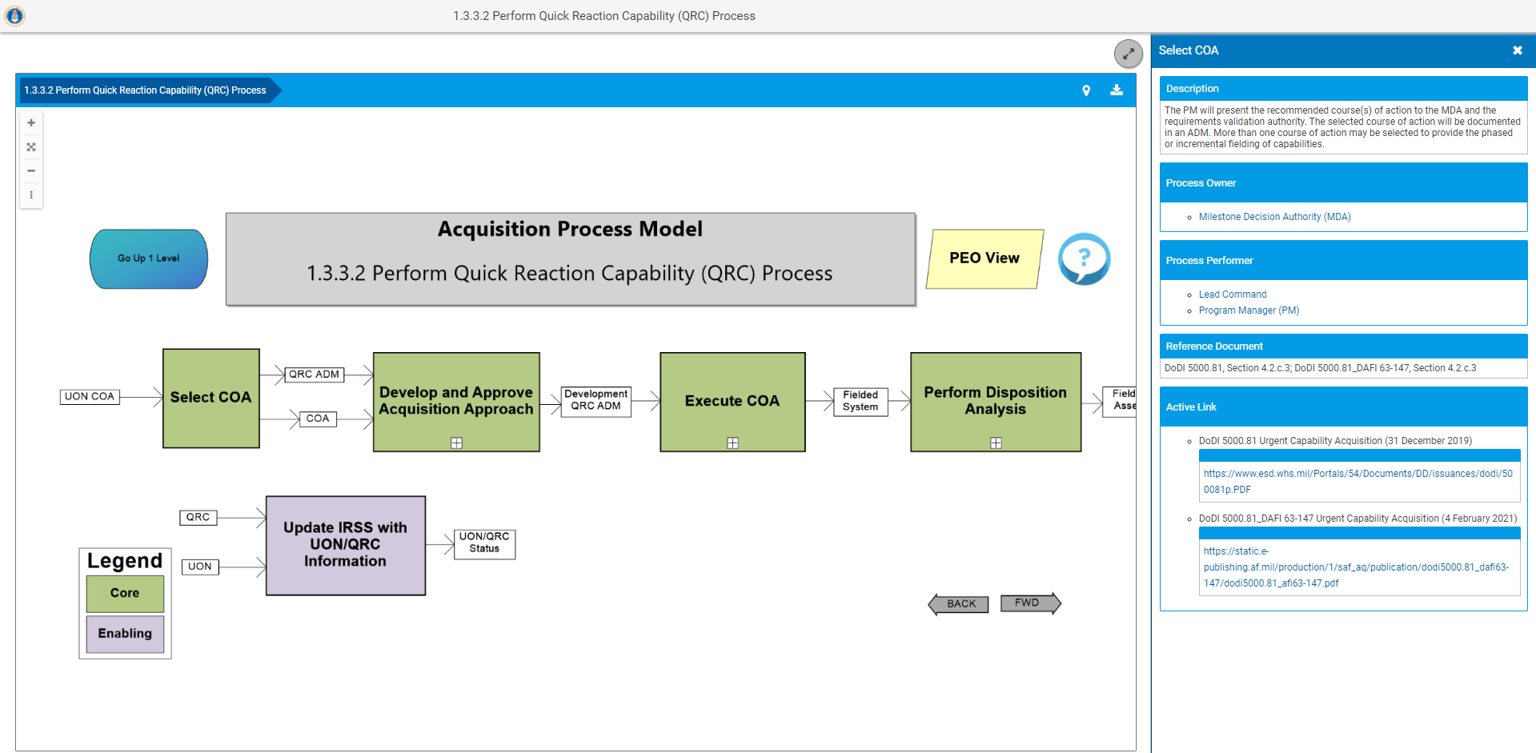
Processes
Process metadata
Click on Select COA to view process details.

Slide 43
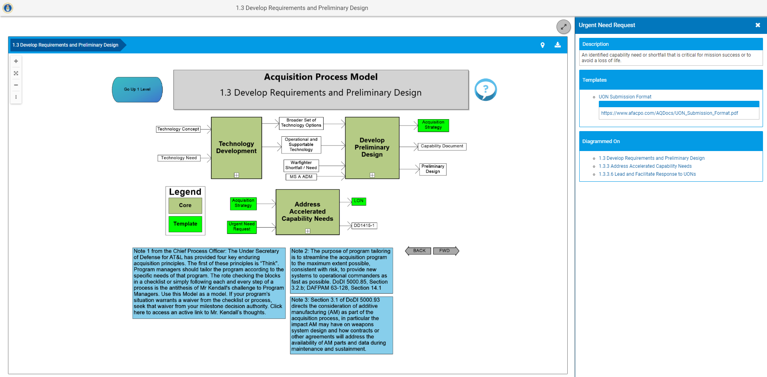
Input / Output Hyperlinks
Click on Urgent Need Request to view details.
Hyperlinks
Inputs/Outputs colored Green indicate a Template
Notes:
Diagrammed On indicates where else in the model Urgent Need Request appears.

Slide 44
Inputs/Outputs
Click here for the Inputs/Outputs

Slide 45
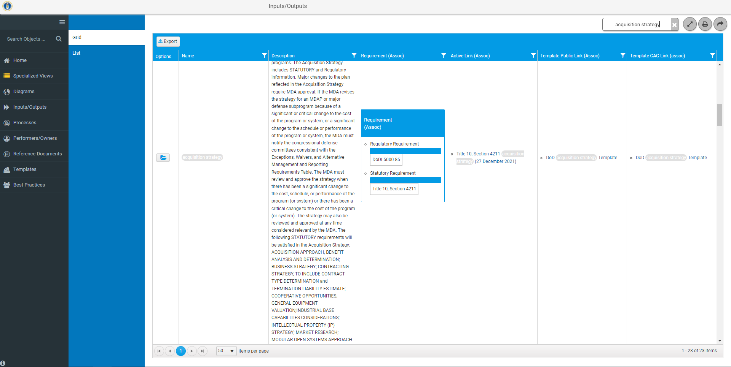
Inputs/Outputs Grid View
Click folder for Details of Acquisition Strategy

Slide 46
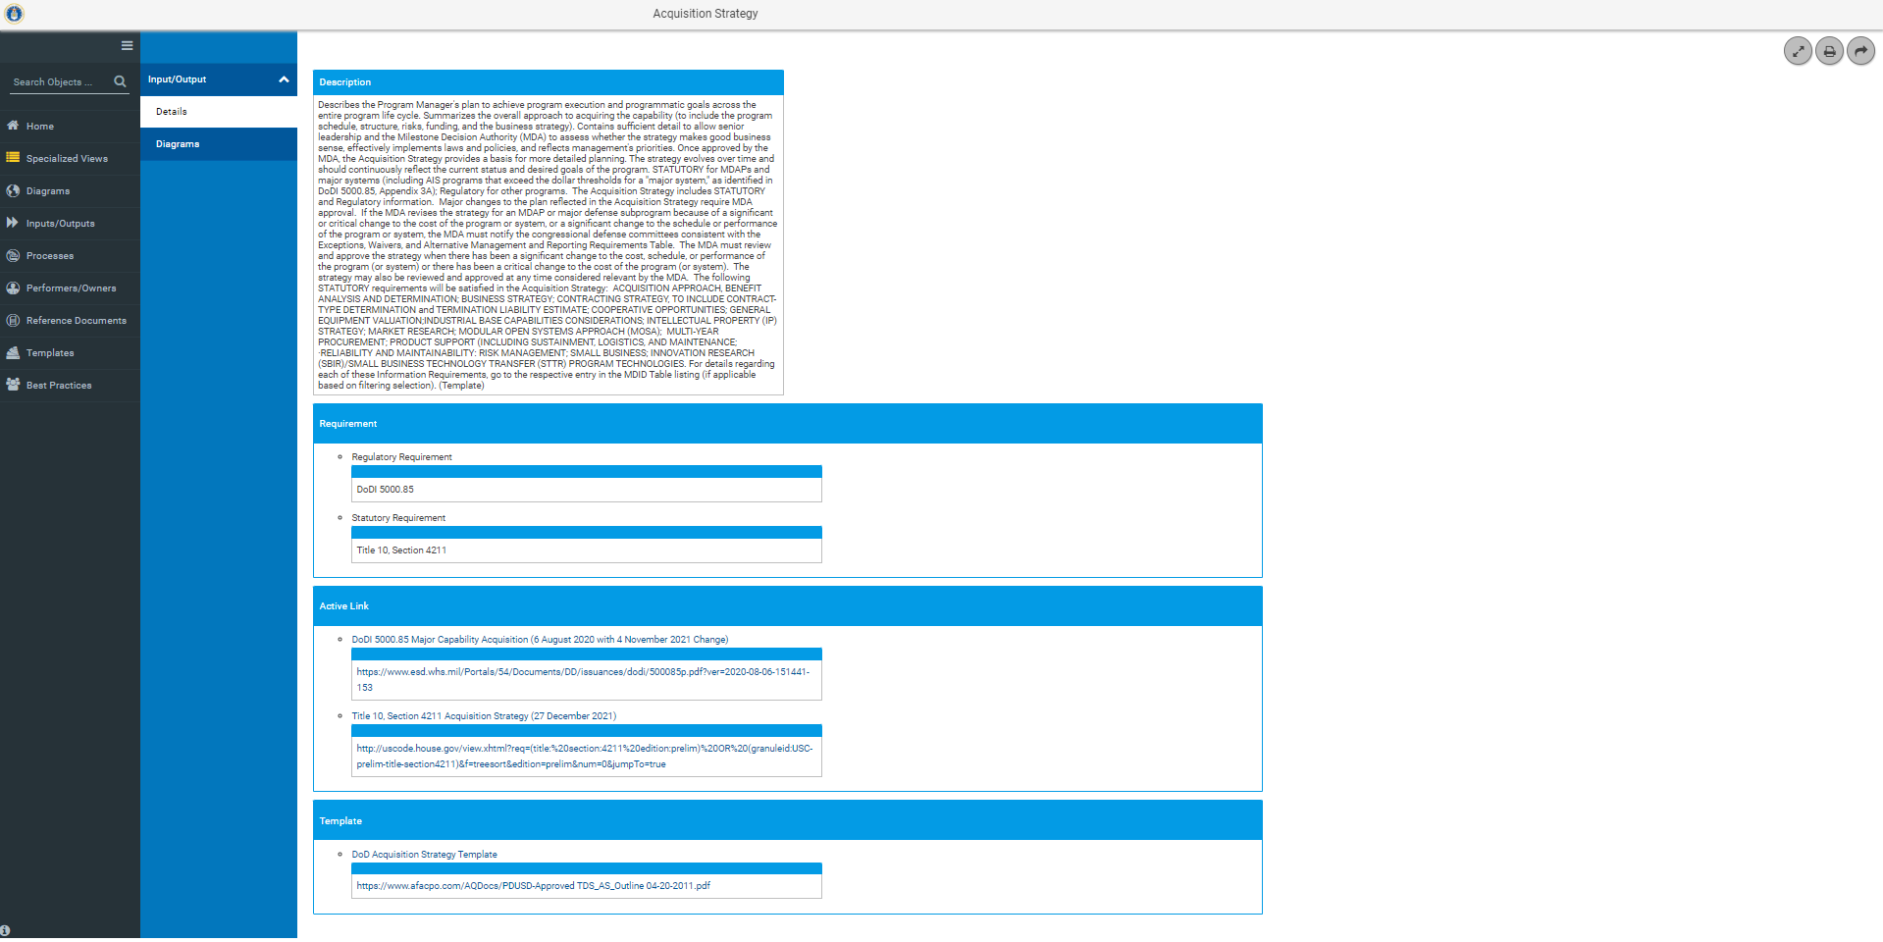
Inputs/Outputs Details
Description of Acquisition Strategy
Reference Documents that Govern Acquisition Strategy
Link to Reference Documents
Link to Acquisition Strategy Template
Details provides all metadata associated with an Input/Output

Slide 47
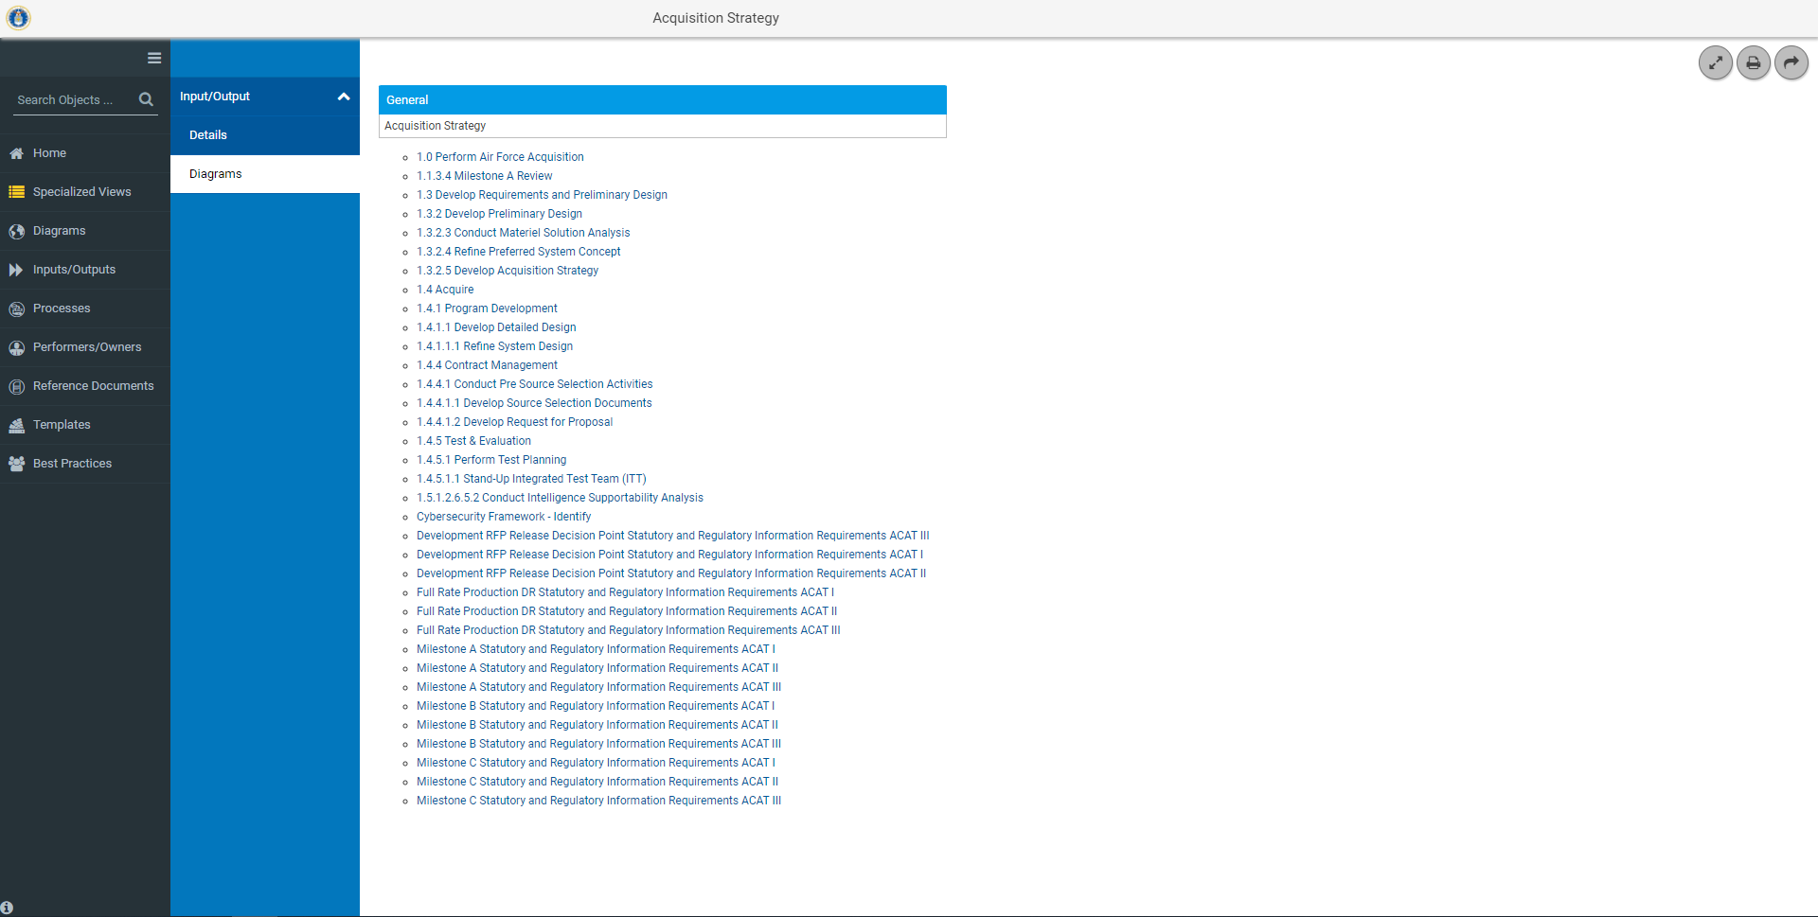
Inputs/Outputs Diagrams
Link to the Diagrams that use Acquisition Strategy as an input/output

Slide 48
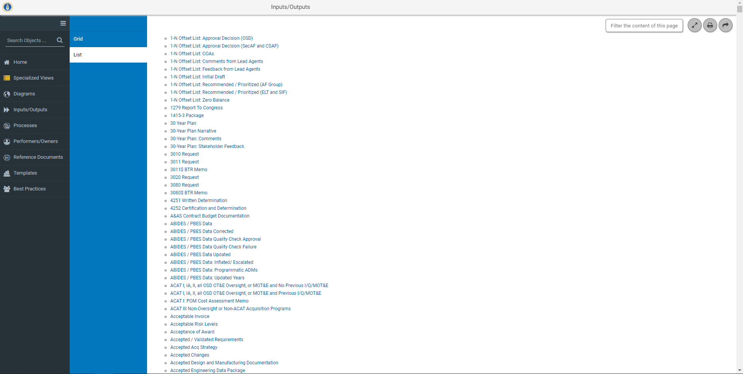
Inputs/Outputs List View
Click to view the details of 30 Year Plan

Slide 49
Performers/Owners
Click here for the Performers/ Owners

Slide 50
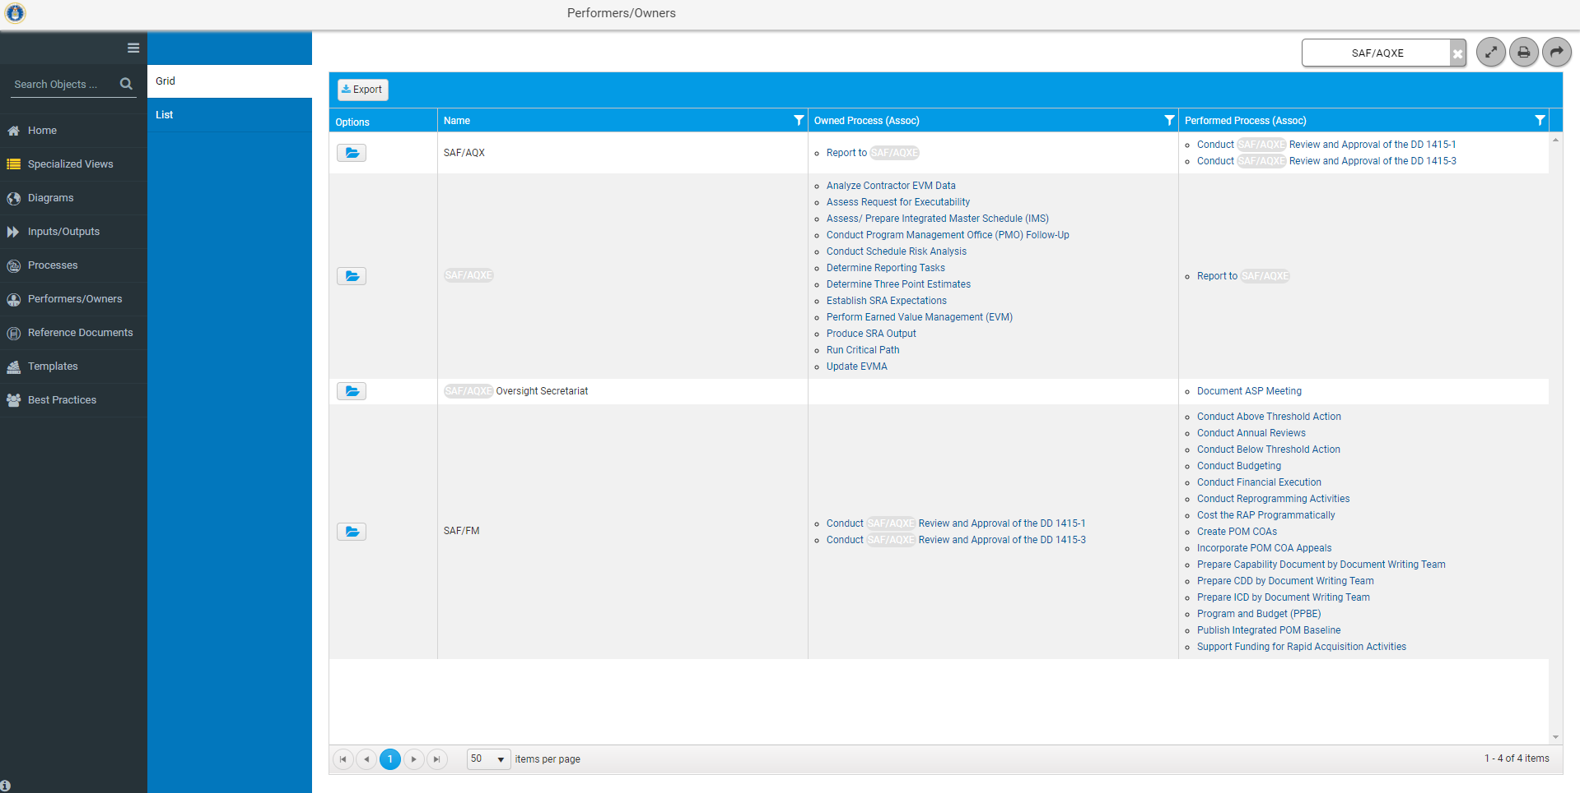
Performers/Owners Grid View
Processes for which SAF/AQXE is the owner
Processes for which SAF/AQXE is a performer
Click on folder for details on SAF/AQXE

Slide 51
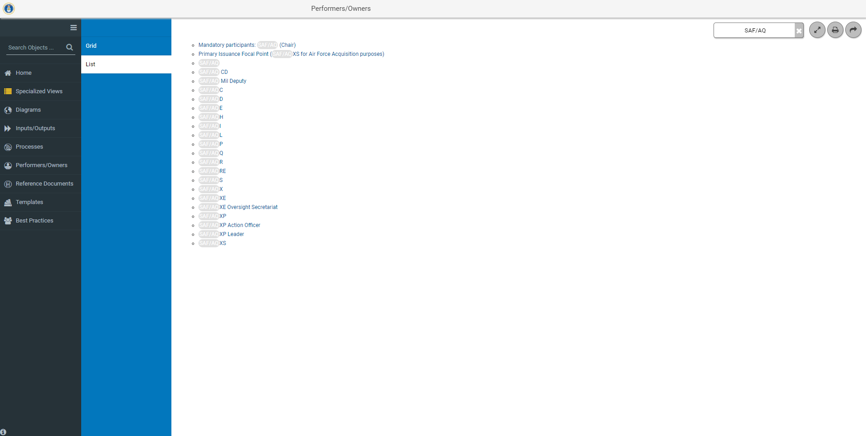
Performers/Owners List View
Click on SAF/AQXE to view details

Slide 52
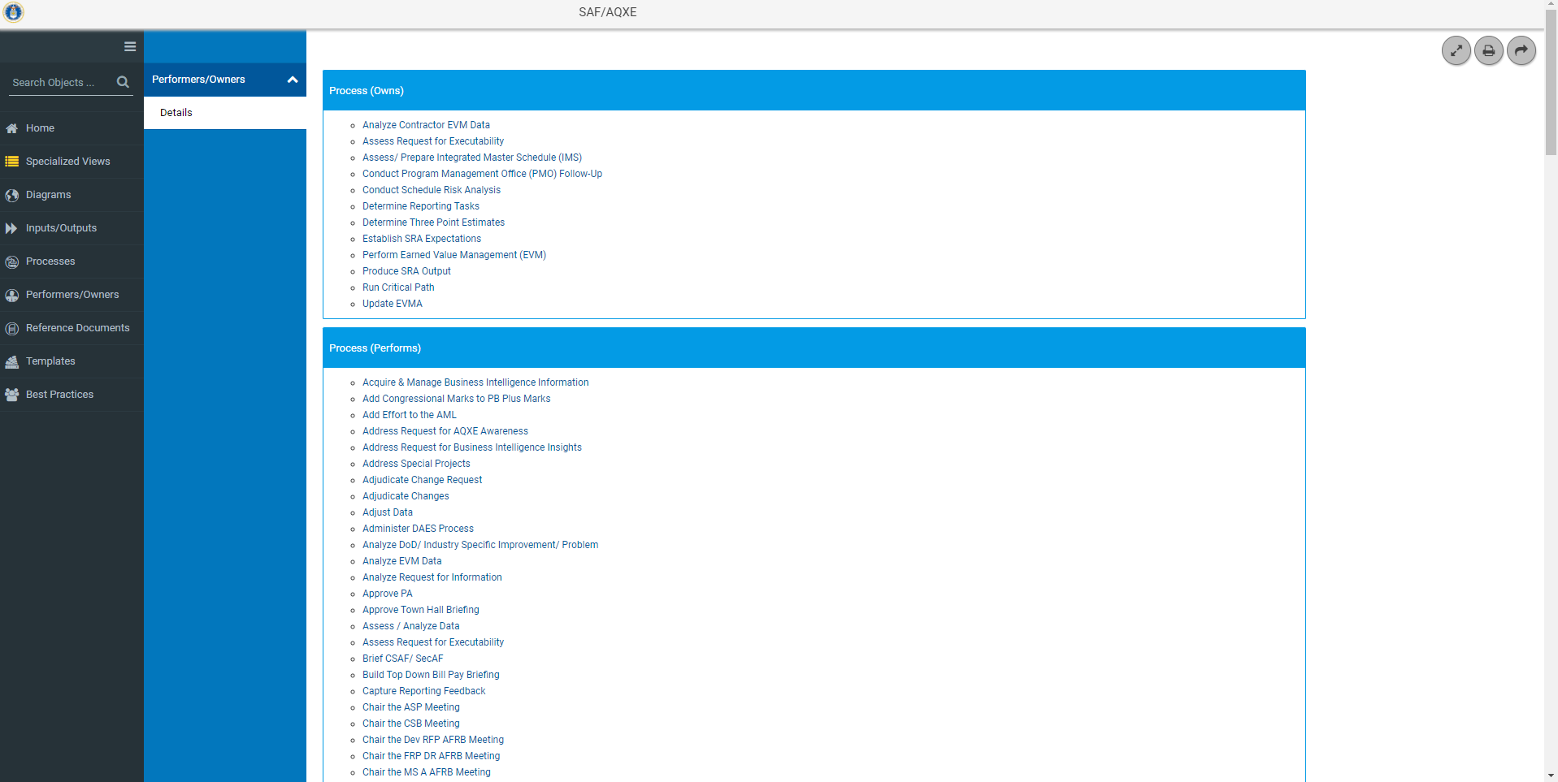
Performers/Owners Details
Provides a list of the Activities that SAF/AQXE Owns.
Link to Details and Diagram for Conduct Schedule Risk Analysis
Provides a list of the Activities that SAF/AQXE Performs.

Slide 53
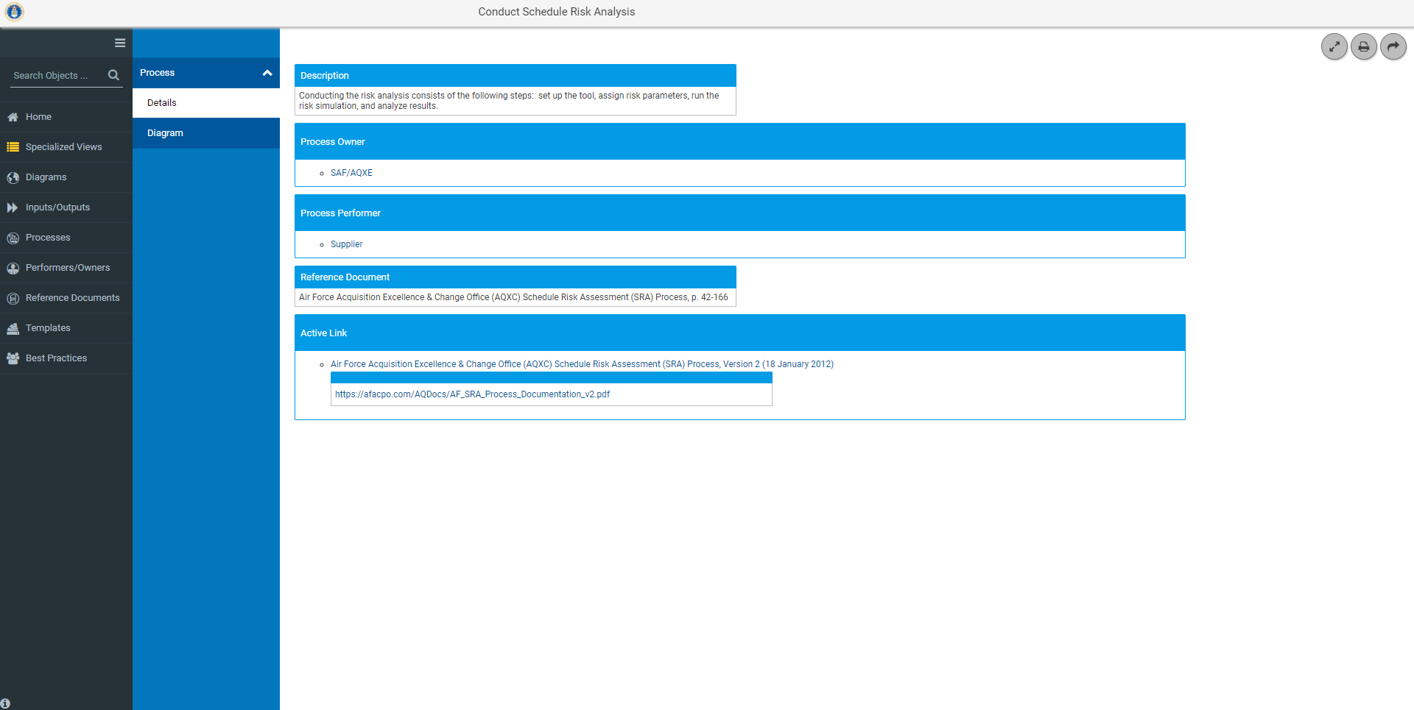
Performers/Owners Details
Metadata for Conduct Schedule Risk Analysis

Slide 54
Performers/Owners Details
Link to Diagram where Conduct Schedule Risk Assessment shows as a Process

Slide 55
Reference Documents
Click here for the Reference Documents
Notes:
Provides a link to all the reference documents used throughout the model. Two views either Grid View or List View

Slide 56
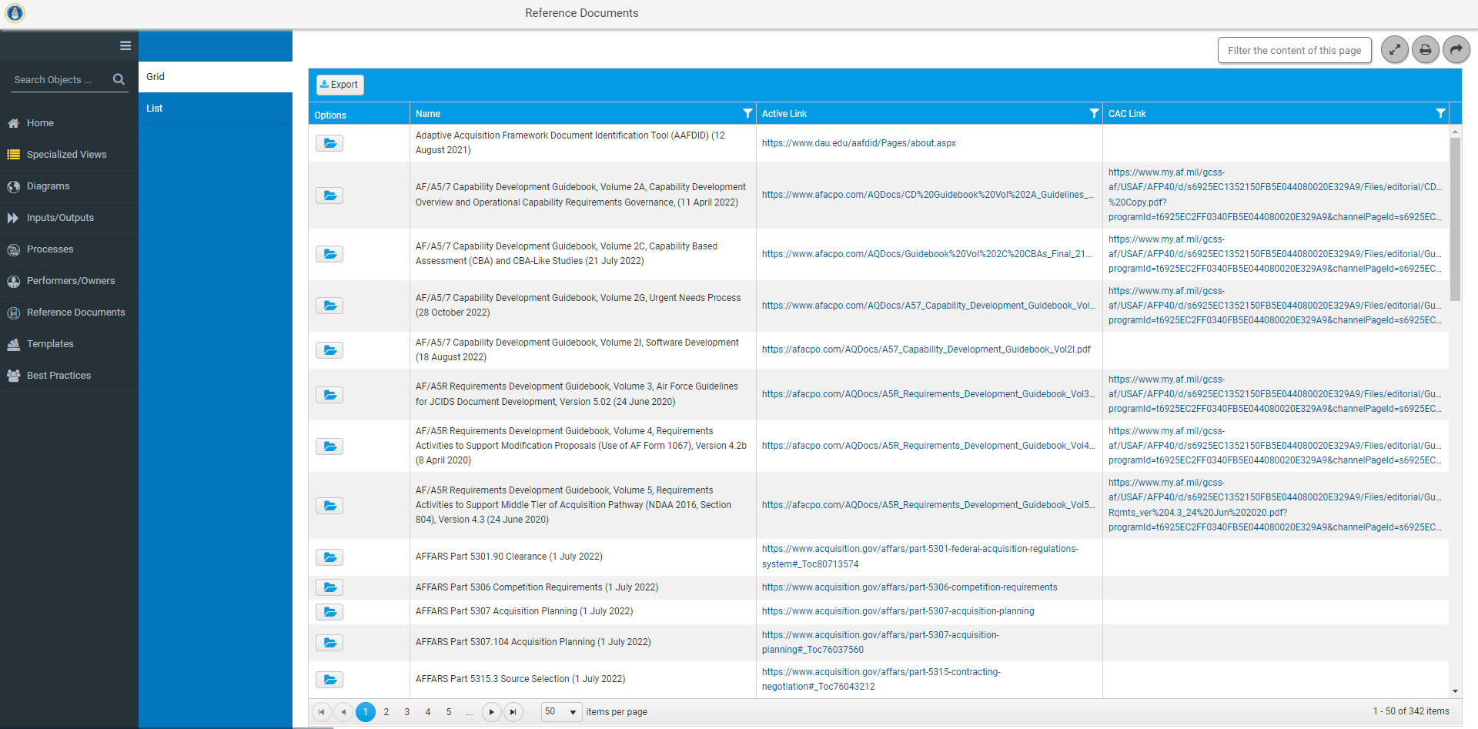
Reference Documents Grid View
Active Link provides a link to the reference document.
CAC Link provides a link to the reference document if its behind a Firewall. This is to ensure the user has the most current document.
Click on folder to view details on AF/A5/7 Capability Development Guidebook
Notes:
Options field opens additional detail regarding the reference document.
Source URL provides link to the Reference document

Slide 57
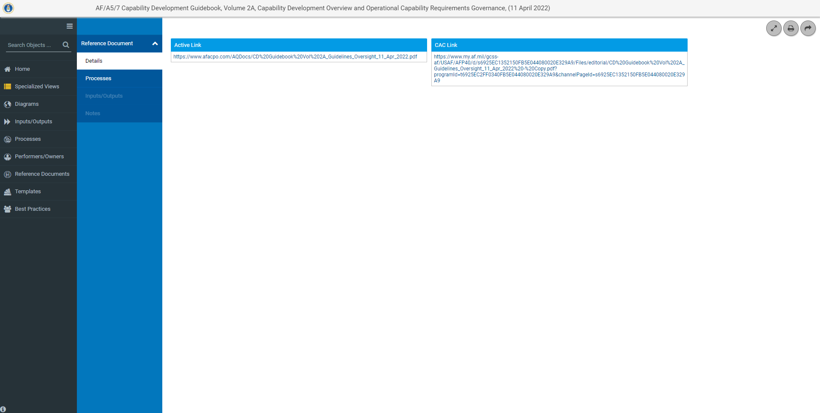
Reference Document Details
Name of Reference Document
Source URL provides a link to the reference document.

Slide 58
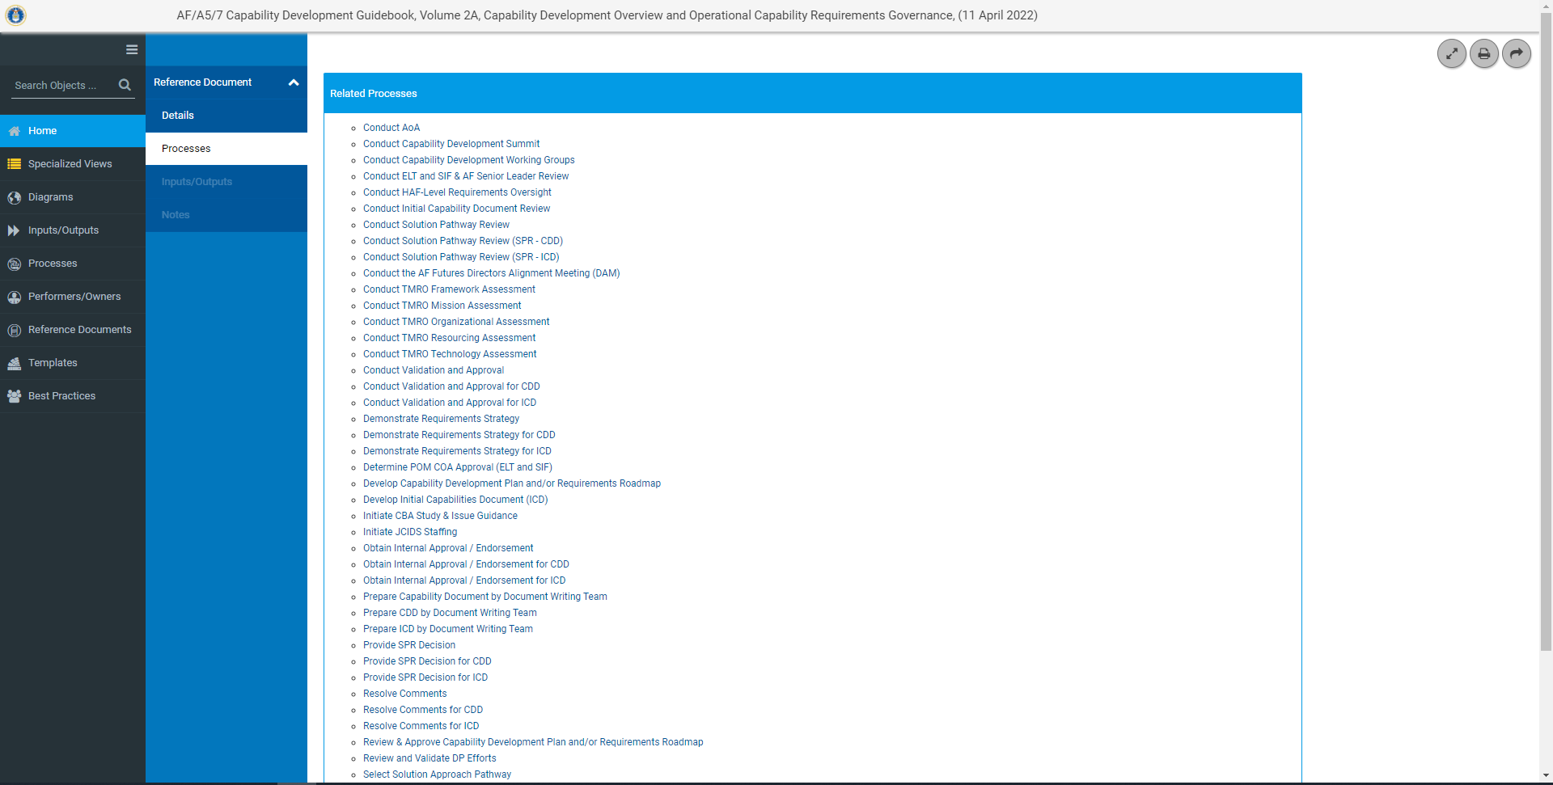
Reference Documents Processes
Identifies Processes and provides a link to details pages for processes in the model that use the AF/A5/7 Capability Development Guidebook as the Reference Document

Slide 59
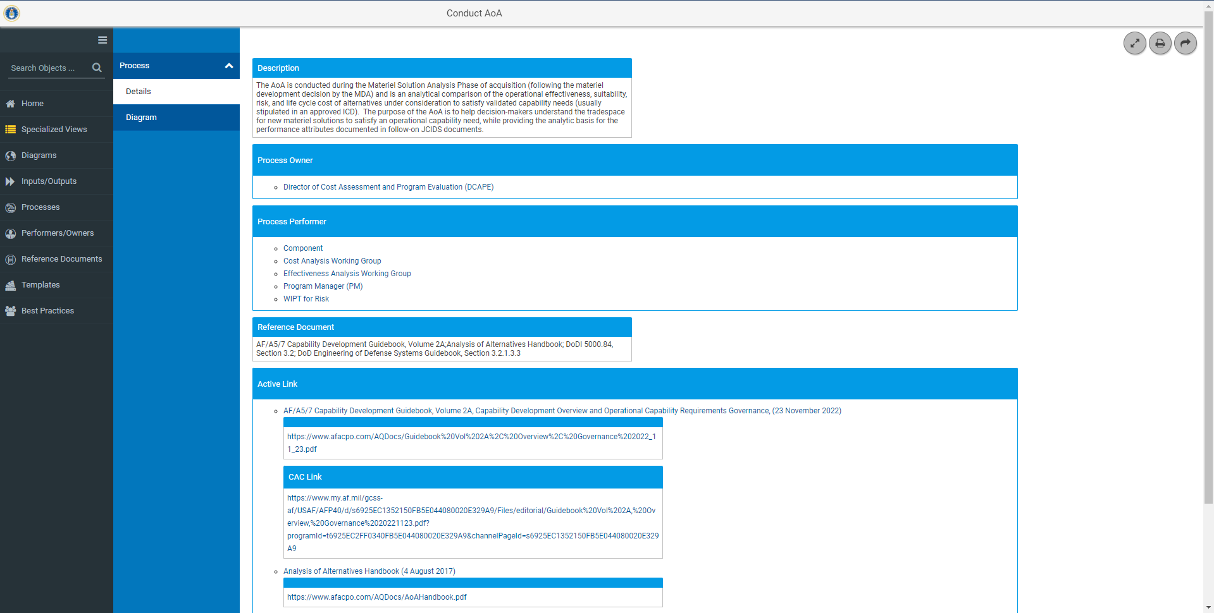
Reference Documents Process Metadata

Slide 60
Reference Documents Process
Link to the Conduct Materiel Solution Analysis Diagram. Conduct AoA is a process in this diagram

Slide 61
Templates
Click here to go to Templates
Notes:
Templates that are used in the APM and their location within the model.

Slide 62
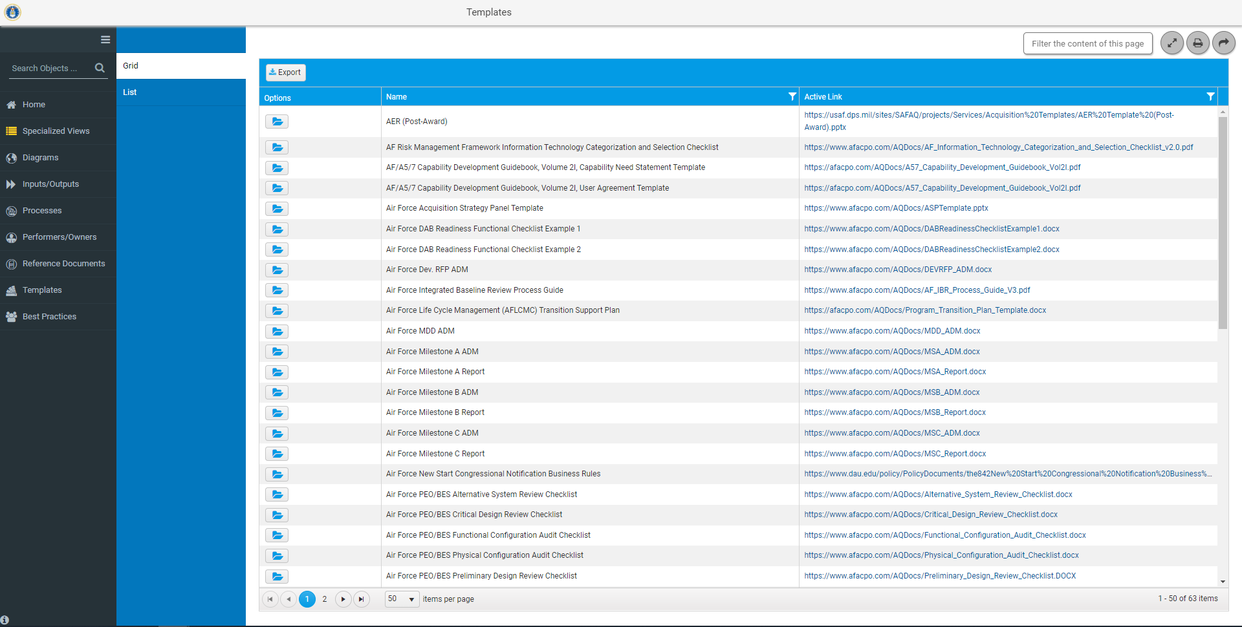
Templates Grid View
Click on Folder to view details and locations of Air Force Acquisition Strategy Panel Template in the APM.

Slide 63
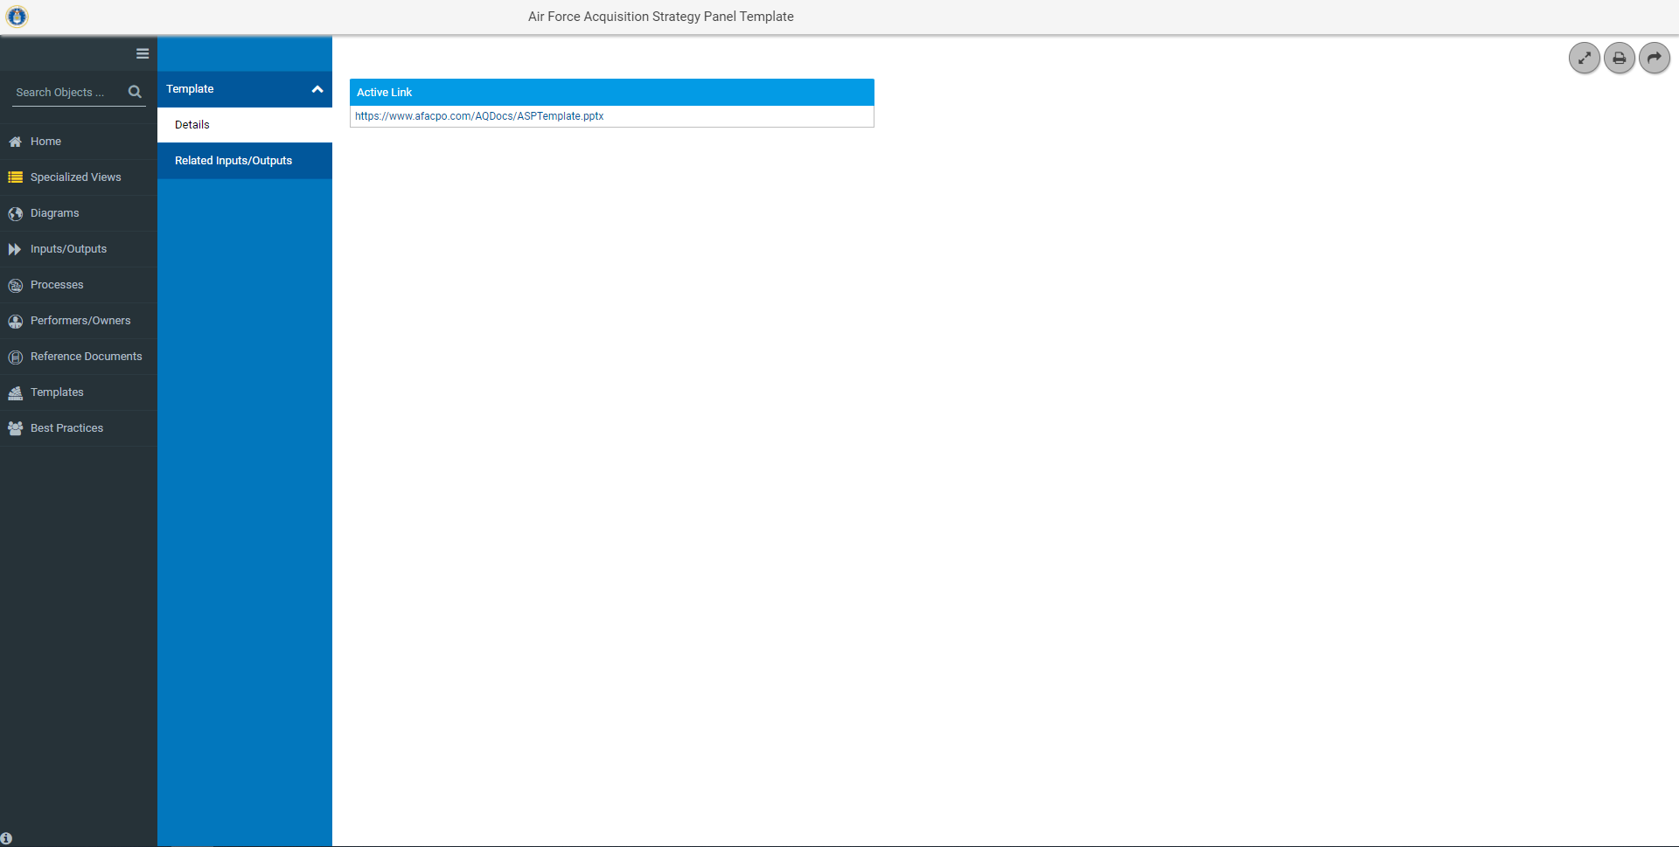
Templates Details
Click here to view the AF Acquisition Strategy Panel Template

Slide 64
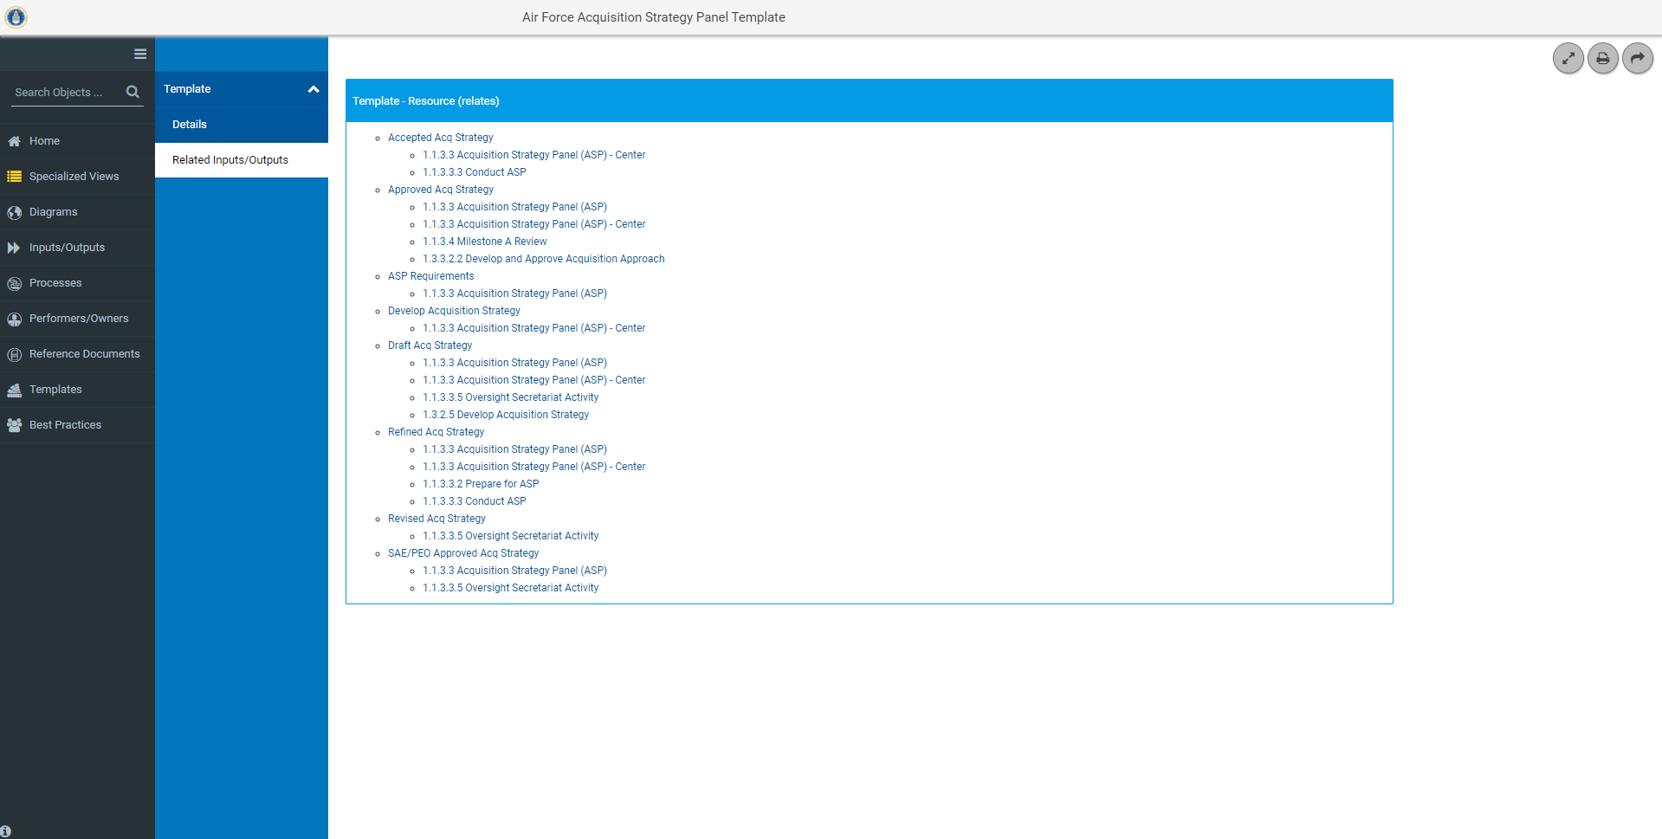
Template Locations
Provides a link to the Inputs/Outputs and the Diagrams they are on

Slide 65
Best Practices
Click here to go to Best Practices

Slide 66
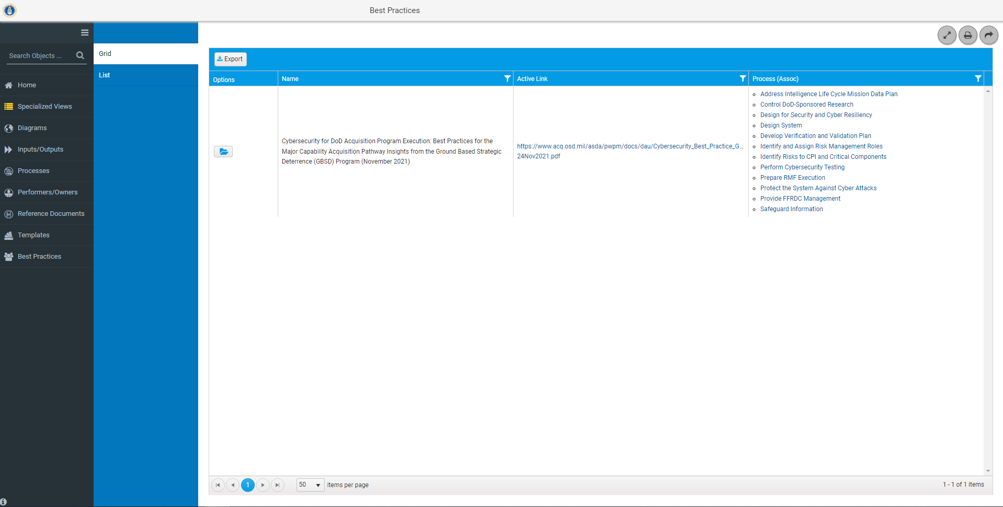
Best Practices Grid View
Hyperlink to the Best Practice Document
Associated processes where you can find the Best Practice

